Slide 1






Professioniste in rete per le P.A.
www.prorete-pa.pariopportunita.gov.it
Split, 17th October 2018 – Caterina Mazzanti
PhD Candidate, University of Udine

Slide 2

What is

Slide 3

:
is a Data Bank for high-skilled and qualified women

Slide 4

:
encourages the job matching between women and Public Administrations or public shareholders companies

Slide 5


Slide 6

Data Bank presentation
The women’s access area
The Public Administrations access area
Additional functions

Slide 7
1.
The Data Bank

Slide 8

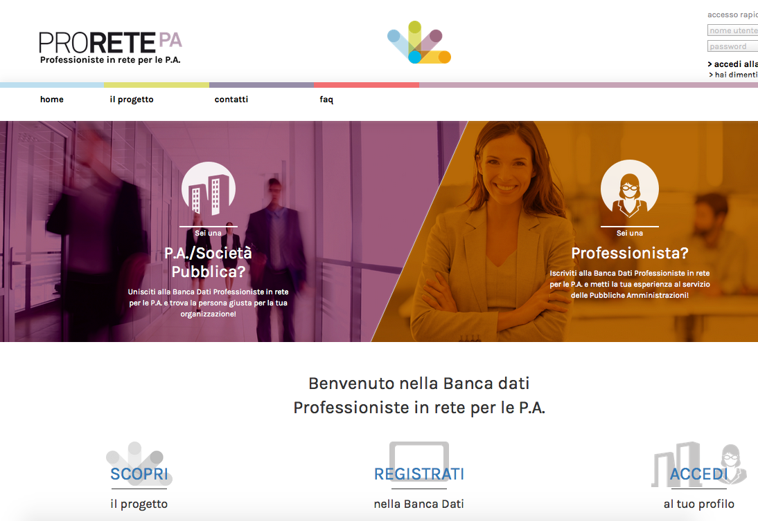
Who is involved
High-qualified women
(currently only ♀, but it might be extended in the future)
Apply for job vacancies
Fill and update their online-CV
PA/public shareholders companies
Search for the best candidates
Analyse their CV and contact them

Slide 9
2.
The women’s access area

Slide 10

Registration
User-Friendly
Email address just required
Safe
Captcha Validation
Smart
Registration form
Username choice
Email address

Slide 11
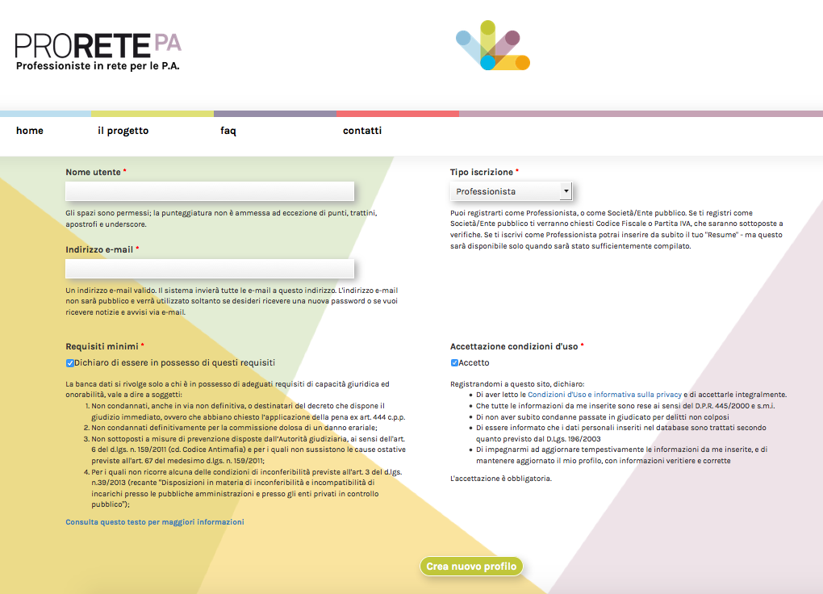
Registration

Slide 12

Minimum requirements
No criminal records
No liability for damages to the State Treasury
No crimes against the Public Administration
No enforcement of preventive measures regarding organised crimes
Acknowledgement of terms and conditions (i.e. Personal Data Processing Authorisation)

Slide 13
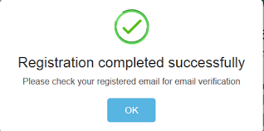
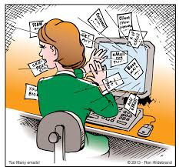

Slide 14

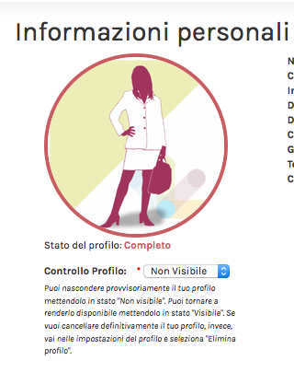
Personal Data
Name and Surname
Email address
Home address and region
Date of birth
Citizenship
Phone number
Social security number
STATUS
VISIBILITY

Slide 15
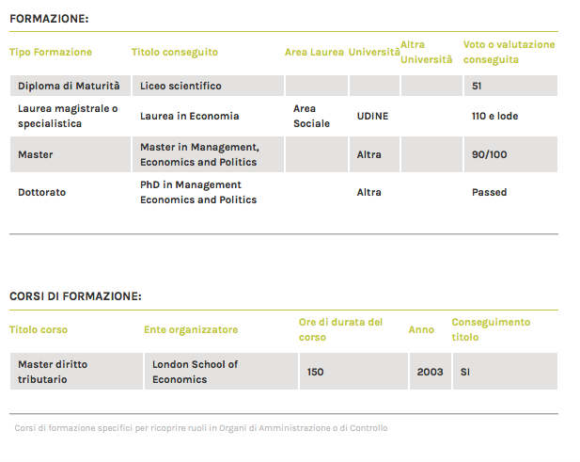

Further information
Studies Background

Slide 16

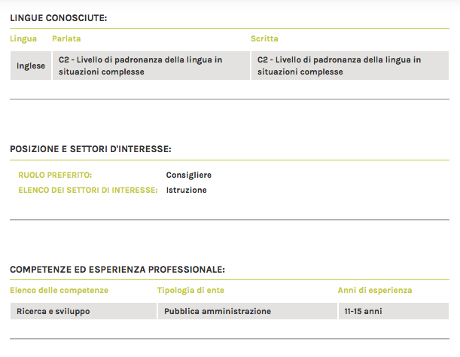
Foreign languages
Working position
Professional competences and skills

Slide 17
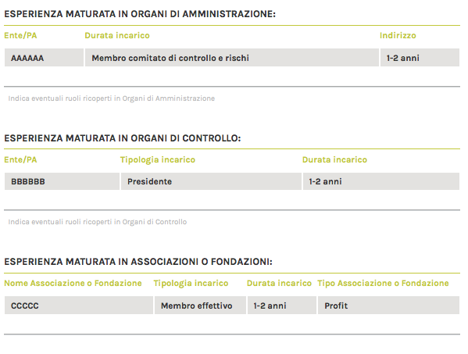

Previous experiences in company boards
Enrolment in professional registers

Slide 18

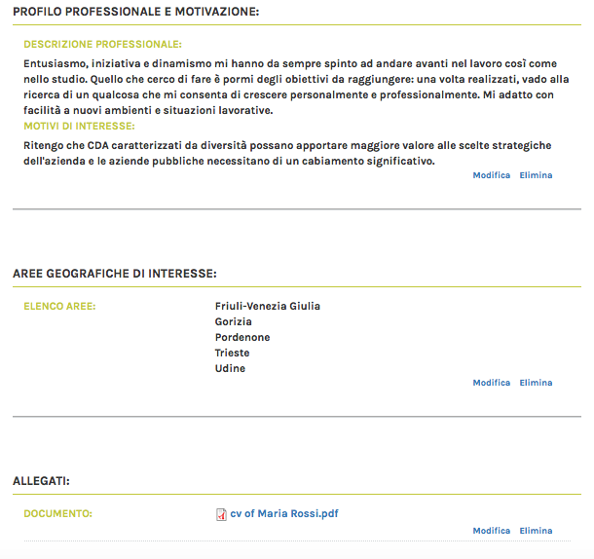
Job description and motivations
It is possible to choose a specific geographical area
(region, province)
Attached: European CV Format

Slide 19


The registration is completed through the attachment of the CV
→ choice: visible or invisible profile?

Slide 20
3.
P.A./Public Shareholder Companies Area

Slide 22
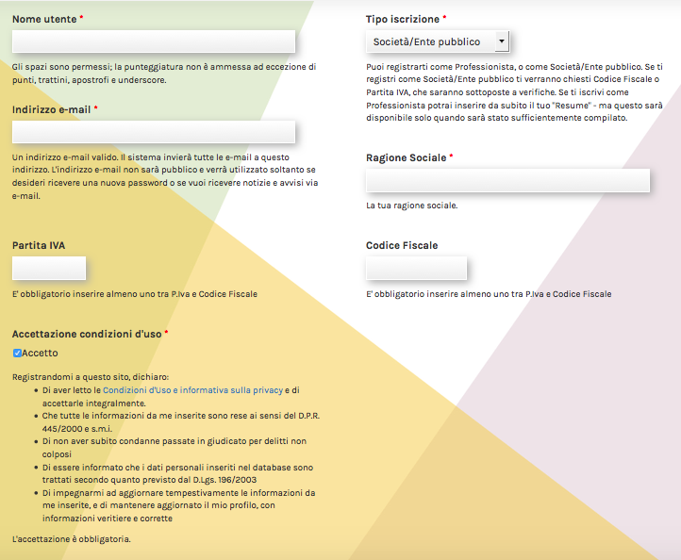
Registration
foto

Slide 23
Registration
User-Friendly
Italian certified Email address just required (so-called “PEC”)
Smart
Registration form
Username choice
Certified Email address
VAT and/or company name
First Login
by certified Email
foto

Slide 24
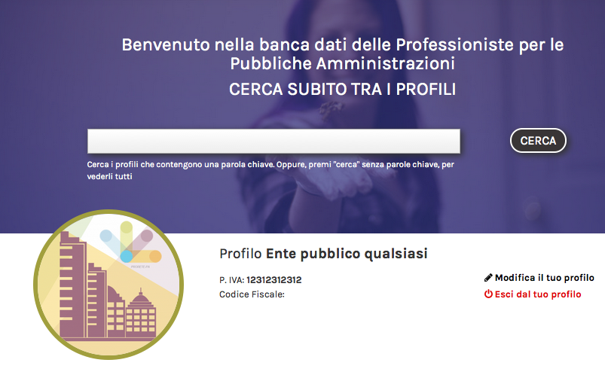
Why is it user-friendly?
it is possible to search by keywords
SEARCH BY KEYWORDS

Slide 25

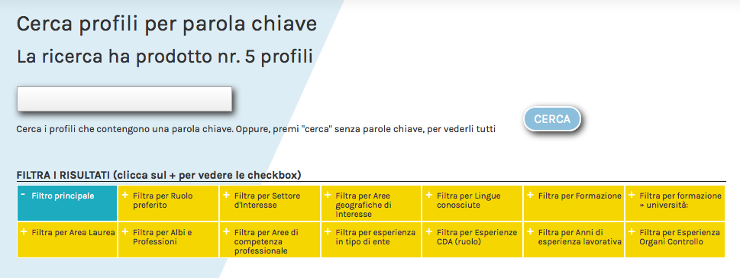
Filters search

Slide 26
4.
Additional functions

Slide 27
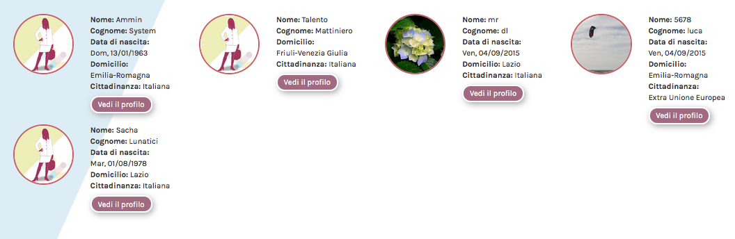
Selected profiles
might be:
printed
Saved as PDF files
contacted (by e-mail
or by specific
the data bank form)

Slide 28

Is it possible to delete the account?
YES it is!

Slide 29






www.prorete-pa.pariopportunita.gov.it

