Slide 1
Commercial Financing on Diversified Markets
Anton Starčević
Workgroup for Economic Analysis „Diversity as a Potential” Split, 17th October 2018

Slide 2
Commercial and Administrated Financing
Commercial financing through credit and other financial institutions is leaded by interest, but it is determined by market conditions and limited by competition.
Functioning of financial markets could be suboptimal for economy, pushing the economy towards centralization and specialization that could be unsustainable.
Administrated financing is focused on specific policy targets like a balanced and sustainable growth instead on commercial interest (profit).
Government grants and budget transfers, subsidizes of financing costs ...
Non commercial sources are needed for financing the unattractive industries, regions, types of clients, types of services.

Slide 3
Commercial Financial Market
Supply side (financial institutions and other investors)
Credit institutions (commercial banks, investment and development banks, saving banks, credit unions ...)
Credit substitutes (leasing, factoring, credit cards companies)
Insurance and funds (pension, investment, venture capital …)
Other financial intermediaries (brokers …)
Non-financial suppliers (corporate credit sales, fintech, debt collectors …)
Demand side (client segments)
Corporate and SME
Consumers
Sovereigns

Slide 4
Financing of Industries
Attractive industries – a commercial financing is primarily interested in propulsive industries that expand in areas of already developed technologies and infrastructure.
Growth in propulsive industries speeded by inflow of capital absorbs the material and human resources and could rise the structural unemployment.
Non attractive industries – decreased financing leads to regression, hence the economic structure should be balanced by non commercial financing.
Supporting the industries important for employment,
Fundamental researches,
Investments in socially desired direction of growth - like green technologies, materials and products.

Slide 5
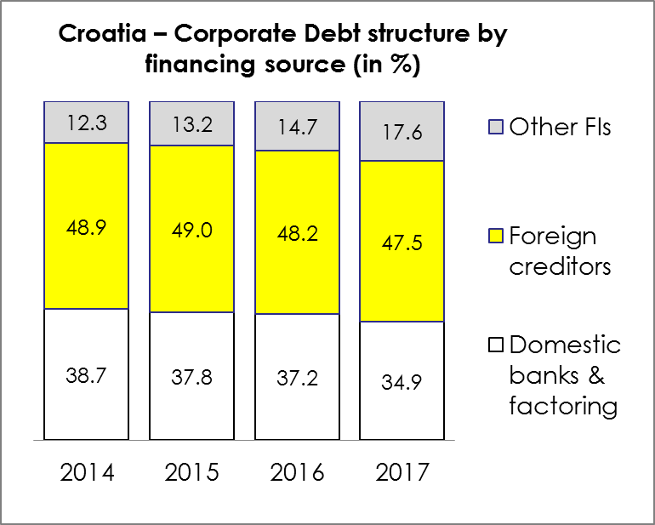
Creditors to Corporate Segment
Clients from corporate segment can use the financial products and services on domestic and foreign financial markets.
Internal financing is usual for multinational companies.
Other financing products providers:
leasing companies,
capital market investors,
debt collection agencies,
loans from non-financial corporate, etc.
Source: CNB, RBA

Slide 6
Financing of Regions
Attractive regions - based on the trends in Croatia a rising demand in tourism is increasing the investments and migrations into coastal regions.
Industries linked to tourism are more attractive for commercial financing than other industries.
Real estate market is exposed to price bubble, attracting the commercial financing toward concentration in construction and real estate projects.
Non attractive regions - an economic activity in inland regions without natural or competitive advantage is weakening, causing the depopulation and aging process. In long-term projection the financing of public services in those regions is not sustainable.
Depopulated regions can not turn to positive side without a support from non-commercial financing sources.

Slide 7
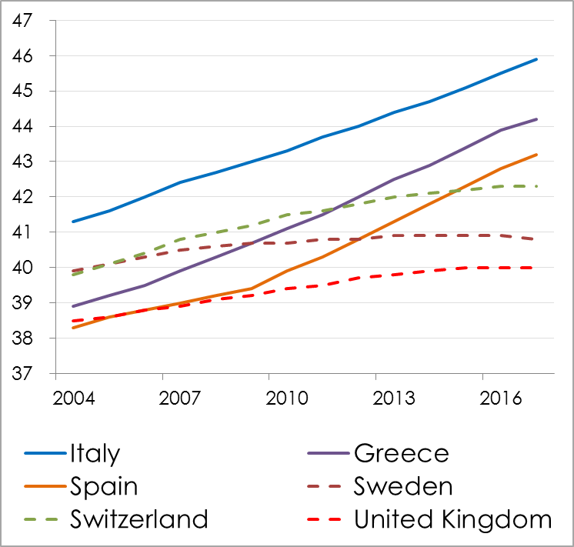
Europe is dividing
Differences in the process of population ageing between countries are showing the rising divergence between the European center and periphery.
Population is moving towards better opportunities, not only in working period, but also in period of retirement, because the sustainability of pensions and public health security depends of population structure.
Population – average age (years)
Source: Eurostat, RBA

Slide 8
Financing of Clients
Established business – the financing sources are available from financial institutions with conservative risk rules applied.
Credit institutions are focused on debt financing for clients with proven creditworthiness (positive track record).
Pension and investment funds, and insurance companies are investors in debt and equity instruments.
Start up clients – only specialized investors are focused on start-ups and fast-growing small business entities.
Venture capital funds are financing the equity.
Debt capital is not available for those clients without support (risk participation) from public sector (local government or EU programs).

Slide 9
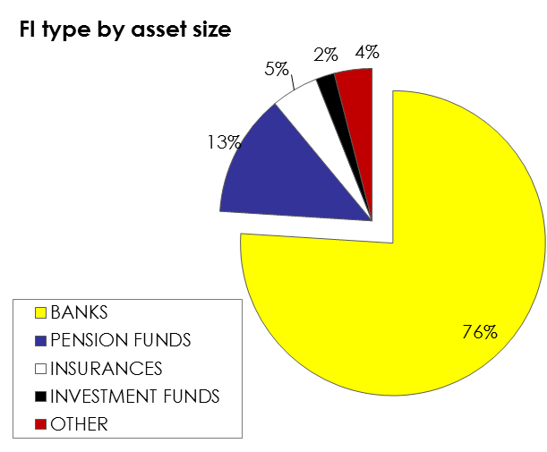
Local Financial Market
Croatian financial market is dominated by Banks (76% of assets).
Major players on non-banking financial market are also managed by international banking Groups.
Pension funds are growing based on the mandatory contributions, other financial institutions are stagnant.
Major FI Groups
 | BANKING | PENSION FUNDS MGMT | LEASING* | INV FUNDS MGMT
 | 27% | 39% | 18% | 21%
 | 19% | 16% | 5% | 18%
 | 15% | 14% | 17% | 19%
 | 8% | 31% | 11% | 6%
 | 12% |  | 17% | 4%
TOTAL | 81% | 100% | 78% | 68%
* By volume of new contracts

Slide 10
Financial Services
Banks – owners of client accounts are providing payments service for all clients.
Payments system is developed for banks, other potential service providers are not allowed to participate.
Fintech – the entrance into payment system will be opened to non-banking companies.
Non-banking service provider has to satisfy high security and other technical standard, and then can approach the client account in bank and execute the transaction.
Companies from ICT sector will have an opportunity to offer customized transaction services for all banking clients.
So far the change of rules is done in favor of Fintech but in future is possible additional support (like subsidies for investments in technical upgrade …).

Slide 11
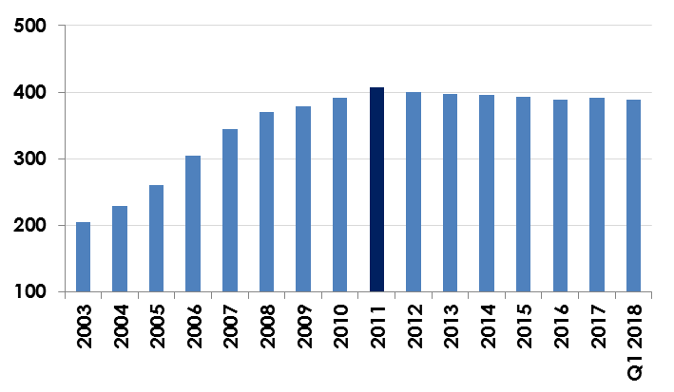
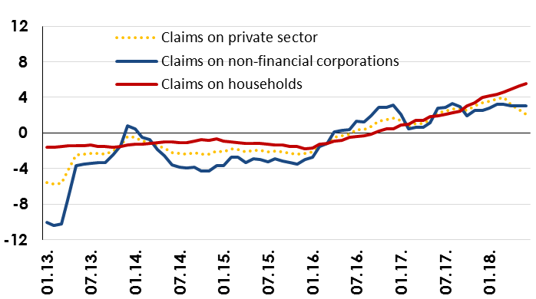
Banking Sector in Croatia
Total assets of the banking sector, HRK bn
Placements to private sector - transaction based, % yoy
Source: CNB
Economy is growing since 2015, but the level of total assets in banking sector is not rising.
Lending activity is improving since 2017 - the trend in corporate segment is slower than at consumers.

Slide 12
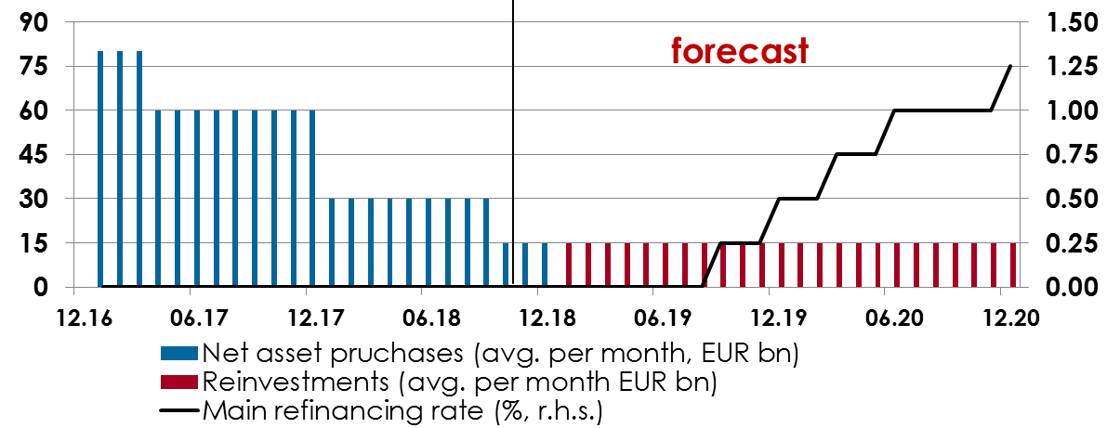
Liquidity and ECB's key rates
ECB: Net asset purchases (APP) are not planned after 2018. Key interest rates are to be kept at the current levels (deposit facility rate: -0.4% and main refinancing rate: 0.0%) at least through summer 2019; or for as long as necessary to ensure that inflation will move towards central bank target (2%).
Source: Thomson Reuters, ECB, RBI
Relaxed monetary policy created a significant surplus of liquidity – it spreads from the euro area on the neighboring financial markets.
Expected normalization of ECB’s policy would increase the price of capital. Consequently, some projects will not meet the criteria for commercial financing any more.

Slide 13
The end

