Slide 1
CHARACTERISTICS OF ATMOSPHERIC AEROSOL IN URBAN AND SUB-URBAN AREA OF CENTRAL BALKAN
Dragana Đorđević¹ and Andrea Gambaro^{2,3}
¹Centre of Excellence in Environmental Chemistry and Engineering,
ICTM - University of Belgrade, Institute of National Importance for Republic of Serbia
Njegoševa 12, 11000 Belgrade, SERBIA
Studentski trg 12 – 16, 11001 Belgrade, SERBIA
dragadj@chem.bg.ac.rs
²Department of Environmental Sciences, Informatics and Statistics, University Ca' Foscari of Venice, Dorsoduro 2137, 30123 Venice, Italy.
³Institute for the Dynamics of Environmental Processes National Research Council (CNR-IDPA), Dorsoduro 2137, 30123 Venice, Italy.

Slide 2
An atmospheric aerosol seldom consists of a single component - it is a mixture of species from a number of sources:
natural and
anthropogenic.
Particles have various atmospheric lifetimes because of various particles sizes and their complex chemical composition.
Fine particles are of especially importance because of their:
impact on human health,
ability to scatter light affecting visibility, and
role in global climate change.

Slide 3
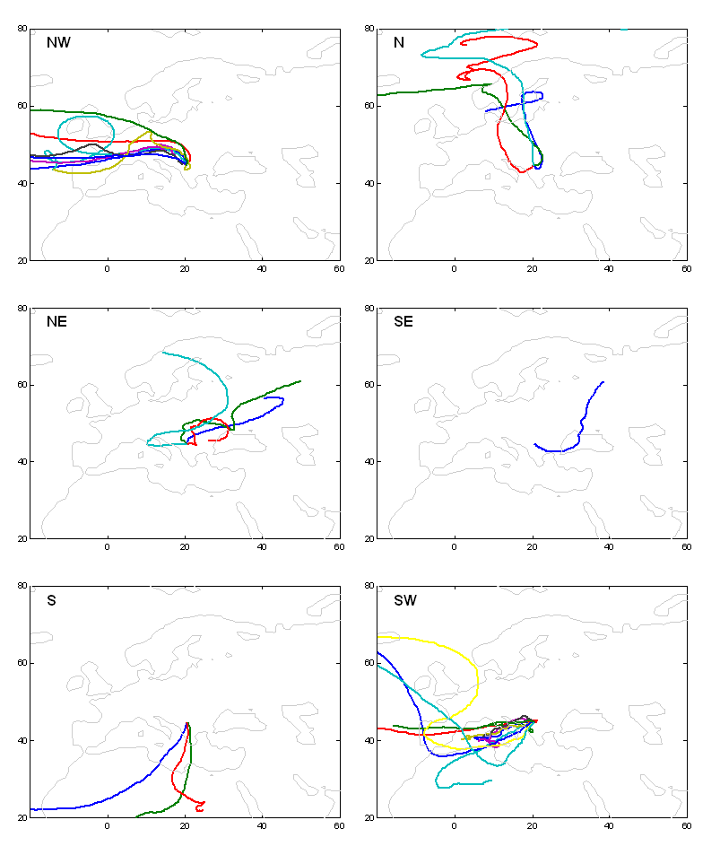
Mihajlidi-Zelić et al, Central European Journal of Chemistry

Slide 4
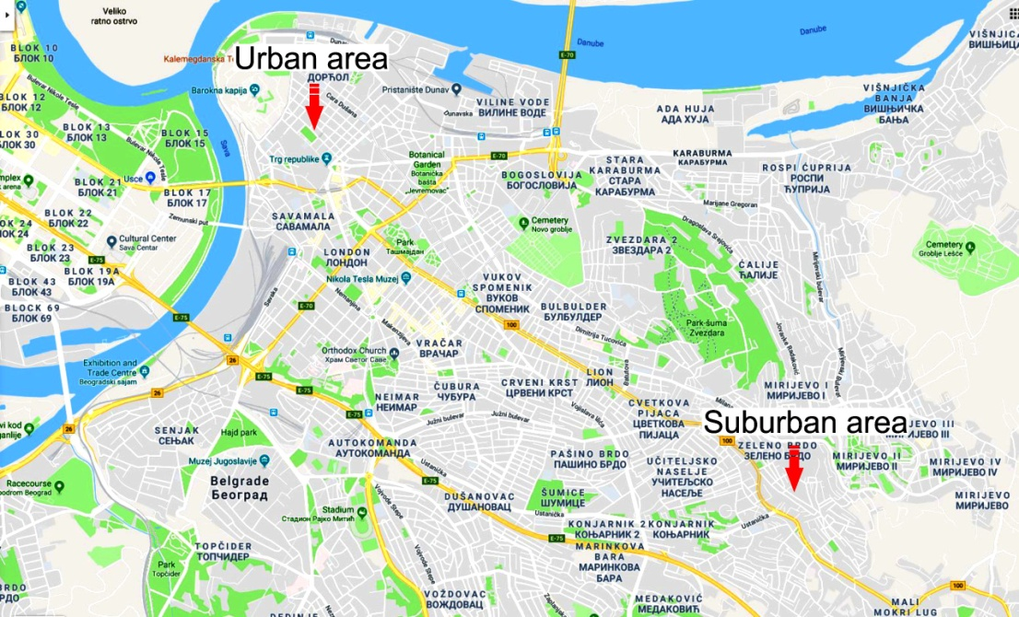
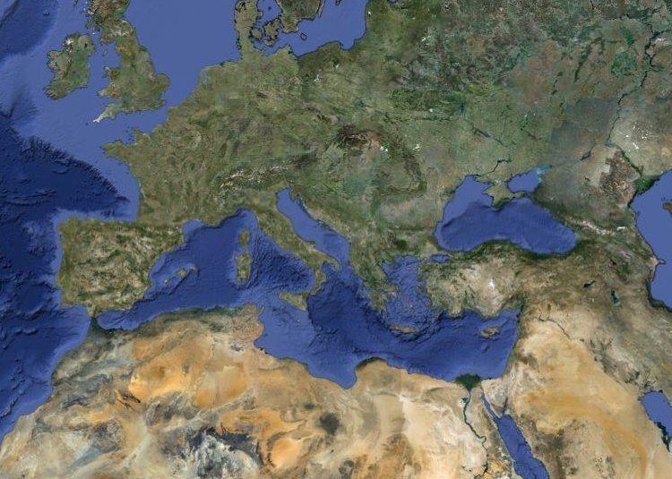
The sampling sites (44⁰49’N, 20⁰27’E) urban and suburban areas in Belgrade.

Slide 5
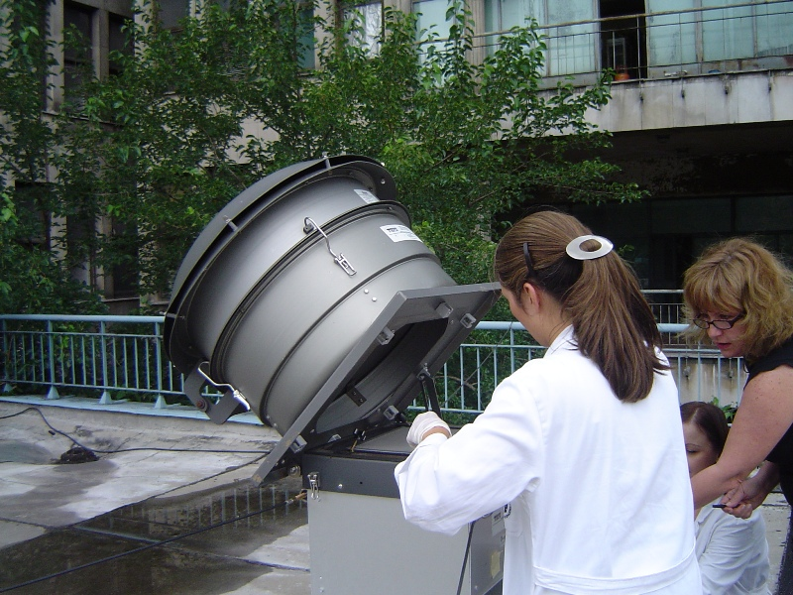
Size segregated aerosol samples collected using High Volume Cascade Impactors

Slide 6
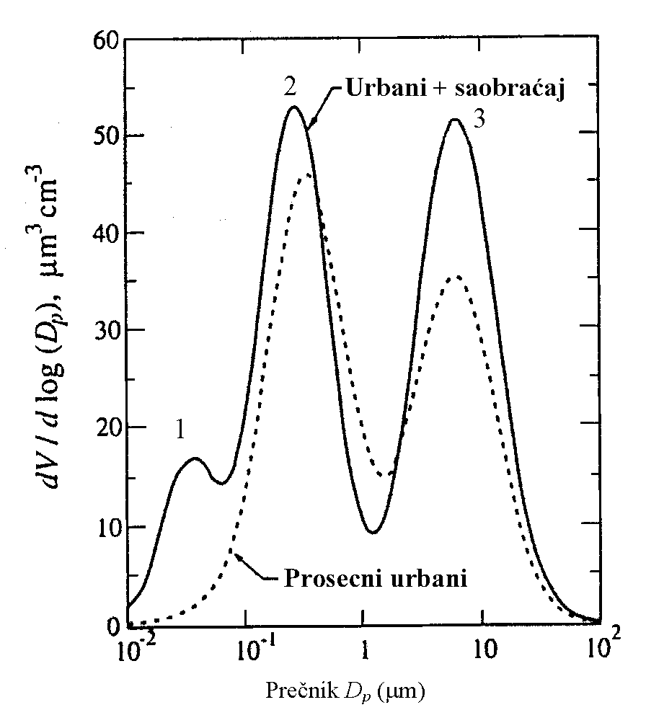

Slide 7
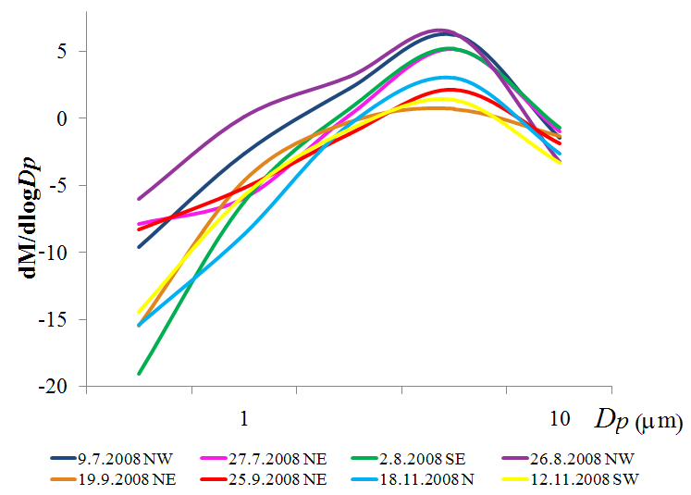

Slide 8
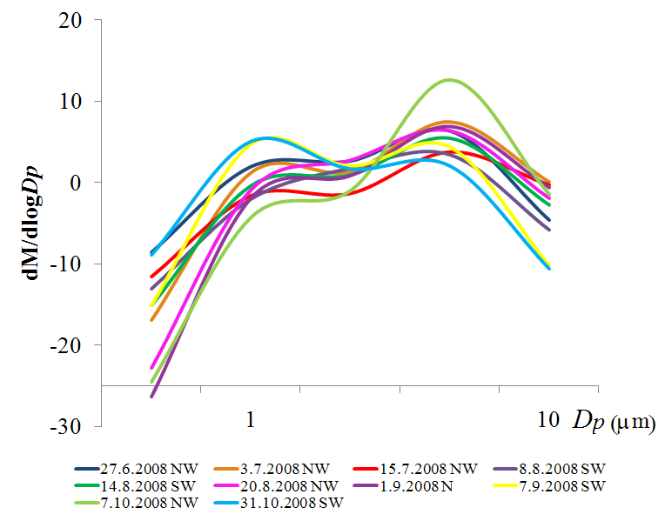

Slide 9
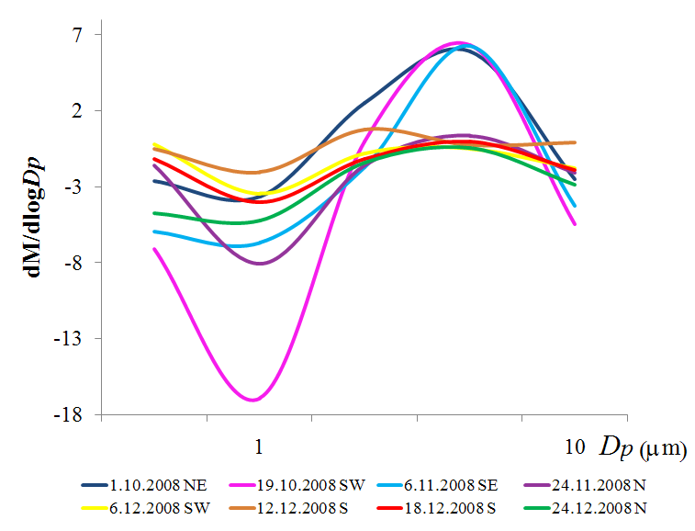

Slide 10
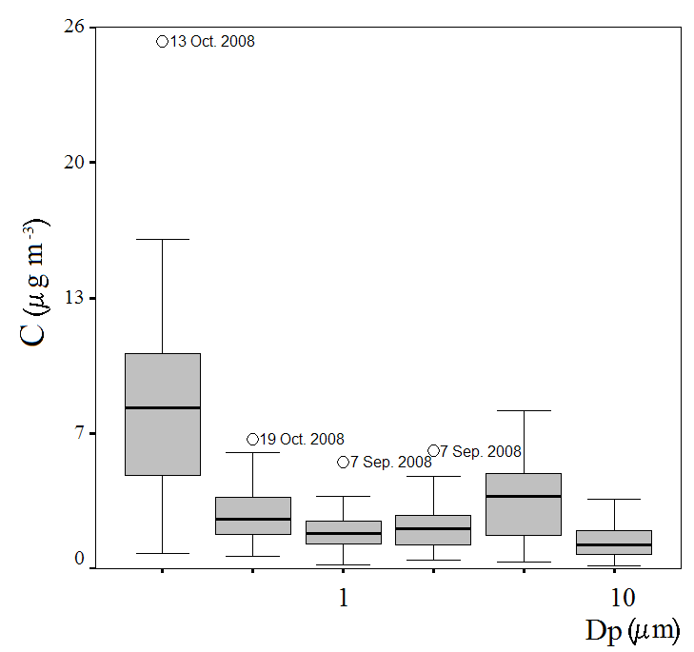
Characteristics of ambient air aerosol – Belgrade
Urban atmosphere of Belgrade
Đorđević et al., 2012, Atmospheric Environment 48 309-317

Slide 11
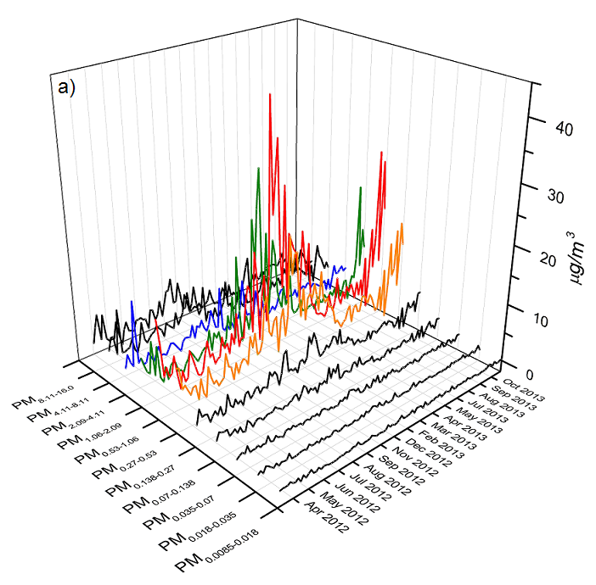
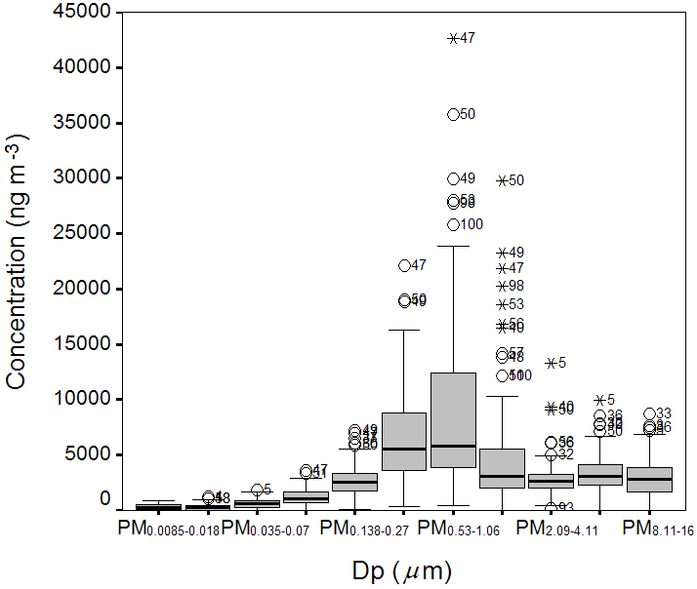
Sub-urban atmosphere of Belgrade
The dominant aerosol fraction is between 0.50mm and 1.0mm
Đuričić-Milanković et al., 2018, Environmental Science and Pollution Research

Slide 12
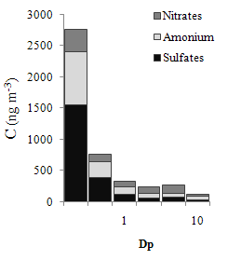
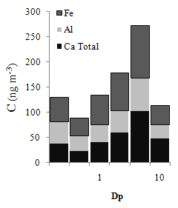
Đorđević et al., 2012. Atmospheric Environment, 46, 309-317

Slide 13
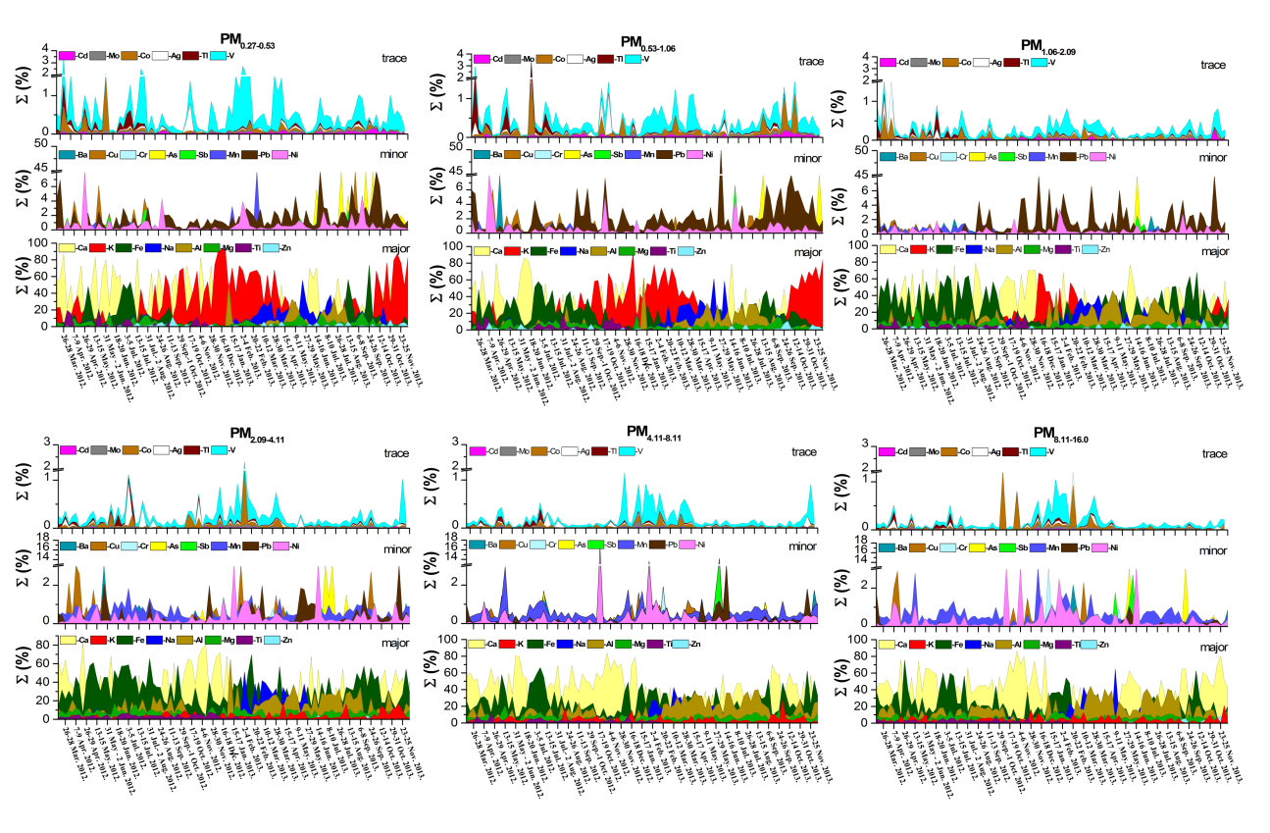
Jelena Đuričić-Milanković et al., 2018, Environmental Science and Pollution Research

Slide 14
Energy dispersive X-ray (EDX) analysis
07 – 09 September 2008 (SW)
Al/Si | 0.50 | Ca/Si | 0.24 | K/Si | 0.13 | Fe/Si | 0.26
Mg/Si | 0.12 | Ni/Si | 0.15 | S/Si | 0.06 | P/Si | 1.08
Ca/Al | 0.40 | Si/Al | 2.10 | Fe/Ca | 0.40 | K/Ca | 0.50
Mg/Na | 2.00
13 – 15 October 2008 (NW)
Al/Si | 0.27 | Ca/Si | 0.48 | K/Si | 0.26 | Fe/Si | 1.36
Mo/Si | 2.47 | Ca/Al | 1.81 | Si/Al | 3.77 | Fe/Ca | 2.81
K/Ca | 0.54 | Mo/Fe | 1.82
06 – 08 November 2008 (SE)
Al/Si | 0.41 | Ca/Si | 12.16 | K/Si | 0.08 | Fe/Si | 0.55
As/Fe | 0.52 | As/Si | 0.05 | Br/Si | 1.09 | Si/Al | 2.37
Zn/Si | 0.02 | Zn/Fe | 0.27 | Ca/Al | 1.04 | Sn/Zn | 2.95
Fe/Ca | 0.01 | K/Ca | 0.93 | Mg/Si | 0.07
18 – 20 November 2008 (N)
Al/Si | 0.28 | Ca/Si | 0.95 | K/Si | 0.23 | Fe/Si | 0.54
As/Fe | 0.13 | As/Si | 0.02 | Ca/Al | 0.83 | Fe/V | 5.44
K/Ca | 1.78 | Mg/Si | 0.08
Đorđević et al. 2014, Environmental Science and Pollution Research

Slide 15
Elements ratio in suburban atmospheric aerosols of central Balkans’ corresponding with their ratios in surface crustal material of Northern Africa for air masses coming from Northern Africa
 |  | Characteristic elements ratios
Periods | Air masses | Ca/Al | K/Al | Fe/Al | Mg/Al | Mn/Al | Ca/Fe | Mg/Fe
1st – 3rd April 2012 | SW | 3.48 |  |  |  |  | 1.57 | 0.26
4th – 6th April 2012 | S |  | 0.50 | 1.15 | 0.36 | 0.03 | 1.50 | 0.35
24th – 26th August 2012 | SW |  |  | 1.21 | 0.45 | 0.03 | 2.25 | 0.34
17th – 19th October 2012 | SW |  |  | 1.07 |  | 0.03 |  | 0.52
10th – 12th November 2012 | SW |  |  | 1.22 |  | 0.04 |  | 0.90
4th – 6th March 2013 | SW | 0.51 | 0.22 | 0.89 | 0.39 | 0.03 |  | 0.47
16th – 18th March 2013 | SW | 0.49 |  |  |  |  |  | 0.22
3rd – 5th April 2013 | SW |  | 0.10 | 1.20 | 0.37 | 0.03 | 0.40 | 0.20
21st – 23rd April 2013 | SW | 0.35 |  | 0.75 | 0.29 |  | 0.49 | 0.37
27th – 29th April 2013 | SW | 0.31 | 0.45 |  | 0.26 |  | 0.48 | 0.38
15th – 17th May 2013 | S | 0.56 |  |  | 0.31 |  |  | 0.44
27th – 29th May 2013 | S | 0.61 |  |  | 0.51 | 0.03 |  | 0.27
8th – 10th June 2013 | SW | 0.59 |  | 0.98 | 0.31 |  | 2.75 | 0.48
6th – 8th October 2013 | S | 0.31 | 0.29 |  | 0.74 |  |  | 0.13
12th – 14th October 2013 | SW | 1.86 | 0.30 |  | 0.77 | 0.04 | 2.03 | 0.27
17th – 19th November 2013 | S | 7.59 |  |  |  |  | 1.18 | 0.23
24th – 26th December 2013 | S | 2.18 |  |  |  |  | 0.98 | 0.48
Đorđević et al. 2018, in press

Slide 16
Element ratios in suburban atmospheric aerosols of central Balkans’ corresponding with volcanic soil in South Iceland
 |  | Characteristic elements ratios
Periods | Air masses | Ca/Al | Mg/Al | Fe/Al | Mn/Al | Ca/Fe | Mg/Fe
6 – 8th August 2012 | NW | 1.01 | 0.39 | 1.46 | 0.03 | 0.42 | 0.31
26th – 28th June 2013 | NW | 0.90 | 0.32 | 1.06 | 0.02 | 0.39 | 0.31
18th – 20th September 2013 | NW |  | 0.47 | 1.72 | 0.08 |  | 0.35
Đorđević et al. 2019, in press

Slide 17
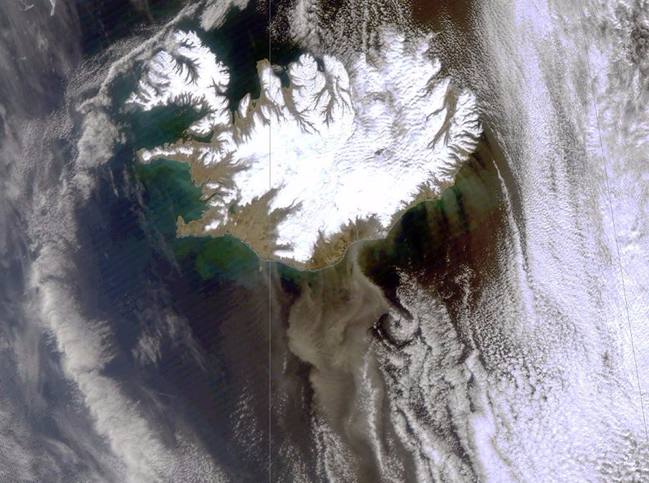

Slide 18
Urban atmosphere
The dominant share of the mean values of the nucleation mode is found for: As, K, Ni, V and U
pointing to anthropogenic emission sources: traffic, heating, combustion processes
Đorđević et al. 2014, Environmental Science and Pollution Research 21:10949–10959

Slide 19
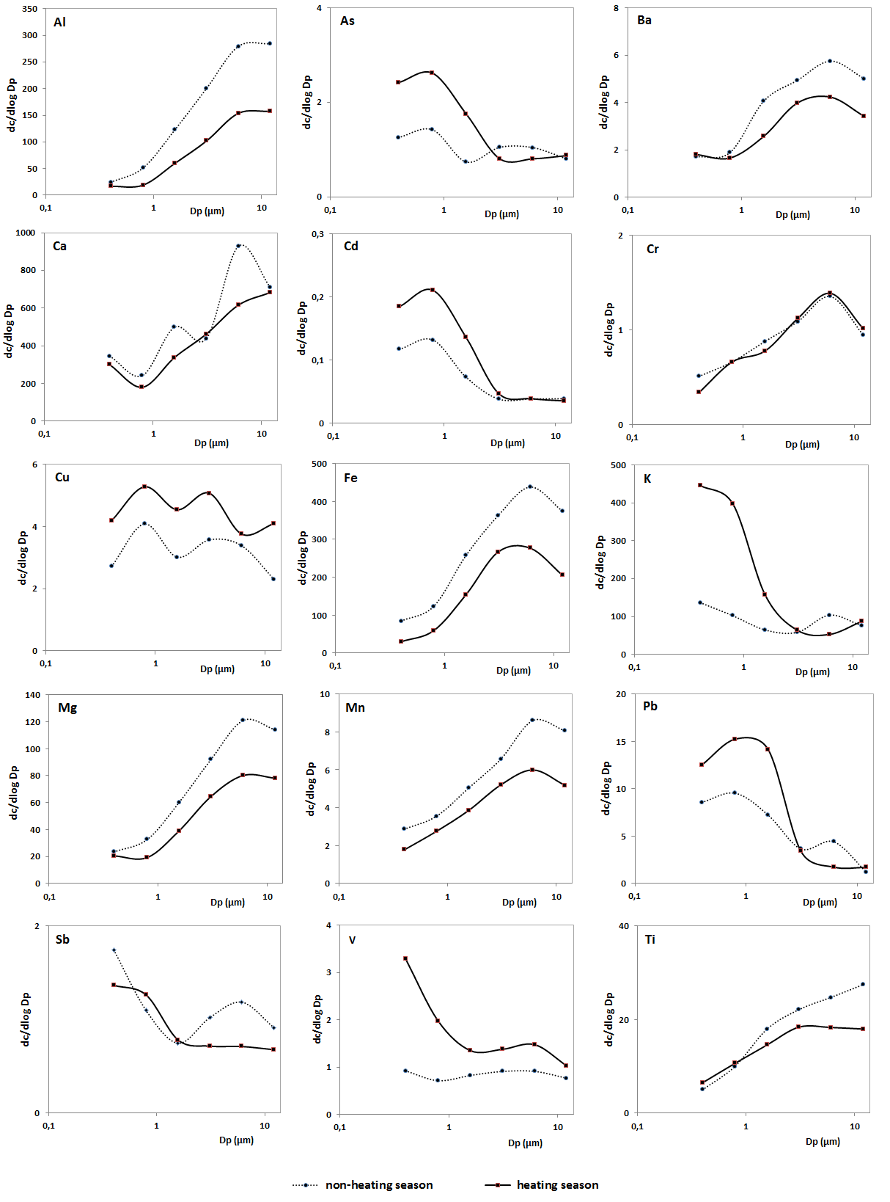
Suburban atmosphere
The dominant share of the mean values of the nucleation mode is found for: As, Cd, K, Pb and V
pointing to anthropogenic emission sources
Jelena Đuričić-Milanković et al., in press

Slide 20
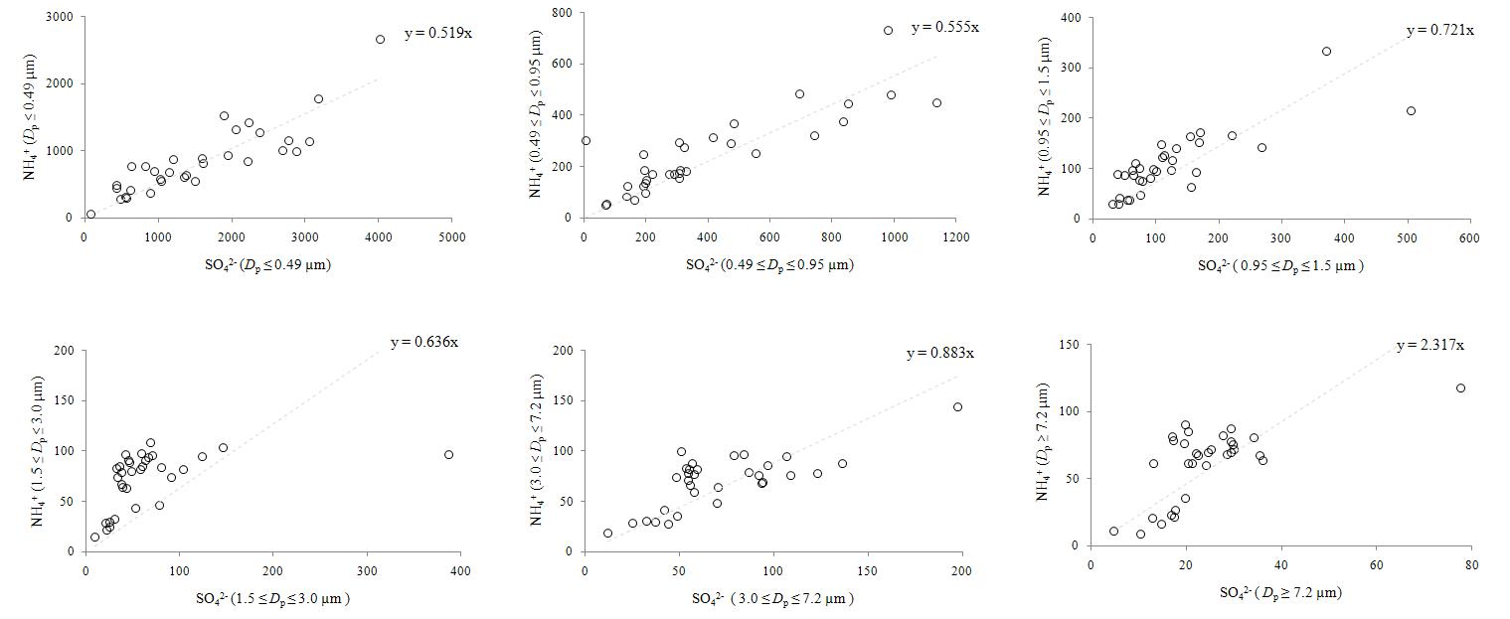
The absolute highest concentration was found for SO₄^{2–} (1555.8 ± 973.6 ng m^{–3}, i.e., 8.19 % of the total aerosol mass) in the particle size range D_{p} < 0.49 mm,
The formation of (NH₄)₂SO₄ was found to be the dominant process, indicating the combustion of fossil fuels enriched with sulfur.
Đorđević et al., 2012, Atmospheric Environment 48 309-317

Slide 21
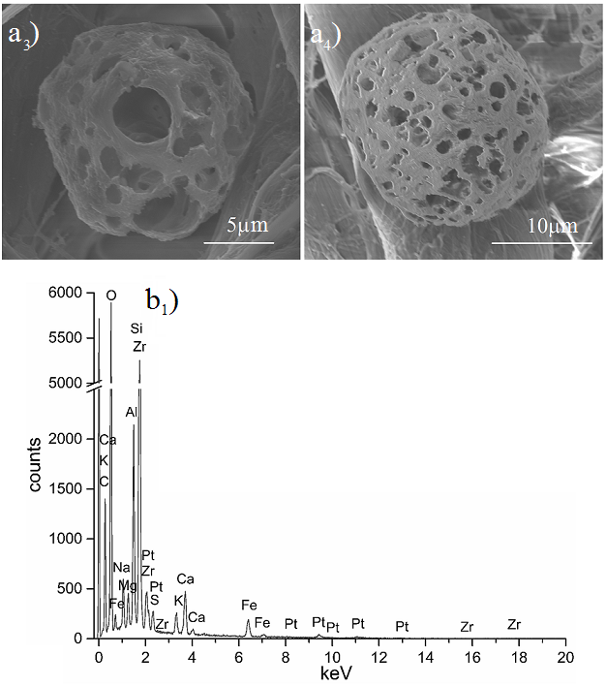
Among atmospheric particles of urban atmosphere in Belgrade - spheric silicate skeletons (Cenospheres) have found.
Cenospheres are tracers for high temperature combustion of coal where they form.
Đorđević et al., in press

Slide 22
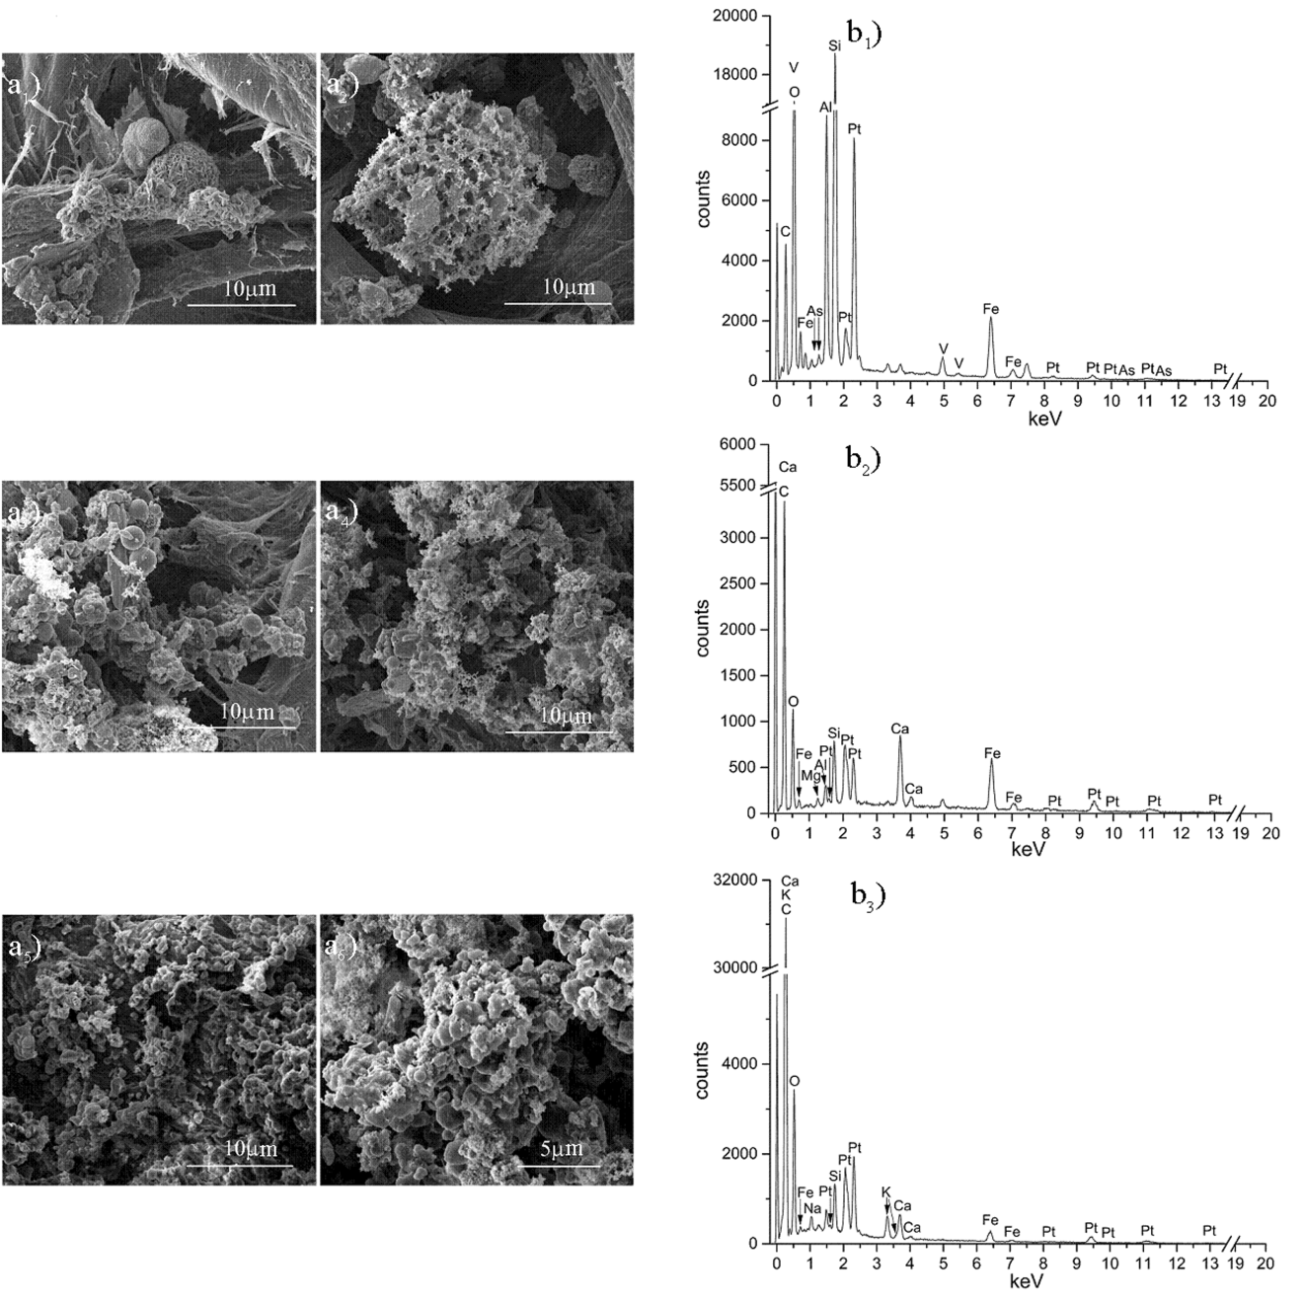
Carbon cenosphere adsorbed by ultrafine particles
Đorđević et al., ESPR

Slide 23
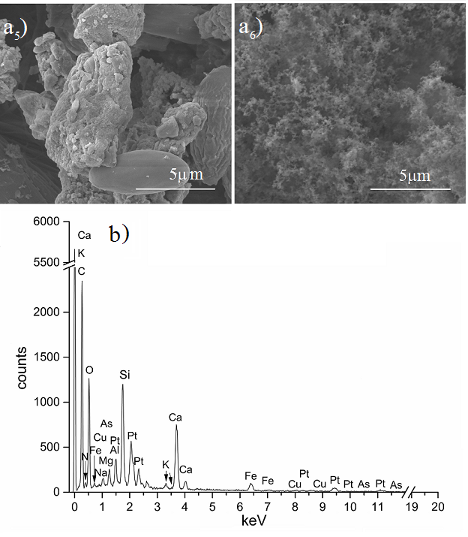
Soot enriched with As in urban atmosphere of Belgrade indicating lignite combustion
Đorđević et al., 2016, Environmental Science and Pollution Research, 23(1)851-859

Slide 24
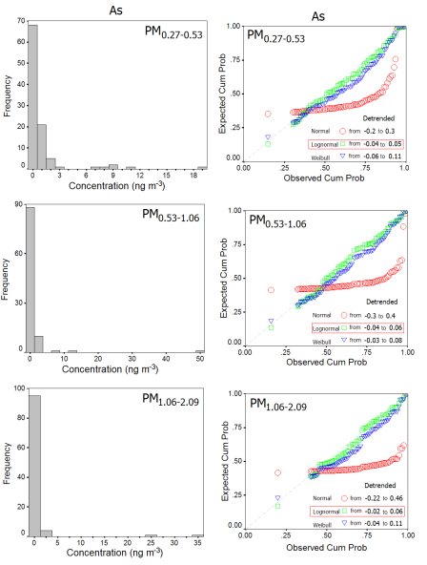
Data set of As concentration have tested with corresponding expected and observed cumulative probabilities by next distributions:
normal,
log-normal and
Weibull
As in the fine particles showed the best fitting with the log-normal test cumulative probability indicating local and regional emission sources of As.
Đorđević et al., in press

Slide 25
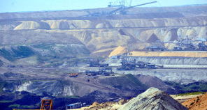
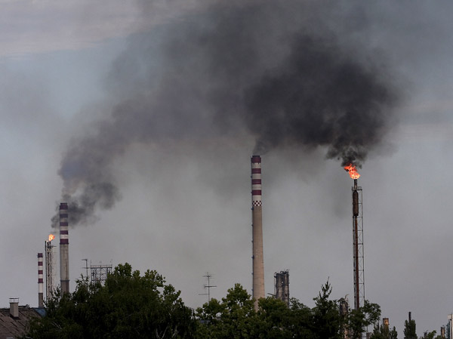
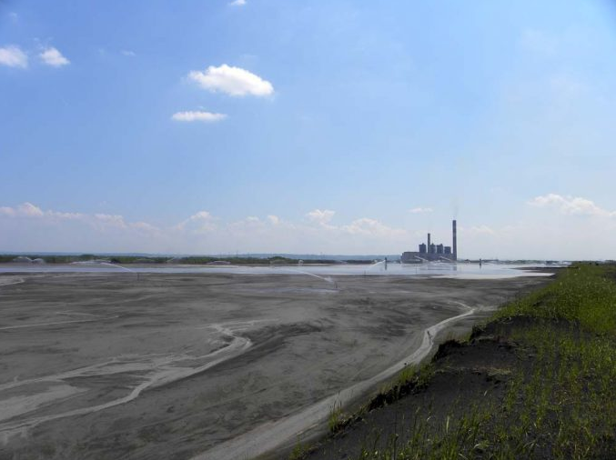
Over 70% of the electricity in Serbia comes from Coal Fired Power Plants (CFPPs)
There are six CFPPs which use low caloric coal - lignite as a fuel.
CFPP are located in the vicinity of the main lignite deposits of Kolubara and Kostolac basins.
32.000.000t/year of lignite is burning and generate 6.000.000t/year of ash.
Combustion temperature of the coal are around 2000⁰C and can be higher.

Slide 26
Characteristics of lignite used in Coal Fired Power Plants (CFPP) in Serbia
General characteristics of Kolubars’ and Kostolacs’ lignite are:
- low caloric value – three times lower than average: 6200-8600 kJ/kg
- 10-26% fly ash
- 45-52% humidity
- 0.3-0.8% sulfur
Lignite contains As, Be, Co, Cr, Mo, Mn, Ni, Pb, Se, Sb and V and concentrate significant contents of elements in ash.
About 1.4g of As and 0.4g of Hg as a gas are emitting during combustion 1t of Kolubaras’ lignite.
In addition, lignite contains U, Th, Ra and Rn. All quantity of Rn from the combustion are emitting as a gas.
Elements in the vapor are more dangerous than one in particles.
Diameter of emitted fly ash particles correspond to PM₁₀, dlp= 10 μm (respirable).
The emission of pollutants from the burning cause environmental and health problems.

Slide 27
Characteristics of CFPPs utilities of »Nikola Tesla A« and »Nikola Tesla B« and of particles emissions, according to measurements
 | Installed power (MW) | Coal consump. (t/h) | Block | Eff. of electrofilt. (%) | Humid gas velocity (m³/h) | Particles conc. (mg/m³) | Particle emiss. (t/year)
TENT A₁ | 210 | 260 | 7.290 | 97,12 | 1.303.000 | 796 | 10.905
TENT A₂ | 210 | 265 | 3.342 | 95,10 | 1.269.000 | 1.429 | 8.675
TENT A₃ | 305 | 369 | 7.411 | 99,75 | 1.727.000 | 78 | 1.360
TENT A₄ | 308,5 | 353 | 6.669 | 99,78 | 1.533.000 | 138 | 1.028
TENT A₅ | 308,5 | 370 | 4.698 | 99,79 | 1.608.000 | 105 | 725
TENT A₆ | 308,5 | 336 | 1.747 | 99,00 | 1.867.000 | 300 | 1.172
TENT B₁ | 620 | 754 | 7.756 | 99,62 | 3.184.000 | 111 | 4.460
TENT B₂ | 620 | 762 | 8.159 | 99,73 | 3.293.000 | 71 | 3.366
Electrofilters are of limitted efficiency; first of all for soot and for Zn, Mn and Pb in fly ash.
D.M. KISIĆ et al., Hem. ind. 67 (5) 729–738 (2013)

Slide 28
Threats to surface and underground water pollution come from lignite ash
Cr (around 6 t/year), 1.5 t of Zn, and between 600 and 700 kg of Ni, are
being leached each year from ash due to transport processes to ash disposals .
(Popović et al., 2001, Environment International, 26(4)251-255)
The largest fraction of elements were associated with the mobile forms.
(Popović and Đorđević, 2005, J. Serb. Chem. Soc. 70(12)1497-1513)
The influence of CFPPs Kostolac and Drmno on the quality of ground water springs is noticed.
The delayed impact has Co from draining waters, Cr and Si from owerflow waters and Mg and V from both overfolow and drainage waters.
(Popović et al., 2007, Fuel, 86 218-226)
The most recently deposited ash represents the highest environmental threat.
(Popović and Đorđević, Energy Sources, Part A: Recovery, Utilization, and Environmental Effects, 31(17) 1553-1560)
(Popović and Đorđević, Energy Sources, Part A: Recovery, Utilization, and Environmental Effects, 37(11) 1224-1232)
(Popović and Đorđević, Energy Sources, Part A: Recovery, Utilization, and Environmental Effects, 37(12) 1291-1299)

Slide 29
On 2nd May 2018th World Health Organisation (WHO) issued document
Ambient (outdoor) air quality and health with some key facts:
Air pollution is a major environmental risk to health:
heart disease,
lung cancer,
and both chronic and acute respiratory diseases, including asthma.
Ambient (outdoor) air pollution in both cities and rural areas was estimated to cause 4.2 million premature deaths worldwide in 2016.
According to toxicological profiles next elements: Al, As, Cd, Co, Cr, Mn, Ni, Pb, Sb, U and V in atmospheric aerosols were identified to have toxicological effects on human health.
The carcinogenic risk has calculated by EPA methodology (US EPA 2013; US EPA 2015), equation below was used:
R = EC × IUR
where is:
R is carcinogenic risks
EC exposure concentration (mg m⁻³)
IUR - inhalation unit risk

Slide 30
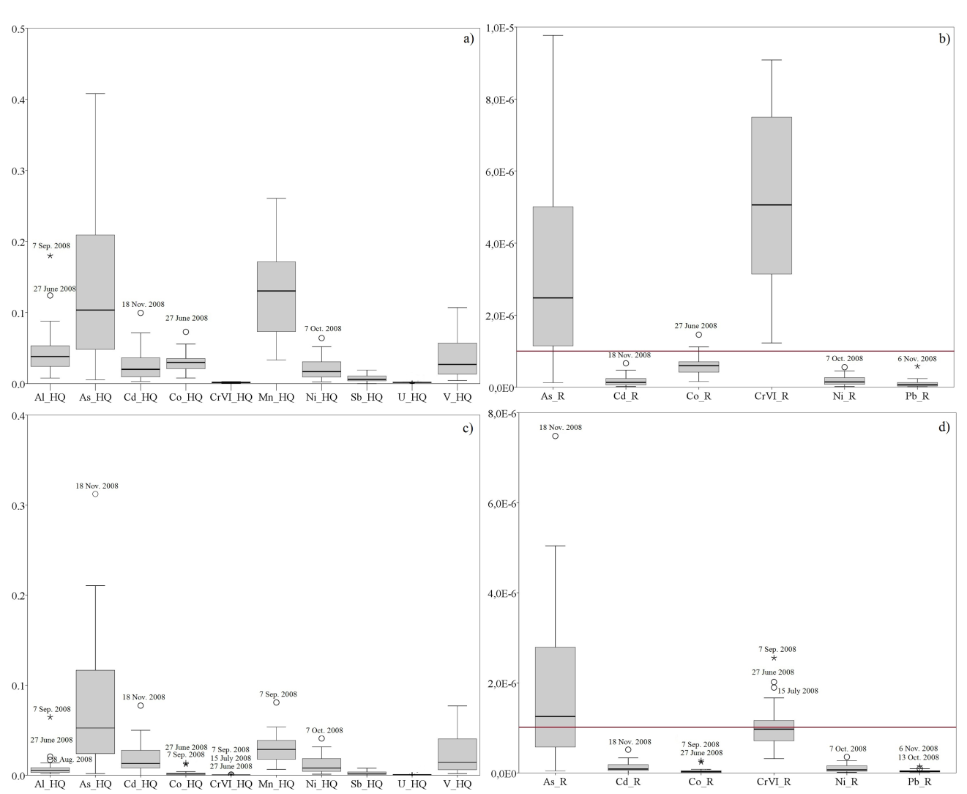
Non-carcinogen hazard quotients (HQ) and carcinogen risks (R) in total PM a) and b), and in PM<0.49 c) and d)
Regional population is under high carcinogenic risk due to high quantities of As and Cr in the respirable atmospheric aerosols
Unpublished data

Slide 31
Instead of conclusion
Serbia has many other possibilities for clean and low carbon energy production:
biogas production from biomass with which Serbia is one of the richest
countries,
metain production from farms and waste dispolsal and its use for
energy production,
huge potential of geothermal energy,
wind energy,
solar energy, etc.
The most important approach must be towards energy efficiency in all sectors:
Cogeneration and energy save in industry,
Energy efficiency in public and domestic sector

Slide 32
Thank you for your attention!

