Slide 1
Lead in the environment - Signals of reduction from the Antarctic and the Adriatic
G. Scarponi, A. Annibaldi, S. Illuminati, C. Truzzi
Marche Polytechnic University, Ancona, Italy

Slide 2
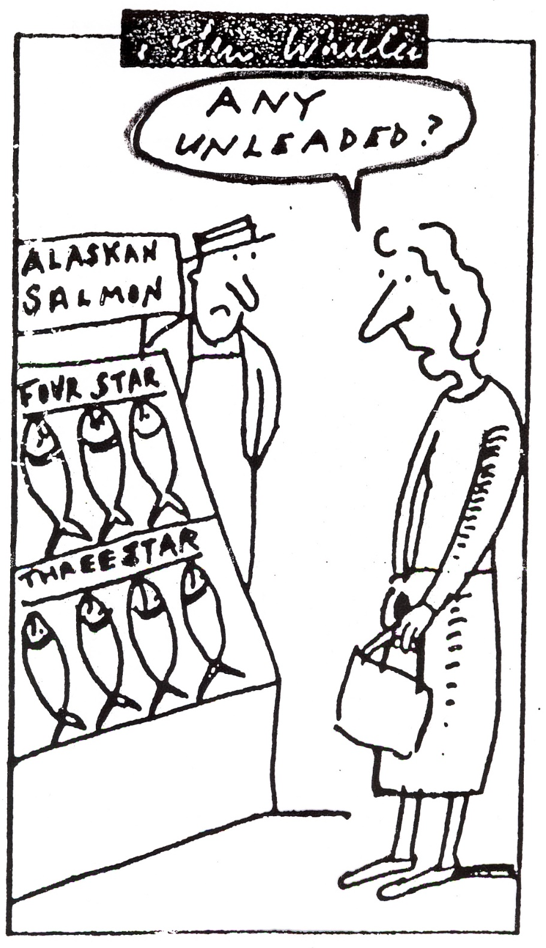
Problems with lead

Slide 3
The major scientific advance has been the demonstration that blood lead (PbB) levels of 10-15 micrograms/dL in newborn and very young infants result in cognitive and behavioral deficits.

Slide 4
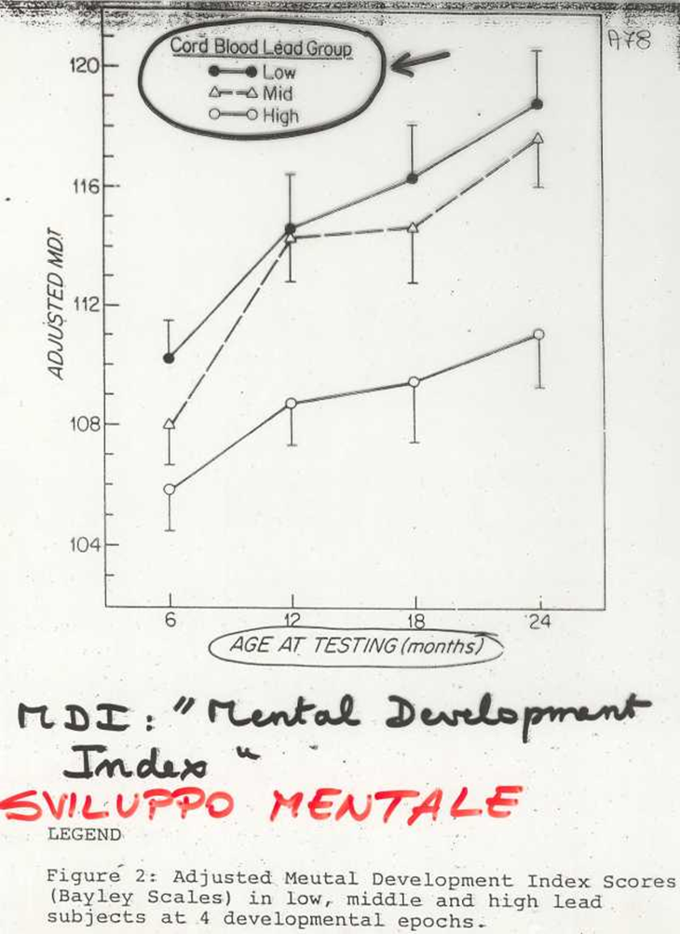
Lead poisoning victim in Germany (1992)

Slide 5
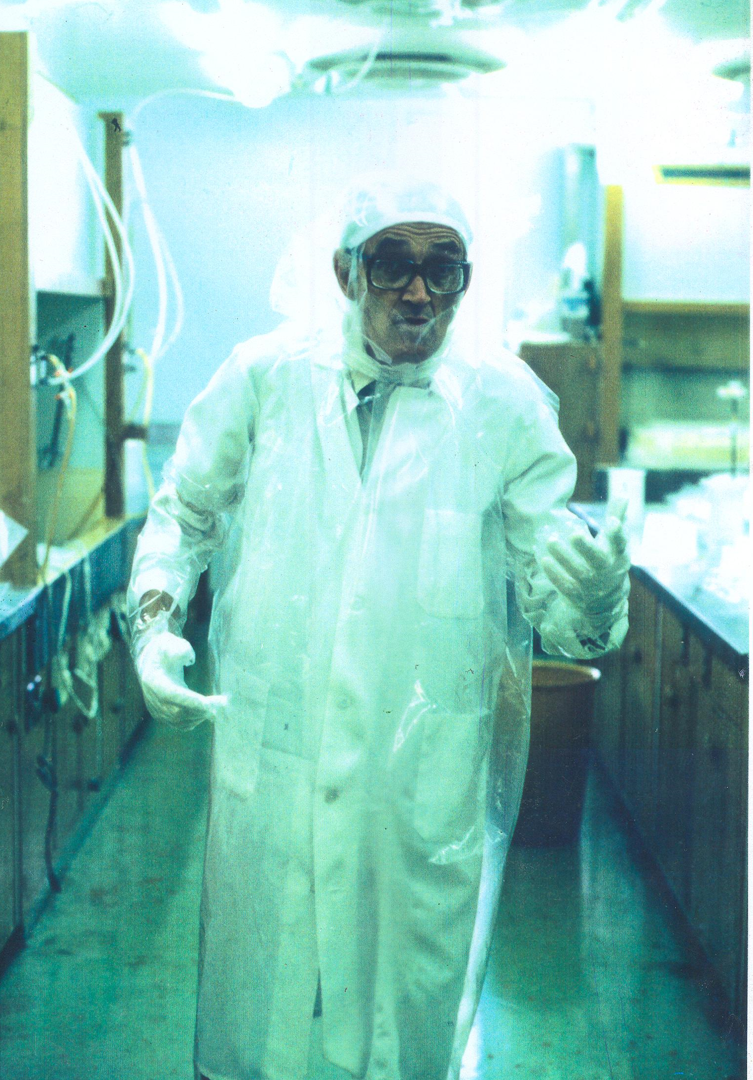
Clair C. Patterson
Clair Patterson in his clean laboratory at CALTECH

Slide 6
The famous curve of Claire C. Patterson (1969)
Relative
Pb contamination
in humans (Patterson 1982)
.
A
B
C
Pb increased rapidly during the industrial revolution

Slide 7
Lead in the Adriatic
Lead enter the sea from rivers
and atmosphere

Slide 8
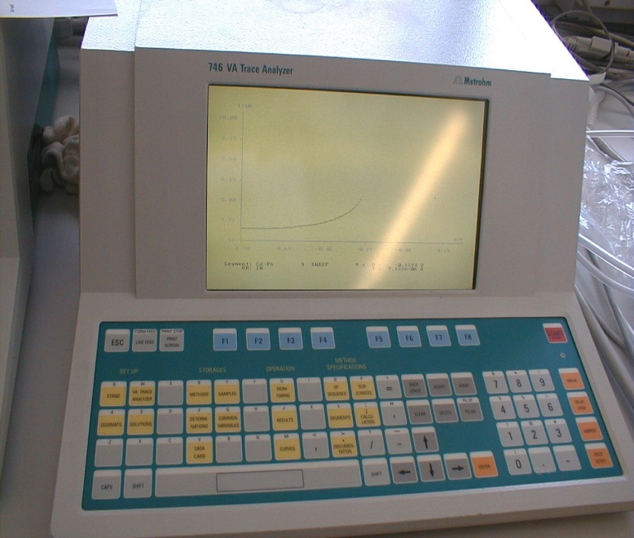
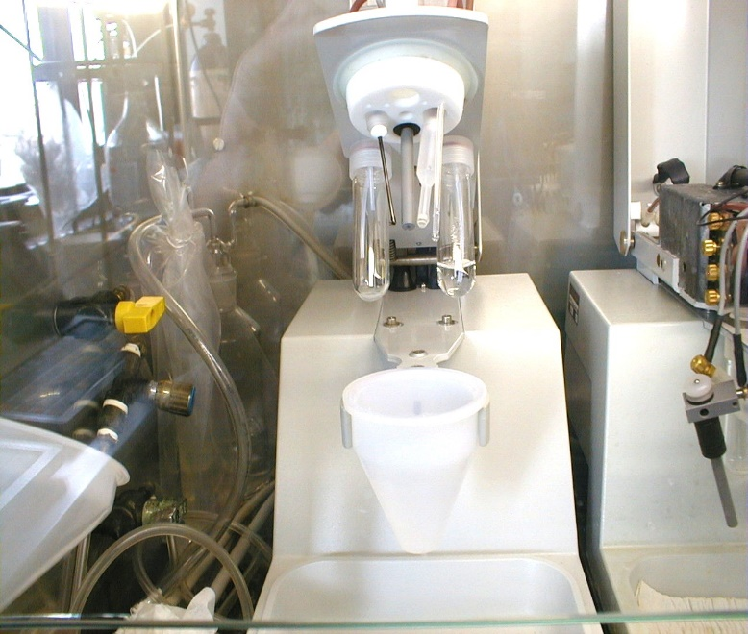
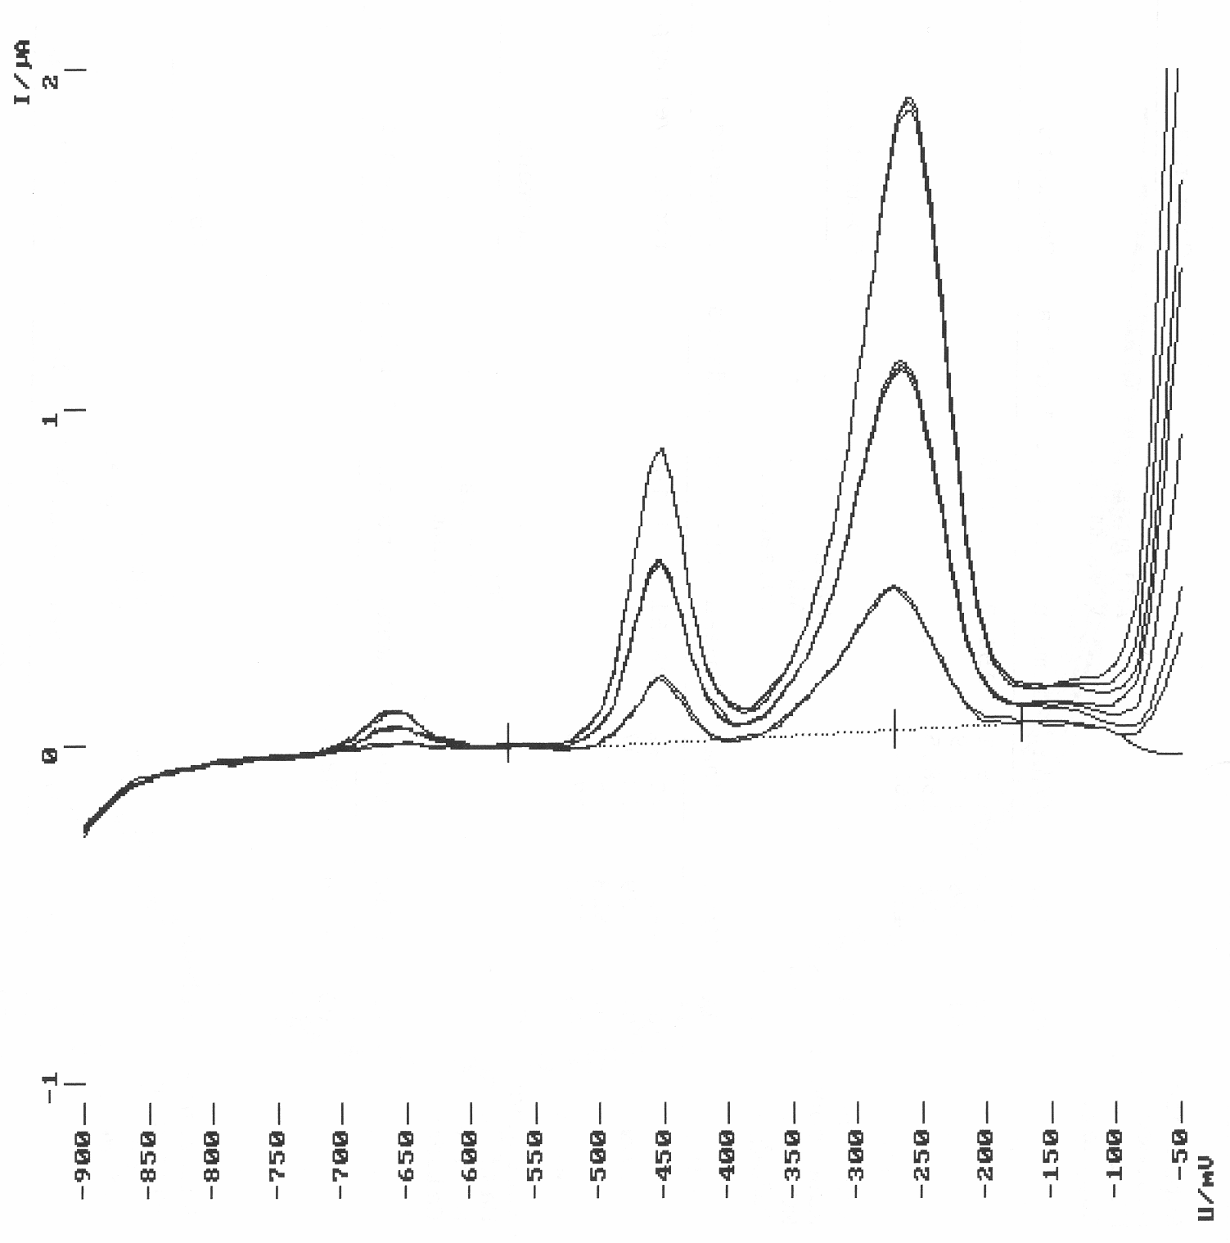
ANODIC STRIPPING VOLTAMMETRY (SWASV)
Typical voltammogram
Cu
2ª addition
1ª addition
Pb
sample
Polarographic system 746, VA Stand 747 Metrohm
Anodic current, μA
Cd
Working electrode:
RDE, mercury film on carbon paste electrode
Reference electrode: Ag/AgCl, KCl 3M
Auxiliary electrode: graphite carbon
Potential, mV vs. Ag/AgCl, KCl 3M

Slide 9
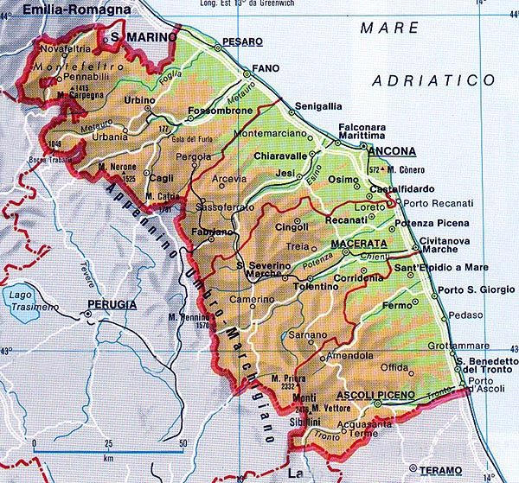
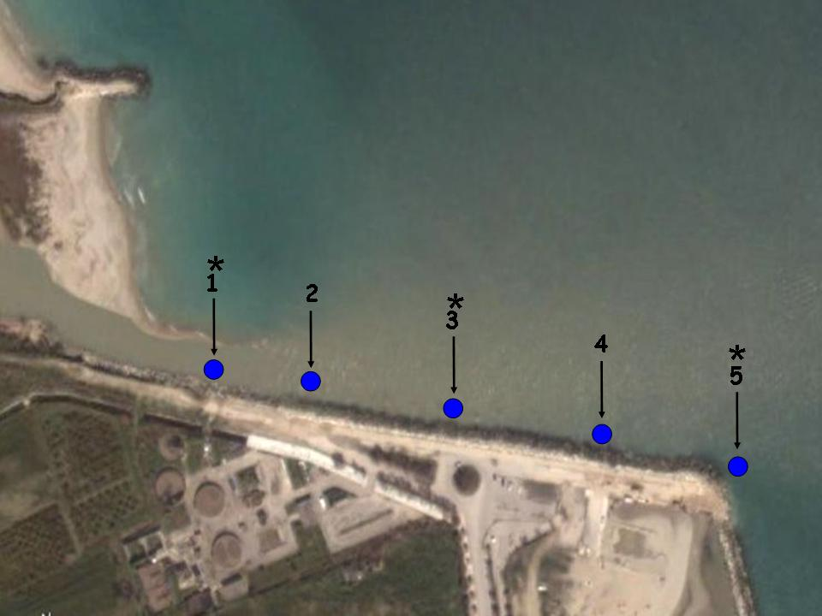
r. Foglia
r. Esino
r. Potenza
r. Tenna
r. Tronto
Lead concentration, ng/l
Foglia
Potenza
Tenna
Esino
Tronto
A study of river estuaries of the Marche Region, Italy
Sampling at
incresing salinity
Tenna
Salinità, psu

Slide 10
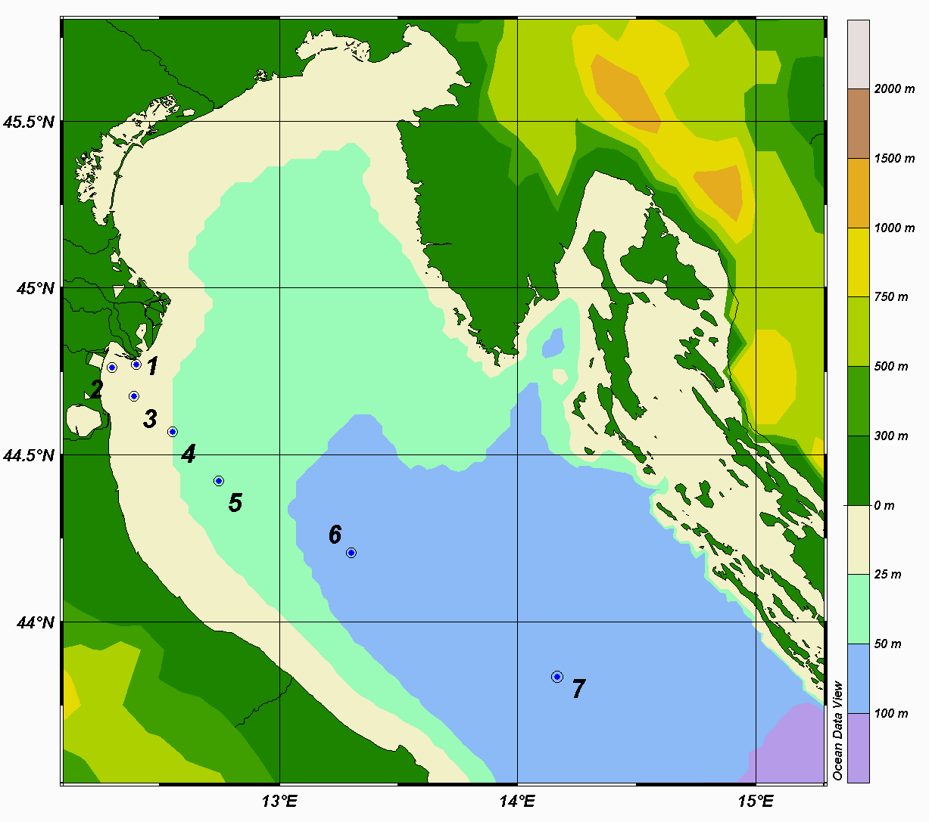
LEAD IN ADRIATIC SEAWATER
2004
Stn.0
Stn.A
Stn.B
Stn.C
Stn.D
2002
2003
Decrease from the mouth to open sea by 86% - 99%

Slide 11
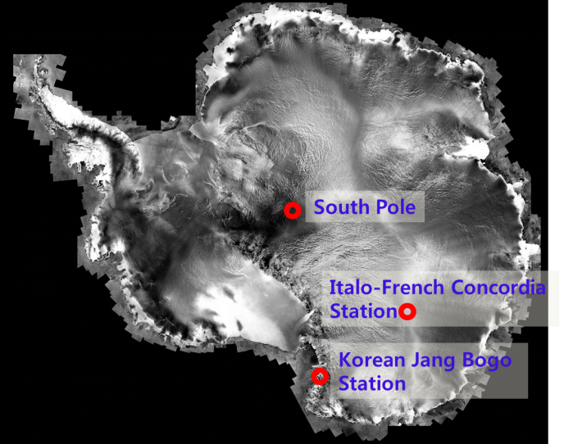
Lead in
Antarctic snow
Antarctica

Slide 12
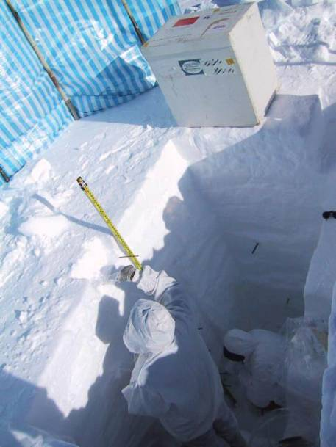
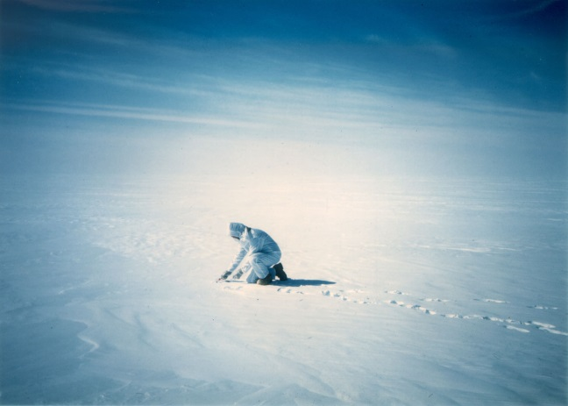
Surface snow sampling in Antarctica
Snow sampling of successive layers in a snow pit in Antarctica

Slide 13
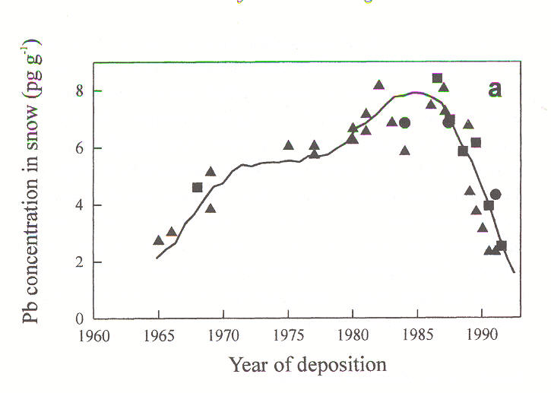
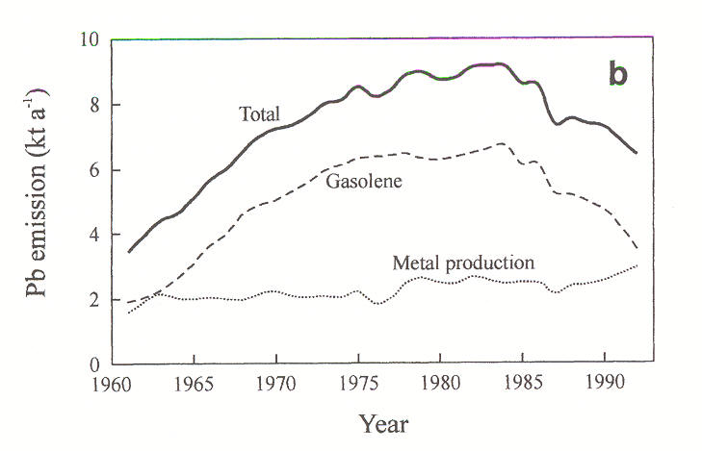
SIGNALS OF LEAD DECREASE IN THE ANTARCTIC SNOW
Pb in ice cores
(Victoria Land, Antarctica)*
Pb emissions in atmosphere
(Oceania, South Pacific, Sector)*
Relationship with lead emissions from leaded gasoline
* Barbante C. et al., Intern. J. Environ. Anal. Chem., 1997

Slide 14
Same observations in the Arctic

Slide 15
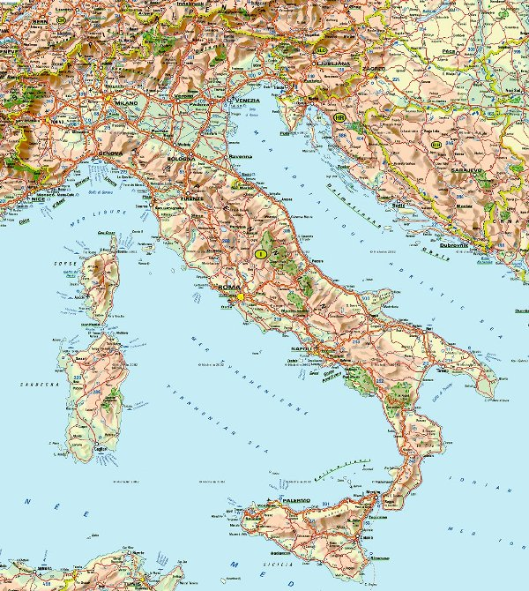
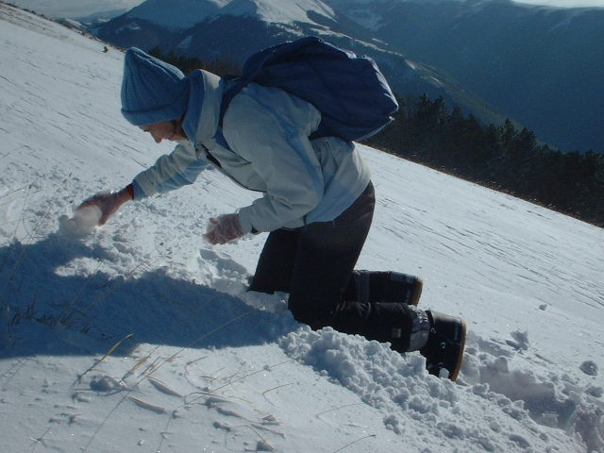
SNOW OF THE APENNINES
Samples collected during winters 2000-2004 on summit of Mount Cornaccione (1700 m asl)

Slide 16
LEAD IN SNOW OF THE APENNINES
Conc. variation 2000-2004
Total concentration | ~80% decrease
Particulate concentration | ~90% decrease

Slide 17
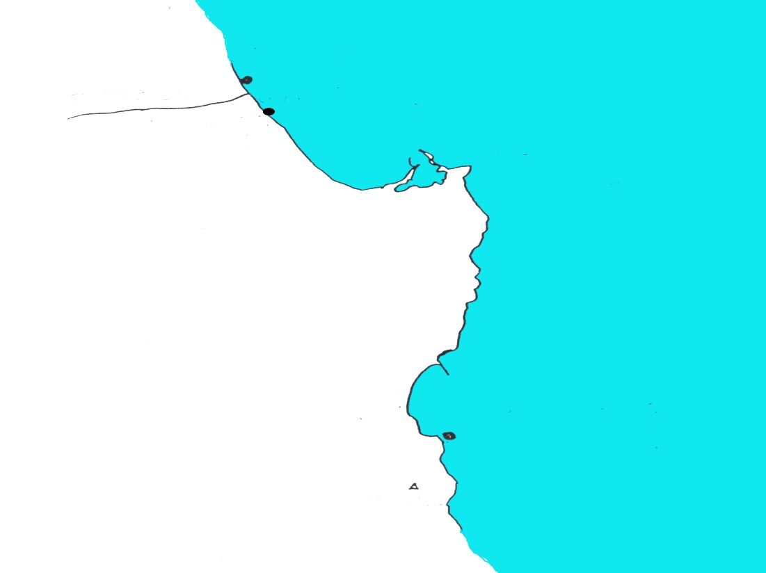
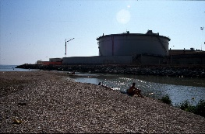
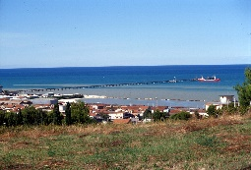
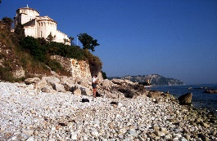
ADRIATIC COASTAL SEAWATER (2001-2004)
Esino
Three sites of Ancona coast
~50% decrease
from
2000-01
to
2003-04
ESINO
Esino
River
API
Api
API
Refinery
Adriatic Sea
Ancona
PORTONOVO
Portonovo
Conero Mountain
Time series

Slide 18
CONCLUSION
A net decrease in environmental lead occurred as a consequence of
the phase out of leaded gasoline
The Adriatic-Ionian Macroregion shows lead reduction in snow and sea water beginning with early 2000s
This is one of the best examples which demonstrates that actions against pollution may have effect even at a global scale

Slide 19
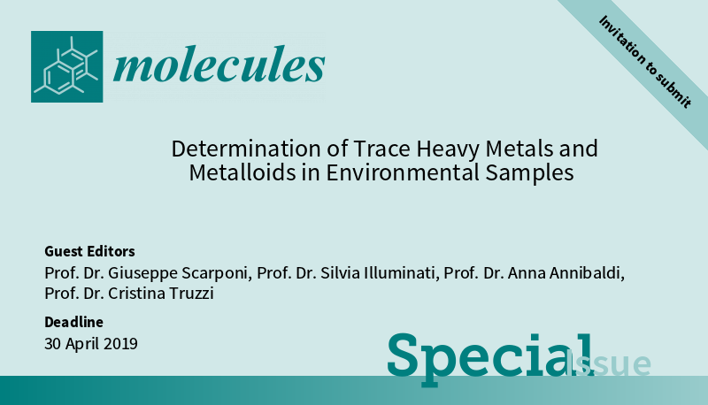
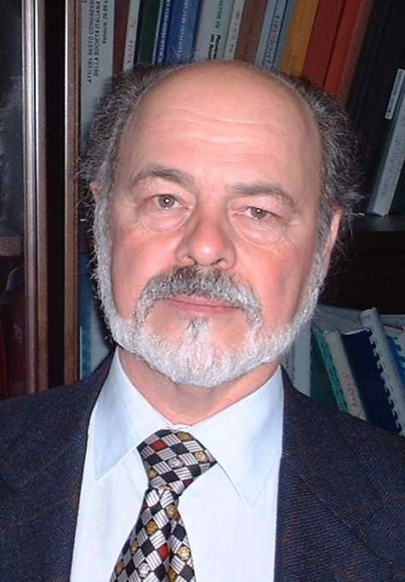
Special Issue: "Determination of Trace Heavy Metals and Metalloids in Environmental Samples“
Website: https://www.mdpi.com/journal/molecules/special_issues/determination_metals_environmental
One of Guest Editors Prof. Dr. Giuseppe Scarponi
Benefits:
Papers invited by guest editors receive 20% discount on the Article Processing Charges for accepted articles

