Slide 1
Women and success:
Carrier after
sport carrier
Sanda Čorak, PhD
Croatian judo federation
UniAdrion, Split, 2018.

Slide 2
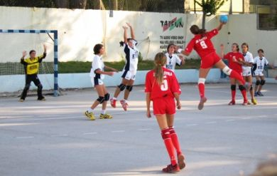
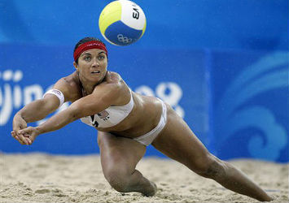
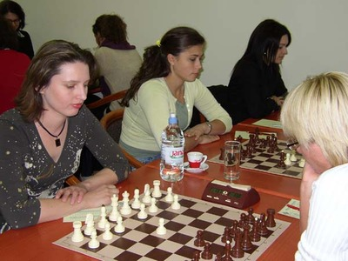
Carrier after carrier
STATUS: small share of women on leadership positions in sport (IOC recommendation – 50%)
STATUS: many women hold a few positions in sport
STATUS: drop out rate is bigger for women in comparison with men, usually because of family obligations and tradition, but also because of less opportunity for advancement
MAIN TASKS: retain women in sport and enable them carrier after sport carrier through education
EDUCATION make possible continuation in sport but also different carrier(s) and possible voluntary work in sports

Slide 3
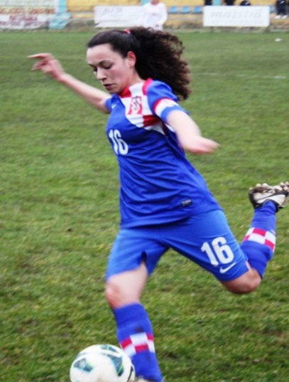
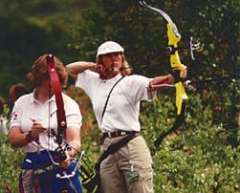
Women sport profile in CRO
In average 15 years of sport carrier regardless of position
52% were engaged in another sport
78% won a medal on national championship
44% won a medal on international competition
Working simultaneously on different positions (competitors – 73%; coaches 25%; organization of comp. 21%; sport administration – 14%; members of executive board 32%; presidents - 6%)

Slide 4
COC – Erasmus+; obstacles
Insufficient possibility of networking through sport
Perception of women as less educated than men
Gender stereotypes
RECOMMENDATIONS
Minimize obstacles!
Enable dual carrier!

Slide 5
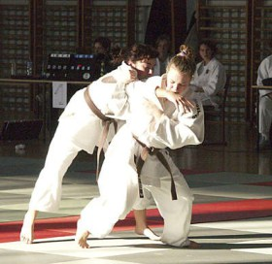
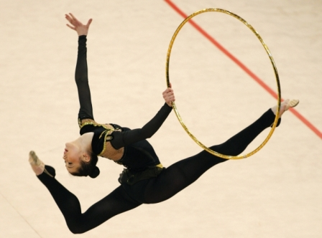
Dual carrier shoud:
Enable sport development of young women athletes
Establish balance between sport obligations and education and later on, between sport and business obligations
Secure support and professional help for categorized women athletes that finished their sport carrier, but interested in continuation of their education
QUESTION IS:
Continuation of carrier in sport; employment, self-employment or volunteering !?

Slide 6
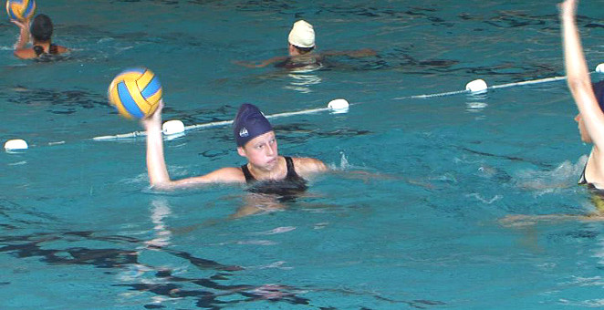
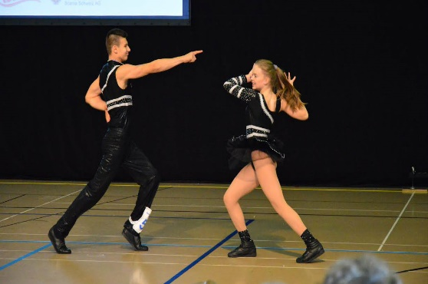
What we are doing !?
National sport federations – some are encouraging more engagement of women and more promotion through various media
COC – Erasmus+ - leader or partner in education projects focused on women on different positions (coaches, women on leadership positions)
Ministry of science, education and sport – Central sport office: „Athletes and education 2012-2016” – promotional days on topic „Carrier after sport carrier”
In period 2014 - 2018 there were no significant improvement
Central office for sport – proposal of National sport strategy – more activities focused on 1) developing of action plans 2) supporting dual carrier (co-financing education and taking care of employment)

Slide 7
Can we do better? Can we do more?
Women and success: carrier after sport carrier
Thank you for your attention!

