Slide 1
Safety and organization in pharmacies during the Covid-19 pandemic - pharmacist in the role of manager -
Ana Zovko, mr. pharm. owner and manager, AFARM Pharmacy

Slide 2
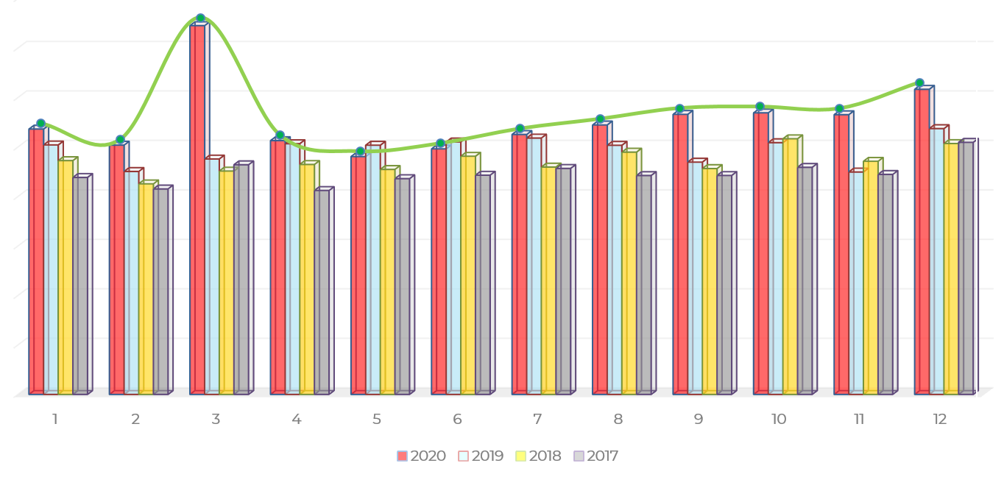
We have achieved business growth in 2020.

Slide 3
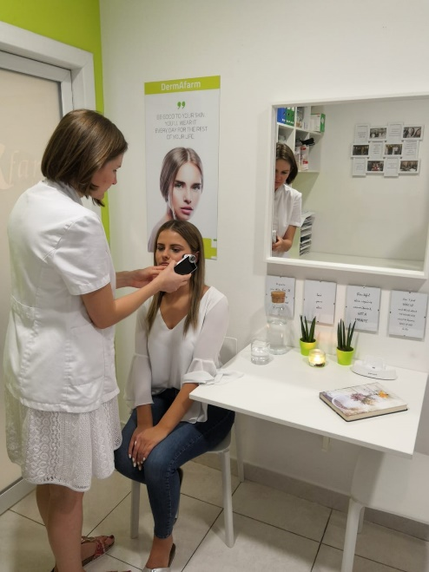
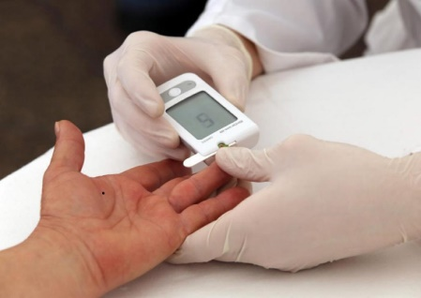
Our working principles
our working principles
consultation
several different measurments
skin analysis by dermatopharmachy specialist
analysis of patient adherece by specialyst of clinical pharmachy
all these acitivities were all of a sudden suspended

Slide 4
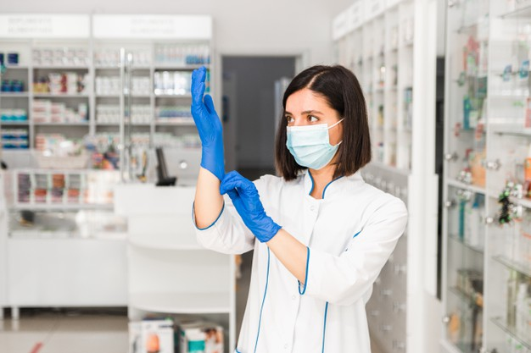
Lockdown
our working principles
pharmacists most accessible health providers
new organization in difficult working conditions
panic among the population, crowds in front of pharmacies
defects of certain drugs and medical devices
the role of leader was crucial

Slide 5
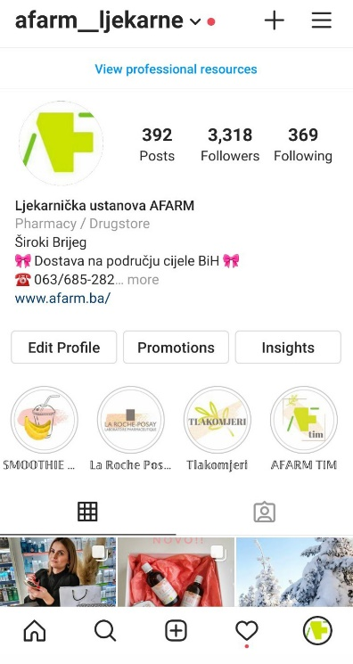
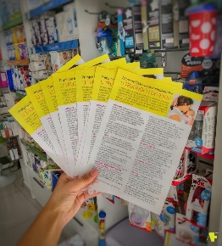
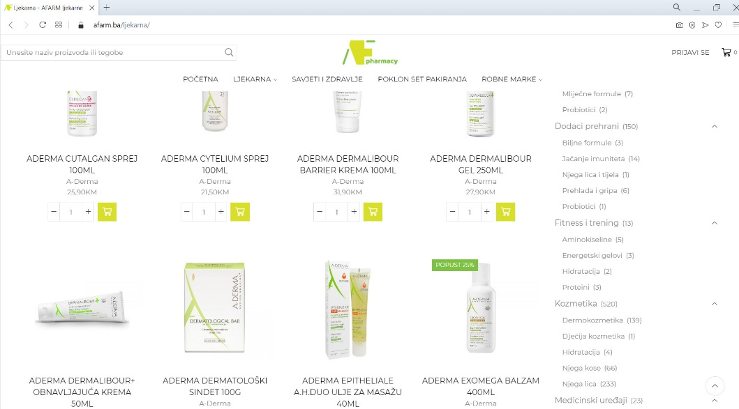
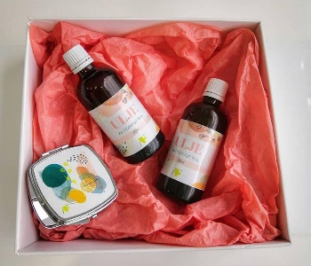
New projects
our working principles
expected decline in sales of OTC preparations
constant engagement on social media
online sales
making info flyers
work on branding

Slide 6
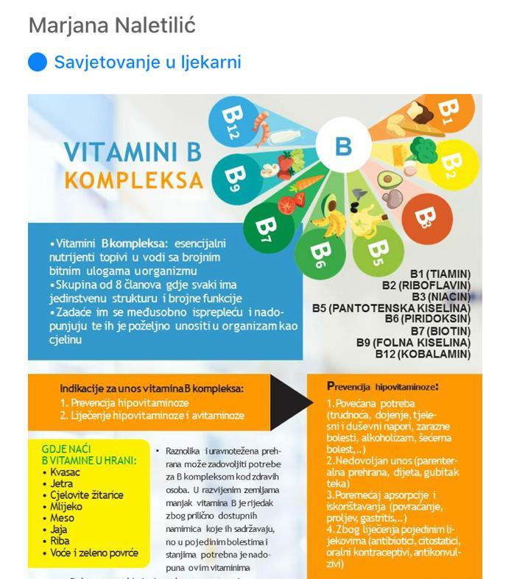
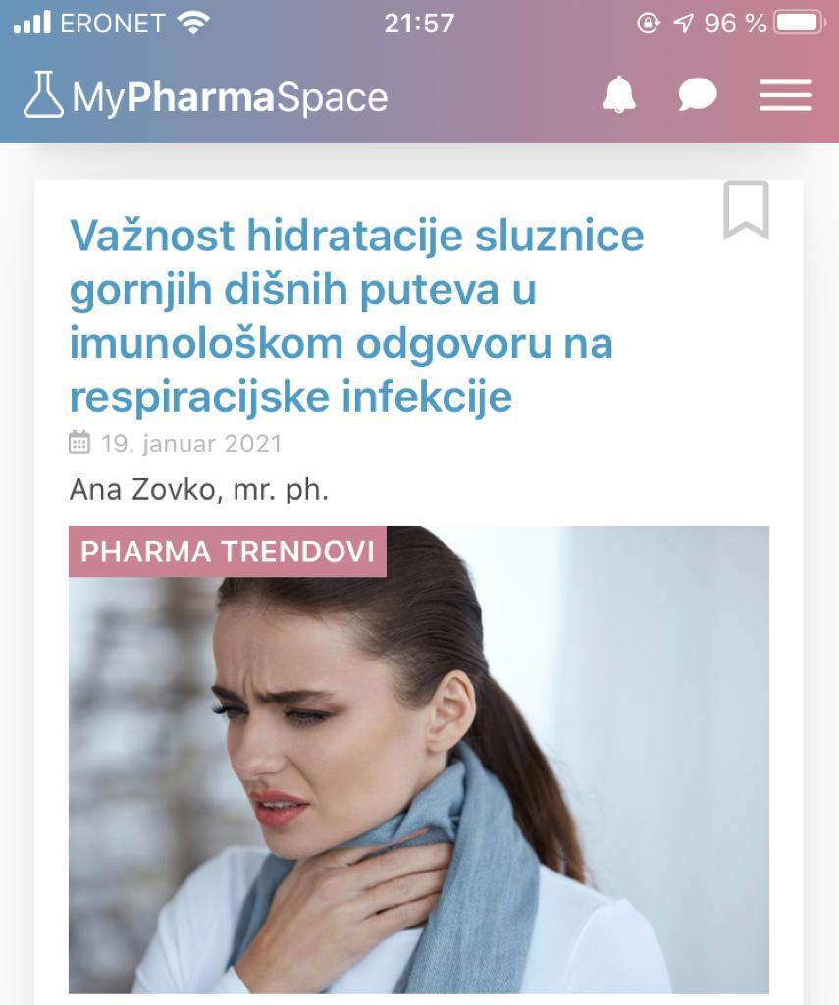
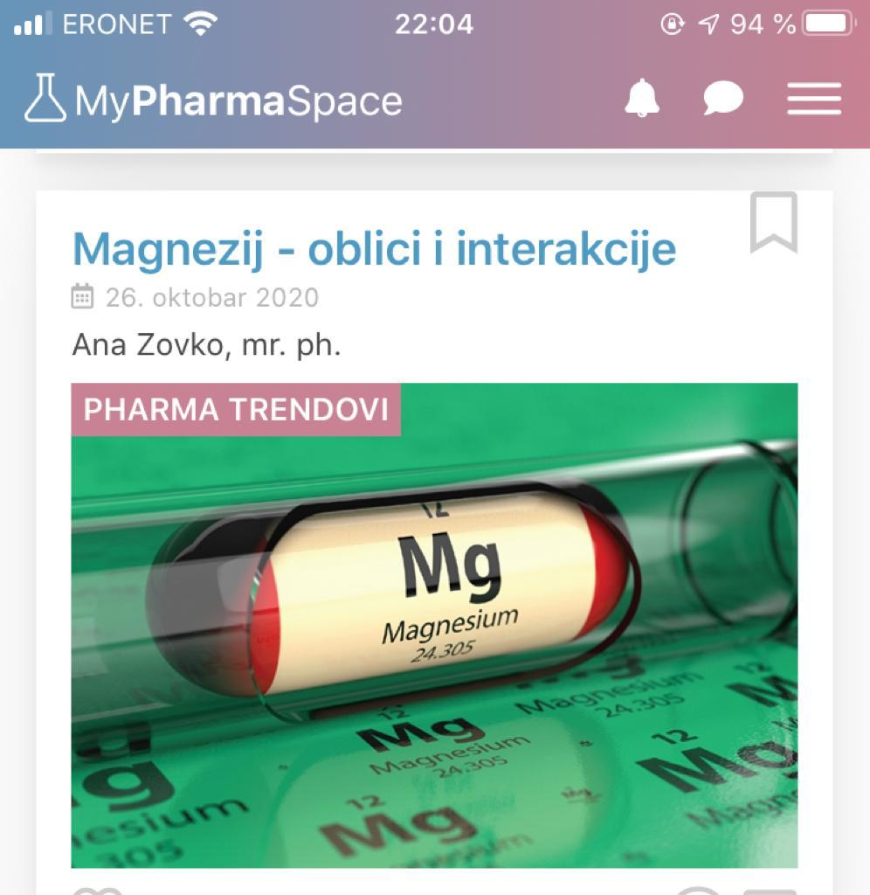
Conclusion
our working principles
importance of consistent education
additional source of income
new experiences
The pandemic has opened new perspectives for us and directed us to some new, interesting and useful paths, although some of our important activities were suspended.

Slide 7
Thank you for attention

