Slide 1
Andrea Kavarić, PhD
Women in Entrepreneurship in tourism during the COVID-19 Pandemic

Slide 2
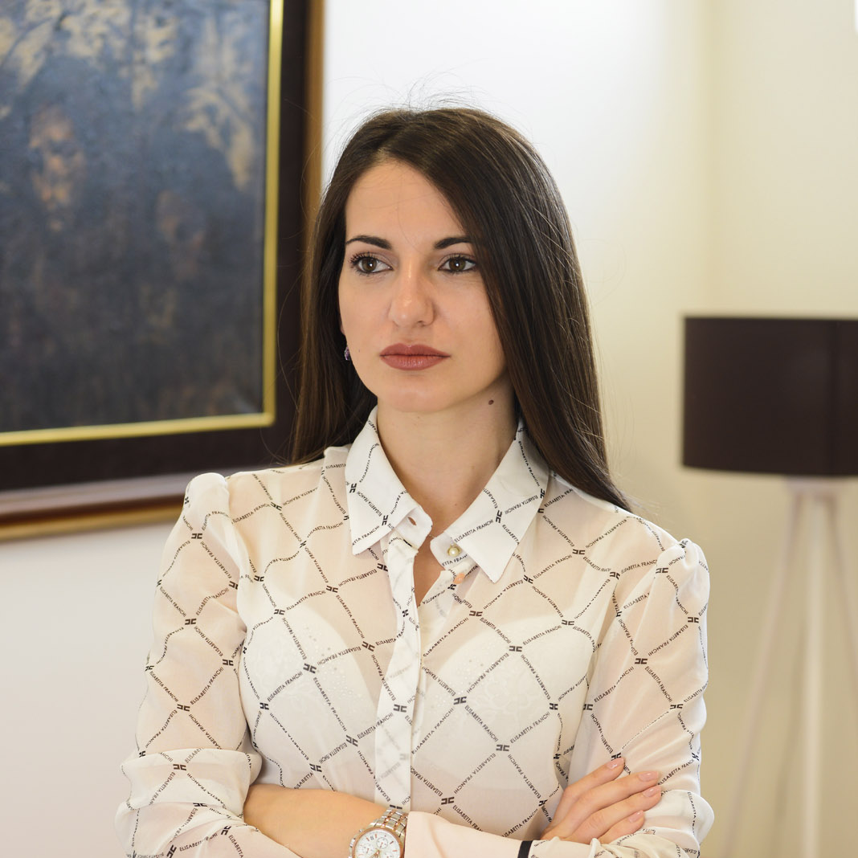
About me
PhD of Tourism management
State Fellow for Doctoral Research
Lecturer at the University of the Mediterranean
Lecturer at University of Donja Gorica
Expert on international projects
Entrepreneur

Slide 3
About Host Consulting
Company portfolio
Franchising in hospitality
Pre-opening of hotels
Strategic management in hospitality
Operational management in hotels
Strategic documents
Projects in field of tourism
Education

Slide 4
Women in entrepreneurship
I wish that I had known this before…

