Slide 1
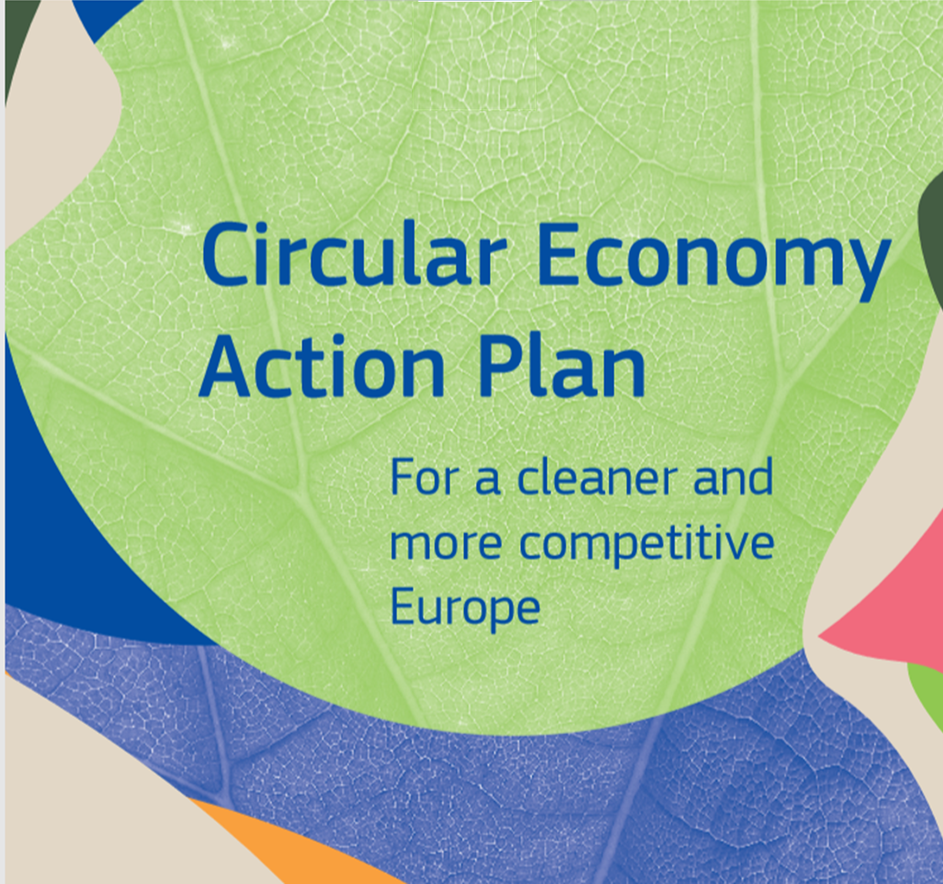
Maria Rincon Lievana
maria.rincon-lievana@ec.europa.eu
Team leader – Circular Economy
Sustainable products, production and consumption
DG Environment
European Commission

Slide 2
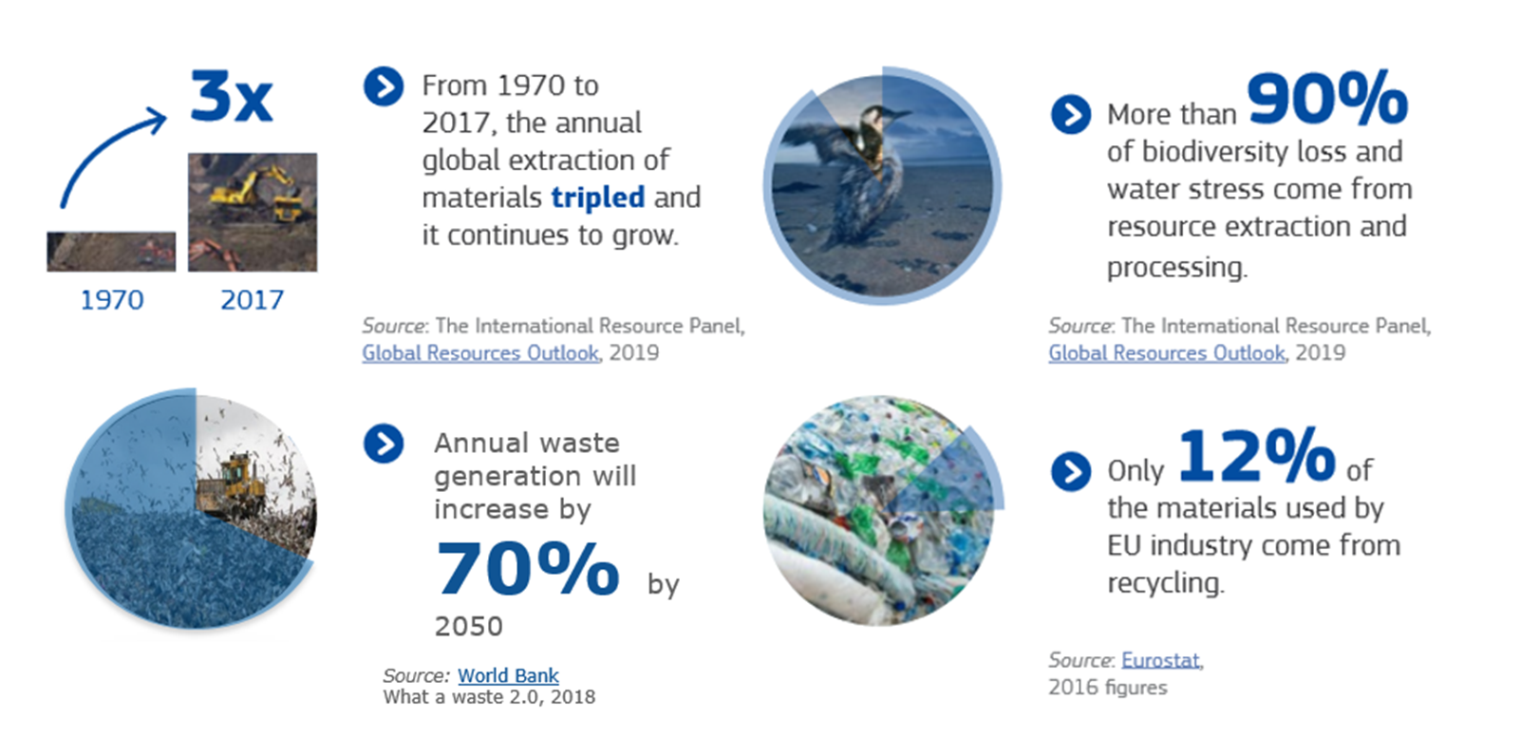
Need for action
There is only one planet Earth, yet by 2050, the world will be consuming as if there were three

Slide 3
CLIMATE
PACT AND CLIMATE
LAW
PROMOTING
CLEAN
ENERGY
INVESTING IN MORE
SUSTAINABLE,
SMARTER MOBILITY
PROTECTING NATURE
MOBILISING INDUSTRY
FOR A CLEAN AND
CIRCULAR ECONOMY
The European
Green Deal
FROM FARM
TO FORK
ELIMINATING
POLLUTION
LEADING THE
GREEN CHANGE
GLOBALLY
ENSURING
A JUST TRANSITION
FOR ALL
MAKING
HOMES ENERGY EFFICIENT
FINANCING
GREEN
PROJECTS
Notes:
Building blocks of the European Green Deal
CE is at the heart of the new regenerative growth strategy for Europe triggered by the Green Deal;
Therefore, the circular economy is supported via the Green Deal in two ways: 1) with the new CEAP; 2) by mainstreaming circularity across all others initiatives of the EGD
To achieve climate neutrality, the EU needs to reduce its material footprint and increase significantly its circular material use rate;
Thanks to CE, it will be possible to achieve the Green Deal targets by scaling up the circular economy from front-runners to the mainstream economic players;
CE provides a future-oriented agenda for achieving a cleaner and more competitive Europe in line with the transformational change promoted by the Green Deal;
CE addresses the conditions to achieve a circular economy where natural systems are protected and regenerated, harnessing the contribution of the circular economy to climate neutrality and the achievement of the 2030 Sustainable Development Goals.

Slide 4
First Circular Economy Action Plan
Where are we coming from?
Lookin at the lifecycle of products
Strong Stakeholder Engagement
Material Specific approach
Eco-Design Working Plan & Sustainable Products in a Circular Economy
Product Environmental Footprint and Consumers REFIT
Revised Waste Legislation
Interface WPC and Fertilising Products Regulation
Material-specific and systemic approach along entire value chains
Single Use Plastic Items Directive & Circular Plastics Alliance
EU Circular Economy Stakeholder Platform
EU Platform on Food Losses and Food Waste
Circular Economy Finance Support Platform
“An economy where the value of products, materials and resources is maintained in the economy for as long as possible, and the generation of waste minimized”
Notes:
The transition towards a circular economy is necessary because in 2050 the world will be consuming as if there were three planets Earth. Global consumption of materials such as biomass, fossil fuels, metals and minerals is expected to double in the next forty years, while annual waste generation is projected to increase by 70% by 2050. At the same time, half of total greenhouse gas emissions and more than 90% of biodiversity loss and water stress come from resource extraction and processing. Therefore, circular economy can provide us with the right answers to today’s and tomorrow’s challenges.
More data: From 1970 to 2017 the annual extraction of materials tripled and continues to GROW.
More than 90% of biodiversity loss and water stress come from resource extration and processing.
Annual waste generation will increase by 70% by 2050. only 12% of the materials used by EU industry come from recycling

Slide 5
Changing the way Europe consumes and produces
Make sustainable products the norm in the EU
Empower consumers and public buyers
Sustainable production processes
Making circular economy work for people, regions and cities
Sustainable Product Policy Framework
Circular economy as a requisite for climate neutrality
Electronics and ICT
Batteries and vehicles
Packaging
Plastics
Textiles
Construction and buildings
Food, water and nutrients
Getting the Economics Right
Financial Markets
Key Value Chains
Less Waste More Value
Investments and R&I
Global Level Playing Field
Reduce Waste
Reduce Waste Exports
Boost market for high quality and safe secondary raw materials
Monitoring
35 actions
Notes:
Key message: comprehensive action plan along the entire life cycle of products.
3 focus areas: products, key value chains, less waste more value

Slide 6
Towards a Sustainable Product Policy Framework
Our response
Many products break down too quickly, cannot be easily reused, repaired or recycled, and many are made for single use only.
Consumers do not repair products, find too many labels and some green claims are misleading.
Production processes in Europe are not resource efficient and can pollute our air, water and soil.
Product Design
Empowering consumers
Circularity in production processes
A new overarching framework addressing all products placed on the EU market, supporting more sustainable patterns of consumption and cutting waste by
e.g. promoting better design
Notes:
Problem definition and solution
EU initiatives and legislation already address to a certain extent sustainability aspects of products, either on a mandatory or voluntary basis (notably, the Ecodesign Directive or, at the same time, instruments such as the EU Ecolabel or the EU green public procurement (GPP) criteria) However, there is no comprehensive set of requirements to ensure that all products placed on the EU market become increasingly sustainable and stand the test of circularity. This will be the new Sustainable Product Policy Framework.

Slide 7
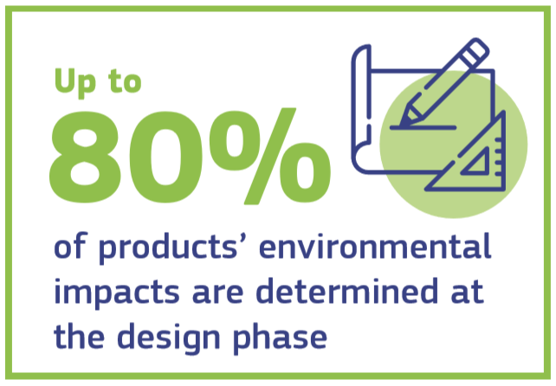
Designing sustainable products
Sustainable Products Initiative
How?
Legislative initiative to ensure products placed on the EU market become increasingly more sustainable
Widen the Ecodesign Directive beyond energy-related products
Establish a set of sustainability principles (via Ecodesign Directive or other instrument)
Adoption of the proposal planned for Q4 2021
« Sustainable products should be the norm, not the exception »
Notes:
It is estimated that 80% of environmental impacts are determined at the design phase. We want to build upon the success of the Ecodesign Directive, applying it to a wide range of products. We want to establish a set of sustainability principles applicable to all products.

Slide 8
Designing sustainable products
Sustainable Products Initiative
What?
Improve durability, reusability, upgradability and reparability
Address presence of hazardous chemicals and increasing recycled content
Restrict single-use and counter premature obsolescence
Incentivise product-as-a-service
Digitalisation, including digital product passport
Implementation in key product value chains is priority: these include electronics, ICT, textiles, furniture and intermediate products such as steel, cement, chemicals

Slide 9
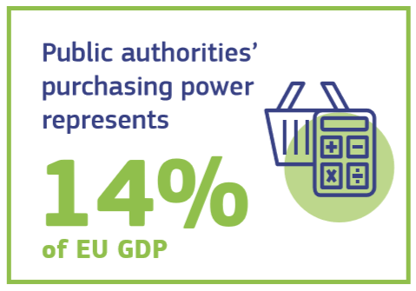
Empowering consumers and public buyers
Revision of the consumer law: consumers to receive trustworthy and relevant information on products at the point of sale
Articulating a new “Right to repair”
Legislative proposal to ensure companies substantiate their green claims using Product and Organisation Environmental Footprint methods (expected Q2 2021)
Include more systematically durability, recyclability and recycled content in EU Ecolabel criteria
c
Proposal for mandatory Green Public Procurement (GPP) criteria and targets in sectoral legislation
Phasing-in mandatory reporting on GPP
Notes:
Empowering consumers and providing them with cost-saving opportunities is a key building block of the sustainable product policy framework. To enhance the participation of consumers in the circular economy, the Commission will propose a revision of EU consumer law to ensure that consumers receive trustworthy and relevant information on products at the point of sale, including on their lifespan and on the availability of repair services, spare parts and repair manuals.
The Commission will also consider further strengthening consumer protection against green washing and premature obsolescence, setting minimum requirements for sustainability labels/logos and for information tools.
In addition, the Commission will work towards establishing a new ‘right to repair’ and consider new horizontal material rights for consumers for instance as regards availability of spare parts or access to repair and, in the case of ICT and electronics, to upgrading services. Regarding the role that guarantees can play in providing more circular products, the Commission will explore possible changes also in the context of the review of Directive 2019/7711.
We will also propose that companies substantiate their environmental claims using Product and Organisation Environmental Footprint methods. The Commission will test the integration of these methods in the EU Ecolabel and include more systematically durability, recyclability and recycled content in the EU Ecolabel criteria.
The Commission strongly supports GPP, and it will propose mandatory GPP criteria and targets in sectoral legislation. GPP have always been crucial for circularity, since public authorities purchasing power represents 14% of GDP. Such figures is likely to increase in the short term due to the recovery efforts, making GPP even more important to ensure a circular Europe.

Slide 10
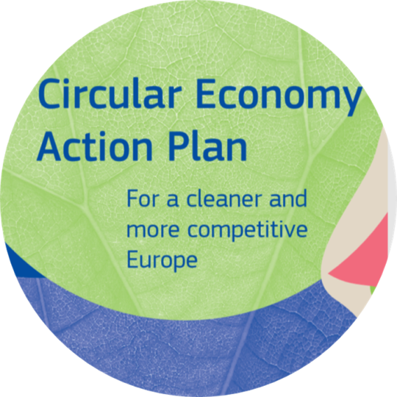
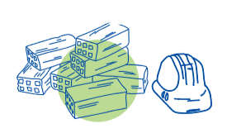
Key product value chains
Electronics and ICT
Food, water & nutrients
Batteries & vehicles
Construction & buildings
Packaging
Textiles
Plastics

Slide 11
Less waste, more value
Prevent waste in the first place
Specific waste reduction targets for more complex streams
Enhance the implementation of the requirements for EPR schemes
Continue modernising EU waste laws (packaging, end-of-life vehicles, hazardous substances in electronic equipment; batteries adopted Q4 2020)
Propose to harmonise separate waste collection systems
Transform waste into high-quality and safe resources in markets for recycled materials
Develop chemicals that are sustainable and safe by design
Reduce the presence of hazardous substances detrimental to health and the environment
Assess the scope to develop further EU-wide end-of-waste criteria for certain waste streams
Address waste exports
Establish ‘recycled in the EU' as a benchmark for quality secondary materials
Thoroughly review EU rules on waste shipments, increasing the processing of materials
Adopt multilateral, regional and bilateral measures to combat environmental crime

Slide 12
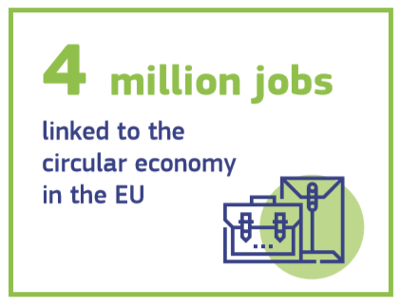
Making circularity work for people, regions and cities
A joint agenda, a transition where no one is left behind
Main actions:
Revision of the Skills Agenda [adopted 2020]
A new Pact for Skills [launched October 2020]
Cohesion policy funds (to help regions implement CE strategies & reinforce their industrial fabric)
Just Transition Mechanism
Urban initiatives
Notes:
Pact for Skills: based on the approach pioneered by the Blueprint on Sectoral Cooperation on Skills, in the context of the Skills4Industry initiative, this partnership would aim at
analysing skill gaps and needs;
developing ambitious upskilling strategies and commitments with vocation education, training excellence centres, private upskilling providers.
Urban Initiatives
European Urban Initiative: New post-2020 instrument providing coherent support for cities that builds on all thematic priorities of the Urban Agenda for the EU (UAEU) and covers all urban areas. This initiative aims to strengthen integrated and participatory approaches to sustainable urban development and provide a stronger link to relevant EU policies, and in particular, cohesion policy investments. It includes actions to ensure better knowledge on available funding, on available knowledge, etc.
DG REGIO leads.
Intelligent Cities Challenge Initiative: Launch a group of “Cities4Circular economy Challenge”, as part of the 100 Intelligent Cities Challenge, to create partnerships with all stakeholders, including industry, SMEs and start-ups, to foster the implementation of a local circular economy (e.g. green public procurement, urban manufacturing; Industry 5.0; industrial symbiosis; smart waste management; shared clean mobility, local clean energy sharing solutions, awareness raising, etc.). It will take the perspective of promoting the development of high-tech innovation ecosystems in European cities/regions, including innovative business models.
GROW leads, EASME involved.
Circular Cities and Regions Initiative: It is lead by DG RTD and it will be framed in the context of HorizonEurope. Hence, it will likely focus on promoting R&D and innovation. Work in progress.
Green City Accord: In general, it explores how to better engage local governments in delivering EU environmental policy objectives in the areas of air quality, noise, water, circular economy, nature and biodiversity. The initiative will support cities in designing and implementing thematic integrated action plans. Other activities include the collection and dissemination of good practices, the organisation of awareness-raising workshops in European countries, and promoting knowledge transfer between city authorities through a ‘twinning programme’. The Green City Accord will be developed in coordination with city experts in the first half of 2020 and it will officially open for cities’ signatures during the second half of 2020.
DG ENV A3 will be following this.

Slide 13
Enablers of the transition
Circular economy as prerequisite for climate neutrality
Measuring circularity contribution to climate mitigation
Strengthening the role of circularity in future revisions of the National Energy and Climate Plans
Certification of carbon removals
Getting the economics right
Integrating CE in EU Taxonomy Regulation (Q4 2021)
EU Ecolabel criteria for financial products (Q4 2021)
CE solutions in State Aid, business strategies, financial instruments and reporting (2021)
Research, innovation and digitalization
European Regional Development Fund/LIFE/HorizonEurope

Slide 14
Towards a global circular economy
An agenda to promote CE at bilateral, regional and multilateral level, including through development & international cooperation programmes
Kick-start negotiations for a Global agreement on plastics
Global Circular Economy and Resource Efficiency Alliance
CE in free trade agreements
Outreach activities – i.a. Circular Economy Missions
Initiate discussions for a global agreement on natural resource management
‘Safe operating space’ for natural resource use
Ongoing
‘Leading the way to a global circular economy: state of play and outlook’
Notes:
In Q1 2021, in context of UNEA 5:
1. We will lead efforts to reach a global agreement on plastics, and promote the uptake of the EU’s circular economy approach on plastics;
2. We will launch a Global Circular Economy Alliance to identify knowledge and governance gaps and take forward partnership initiatives;
The Commission is already working to:
Ensure that Free Trade Agreements reflect the enhanced objectives of the circular economy;
Outreach activities are stepped-up, including through the European Green Deal diplomacy and – when the covid emergency will make it logistically possible- the Circular Economy missions. The EU will work with EU Member States to enhance coordination and joint efforts for a global circular economy.
Safe operating space & discussions on global agreement on natural resource use management are scheduled for post-2021.

Slide 15
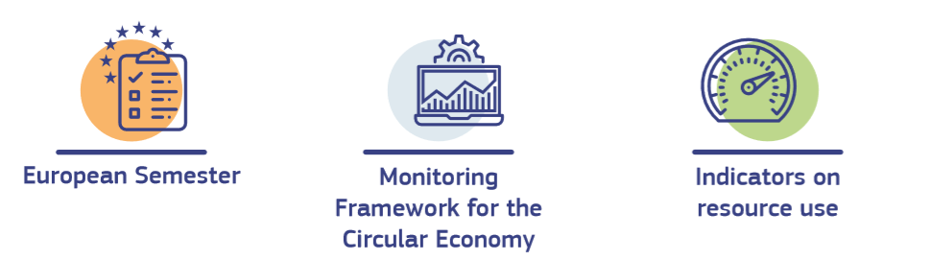
Monitoring progress
Measuring progress at EU and national level in the transition to a circular economy
Notes:
In line with the European Green Deal and the 2020 Annual Sustainable Growth Strategy, the Commission will reinforce the monitoring of national plans and measures to accelerate the transition to a circular economy as part of refocusing the European Semester process to integrate a stronger sustainability dimension.
The Commission will also update the Monitoring Framework for the Circular Economy. Relying on European statistics as much as possible, new indicators will take account of the focus areas in this action plan and of the interlinkages between circularity, climate neutrality and the zero pollution ambition. At the same time, projects under Horizon Europe and Copernicus data will improve circularity metrics at various levels not yet reflected in official statistics. Indicators on resource use, including consumption and material footprints to account for material consumption and environmental impacts associated to our production and consumption patterns will also be further developed and will be linked to monitoring and assessing the progress towards decoupling economic growth from resource use and its impacts in the EU and beyond.

Slide 16
Mainstreaming circularity
Biodiversity Strategy for 2030 to protect our fragile natural resources
Farm to Fork Strategy to make food systems more sustainable
Renovation Wave to boost renovation in line with circular principles
Chemical Strategy for Sustainability to ensure chemicals are safe and sustainable
Adopted:
Circular Economy in the context of the European Green Deal
Ongoing:
Circular economy in the EU Recovery Plan → Cooperation with Member States via the Semester on their draft RRPs + Mainstreaming circularity in EU funding programmes within the MFF
The New European Bauhaus initiative (launched on 18/01) → A design movement integrating three dimensions: sustainability (including circularity), quality of experience (including aesthetics) and inclusion (including affordability)
Notes:
We are well in track in delivering on our commitments.
However, we cannot see CE and the Circular Economy Action Plan in isolation; in fact, the circular economy remains a priority in the latest deliverables of the European Green Deal:
The Biodiversity Strategy for 2030 acknowledge the role circularity can play to help reduce the economic system’s negative effect on biodiversity
The Farm to Fork Strategy combats food waste and integrate circularity thinking in the food system
The recently adopted Renovation Wave integrates circular economy principles, to make the renovation of buildings in Europe circular and sustainable on top of energy efficient – for example by supporting the use of Level(s) and life cycle thinking when carrying out renovation efforts.
The Chemical Strategy for Sustainability proposes a series of actions to ensure that products are safe and sustainable-by-design, and downstream, to increase safety of and trust in recycled materials and products, making ‘Recycled in the EU” a benchmark worldwide.
MORE ON RRPs:
The deadline for submission of the National Recovery and Resilience plans is 30 April 2021. However, Member States have been encouraged to submit their preliminary draft plans from 15 October 2020.
MORE ON THE BAUHAUS INITIATIVE (text taken from EC website)
The New European Bauhaus will:
Bring citizens, experts, businesses, and Institutions together and facilitate conversations about making tomorrow’s living spaces more affordable and accessible.
Mobilise designers, architects, engineers, scientists, students, and creative minds across disciplines to reimagine sustainable living in Europe and beyond.
Strive to improve the quality of our living experience. It will highlight the value of simplicity, functionality, and circularity of materials without compromising the need for comfort and attractiveness in our daily lives.
Provide financial support to innovative ideas and products through ad-hoc calls for proposals and through coordinated programs included in the Multi-Annual Financial Framework.
1st PHASE
The goal of the design phase (the first phase, the one that was kick-started this week) is to connect to what is already out there to see where and how the New European Bauhaus can accelerate, concretise and materialise good ideas. The outcome should be a framework including a call for proposals for at least five places where the new Bauhaus concept can be materialised. These pilots should be distributed in different EU Member States.
2nd PHASE
Delivery
From September 2021 onward
This phase will start with the setup and implementation of New European Bauhaus pilots, supported by specific calls for proposals. They will be closely followed and monitored in a 'community of practice' mode, to share the lessons learned from these first experiments.
The focus of the dissemination phase will then be on diffusing good ideas, across Europe and beyond. This will be about networking and knowledge sharing, to identify open, replicable methods, solutions and prototypes, and make them available to cities, localities, architects and designers. It will be key to engage with citizens, businesses, academia, and to reinforce urban institutional capacities.
Flanking initiatives and additional policy instruments beyond the call for proposal will bring further structure to the movement and spread it through digital networks and engagement platforms.

Slide 17
Stakeholder engagement
Advancing the circular economy concept on the ground
Strengthening cooperation among stakeholders' networks
representatives of networks of businesses, civil society and
local, regional and national public authorities
Submit your own good practices, knowledge, strategies and voluntary commitments!
Link to website: http://circulareconomy.europa.eu/platform/
Notes:
In parallel with policy development, we are also working to strengthen cooperation and information sharing among different stakeholders and across value-chains. Diversity is the best recipe for innovation and progress, and creating the conditions for a multitude of ideas to thrive is the key to success.
In cooperation with the European Economic and Social Committee, the European Commission manages the European Circular Economy Stakeholder Platform.
This is a virtual open space which aims at promoting Europe's transition to a circular economy by facilitating policy dialogue among stakeholders and by disseminating activities, information, good practices, and strategies on the circular economy. Stakeholders started sharing their expertise and made them available for replication.
I encourage you to do the same and become a recognized actor in the circular transition.

Slide 18
Thank you Learn more here: https://ec.europa.eu/environment/circular-economy/index_en.htm
© European Union 2020
Unless otherwise noted the reuse of this presentation is authorised under the CC BY 4.0 license. For any use or reproduction of elements that are not owned by the EU, permission may need to be sought directly from the respective right holders.

