Slide 1
EU cluster policy Durres, 12 May 2015
Cinzia De Marzo, Policy officer, DG Internal market, Entrepreneurship, Industry, SMEs, European Commission
Notes:
1

Slide 2
Definition of clusters
Clusters are groups of specialised enterprises – often SMEs – and other related supporting actors that cooperate closely together in a particular location.
In working together SMEs can be more innovative, create more jobs and register more international trademarks and patents than they would alone.
Clusters are particularly useful for SMEs to share infrastructures, exchange business experiences, find qualified skills and minimise costs for marketing and legal services. Cluster organisations (management teams) can facilitate this process by providing top-quality services to their members.

Slide 3
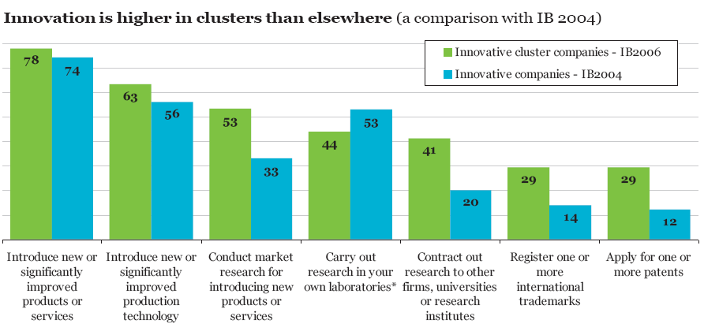
Why clusters? SMEs are more innovative!
Cluster firms …
- are more innovative than non-cluster firms
- register more trademarks and apply for more patents
- cooperate more
38% of European jobs are based in 2000 clusters.
3

Slide 4
What is the European Commission doing?
The Commission Communication for a European Industrial Renaissance (COM (2014) 14) highlighted clusters as being able to facilitate cross-sectorial and cross-border collaboration, helping SMEs to grow and internationalise.
The Commission is launching several initiatives under COSME and Horizon2020 to support SME innovation and growth through clusters such as:
The European Cluster Collaboration Platform (ECCP) facilitates cluster cooperation within the EU and helps clusters access international markets
International Cluster Matchmaking Events are being organised to offer cooperation opportunities for European cluster organisations with partners within and beyond Europe. The matchmaking events can be organised in third markets as well as in Europe with a view to bring together delegations of cluster representatives from Europe and third countries to promote business opportunities and initiate partnerships in strategic fields of mutual interest
European Strategic Cluster Partnerships (ESCPs) are being promoted to lead international cluster cooperation in new areas, notably in support of emerging industries.
A "Cluster Go International" action is being launched under COSME to support the establishment and development of European Strategic Cluster Partnerships – a first call for proposals was published at the end of 2014 covering 2014-15.

Slide 5
On Cluster Excellence: European Cluster Excellence Initiative Benchmarking and trainings; 600 cluster organisations (bronze), 42 (gold); 50 instructors and 80 cluster managers trained (through 4 projects under CIP) On Cluster Analysis: European Cluster Observatory EU cluster mapping; Framework conditions for emerging industries On Cluster Cooperation: European Cluster Collaboration Platform 8 international MoUs signed; 6 CIP cluster international projects supported; 4 international cluster matchmaking events.
Achievements so far:

Slide 6
The European Commission portal dedicated to clusters policy
The European Cluster Observatory – providing information, mapping tools and analysis of EU clusters and cluster policy. Also informs about events and activities for clusters.
Cluster Excellence – supporting benchmarking and training tools for cluster organisations.
Cluster Internationalisation –enabling EU clusters to profile themselves, exchange experience and search for partners for cooperation within and beyond the EU.
Clusters and Emerging Industries – providing background information on EU initiatives which support emerging industries.

Slide 7
Horizon2020: Cluster facilitated projects for new
industrial value chains
Challenges
Objectives
Measures
Create new industrial value chains
Support development of emerging industries in Europe
Contribute to regional smart specialisation strategies
Support cross-sectoral and cross-regional cooperation
Support innovation activities
Improve business environment through open collaboration spaces
Reindustrialise EU's industrial base
Develop long-term internationally competititive goods and services

Slide 8
Synergies with the S3 Platform
The EU Cluster Portal complements the Smart Specialisation Platform that assists regional and national policy-makers to develop, implement and review their Research and Innovation Strategies for Smart Specialisation (RIS3) such as through guidance documents and tools to identify regions with similar policy priorities.

Slide 9
Mind Shift towards Cross-sector Synergies and Internationalisation Outside the EU
1. Sectors often reported as relevant to coastal tourism:
creative industries, including culture heritage and marine science, gastronomy; mobile and mobility industries, including apps, internet of things; sports goods, services and events, including
fishing (experience economy); shipbuilding; environment conservation…
2. Internationalisation outside the EU:
Much growth is originated outside the EU
3. Additional instruments:
EU Baltic Sea Region, Danube, Adriatic and Ionian Strategies
ESIF Regional Smart Specialisation Strategies (RIS 3)

Slide 10
DG GROWTH website:
https://ec.europa.eu/growth/
Thank you for your attention

