Slide 1




Economy clustering as a new MRAI reality: obstacles and opportunities
12 maggio 2015
Luca Penna
Azienda Speciale ConCentro
Camera di Commercio di Pordenone

Slide 2
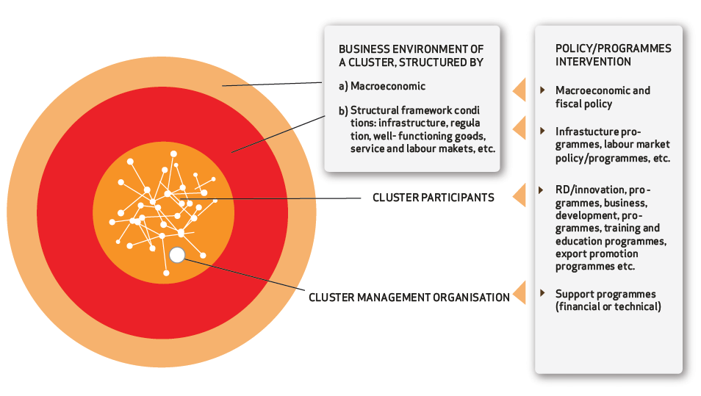
CLUSTER / DISTRICTS:
Geographic concentration of inteconnected business, suppliers and associated institutions in a specific field

Slide 3
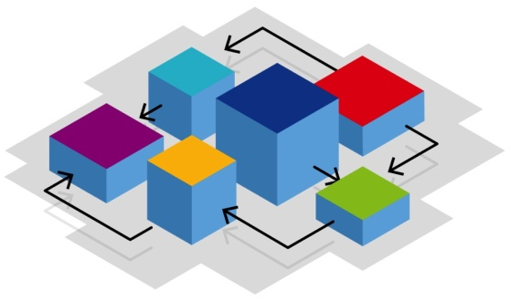
Traditional industrial sectors
Enterprises, Institutions, Agencies,…
INDUSTRY CLUSTER
High technology sectors
Enterprises, Institutions, Universities, Technology Parks,…
TECHNOLOGY CLUSTER
Infrastructures and research&innovation policies

Slide 4
Creativity and non technology innovation
Enterprises, Institutions, Creative centers, Fundations, ..
CREATIVE CLUSTER
Enterprises, Institutions, Universities, Cultural bodies,…
CULTURAL CLUSTER
Cultural resources

Slide 5
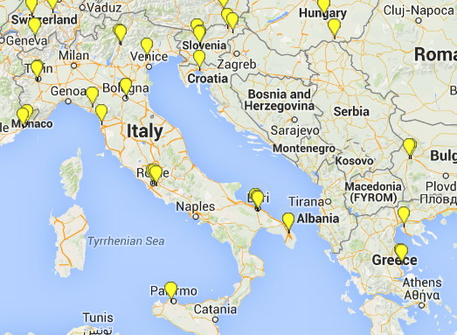
A living lab is a user-centred, open-innovation ecosystem, often operating in a territorial context, integrating concurrent research and innovation processes within a public-private-people partnership
Imprese, Istituzioni, Enti di ricerca,
“end users”
LIVING LAB
Rete ENoLL: European Network of Living Labs

Slide 6
RETI D’IMPRESA (ENTERPRISE NETWORK)
Network contract (Contratto di rete) (IT Law n. 99/2009)
CARATTERISTICHE:
Undersigned by 2 or more enterprises
Common programme aimed at increasing individual and collective innovation skills and competitiveness
Registered at a Chamber of Commerce
Common board
Common financial fund
Governance & mangement established in the contract
(decisions, adhesions, withdrawals)

Slide 7
RETI D’IMPRESA
“Contratti di rete” (Italy – up to 4.5.2015) = 2.152
n. enterprises (Italy – up to 4.5.2015) = 10.765
n. enterprises (RAI up to 4.5.2015) = 4.451

Slide 8
RETI D’IMPRESA
n. enterprises in network contracts (Italy)
Trend 2015
1303
(1.1.2015-1/5/2015
Geographical extension of the networks
(Friuli Venezia Giulia)

Slide 9
CLUSTER: TYPES
Horizontal cluster NACE codes (ATECO)
Vertical cluster supply chain (filiere)
Spontaneus cluster enterprise networks (reti d’impresa)

Slide 10
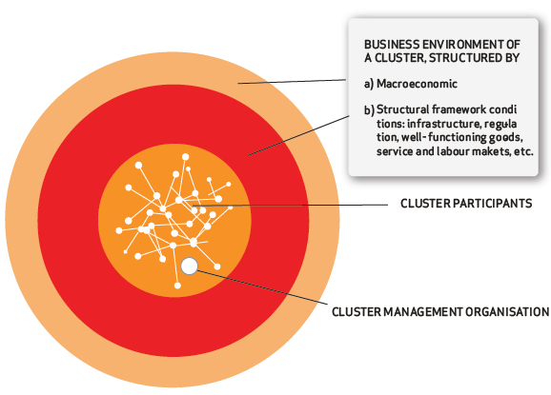
CLUSTER PARTICIPANTS

Slide 11


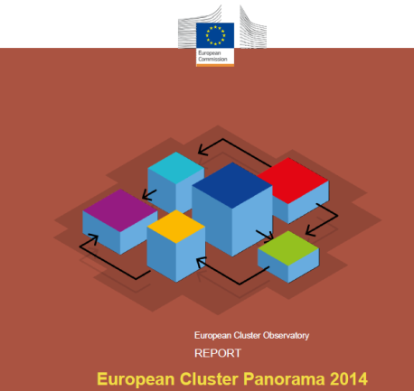

CLUSTER: POLICIES
Smart Specialization Strategy (S3)
Technologies clusters
Emerging industries Clusters
Creative & Cultural Clusters (Tourism)

Slide 12
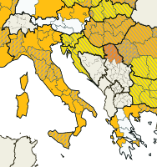
SMART SPECIALIZATION STRATEGY (S3)
Com(2010)553: Regional policy contributing to smart growth in Europe 2020
Regulation (EU) n. 1303/2013: common provisions on the new structural funds 2014-2020

Slide 13
SMART SPECIALIZATION STRATEGY (S3)

Slide 14
ITALIAN TECHNOLOGY CLUSTERS

Slide 15
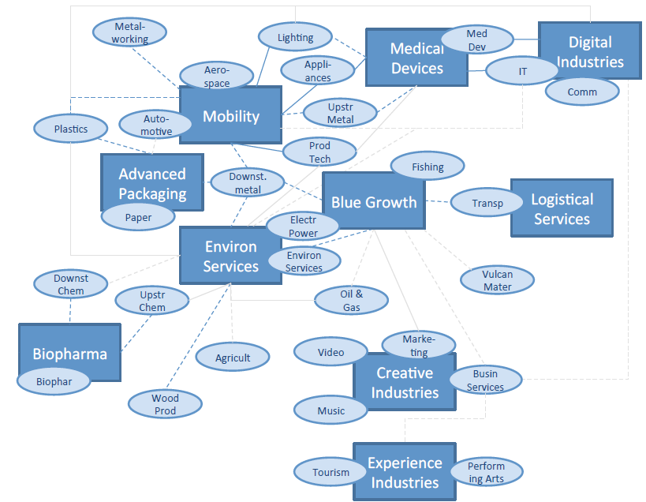
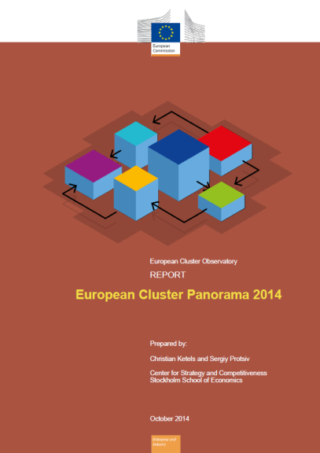
CLUSTERS AND EMERGING INDUSTRIES

Slide 16
CLUSTER: OBSTACLES & OPPORTUNITIES

Slide 17


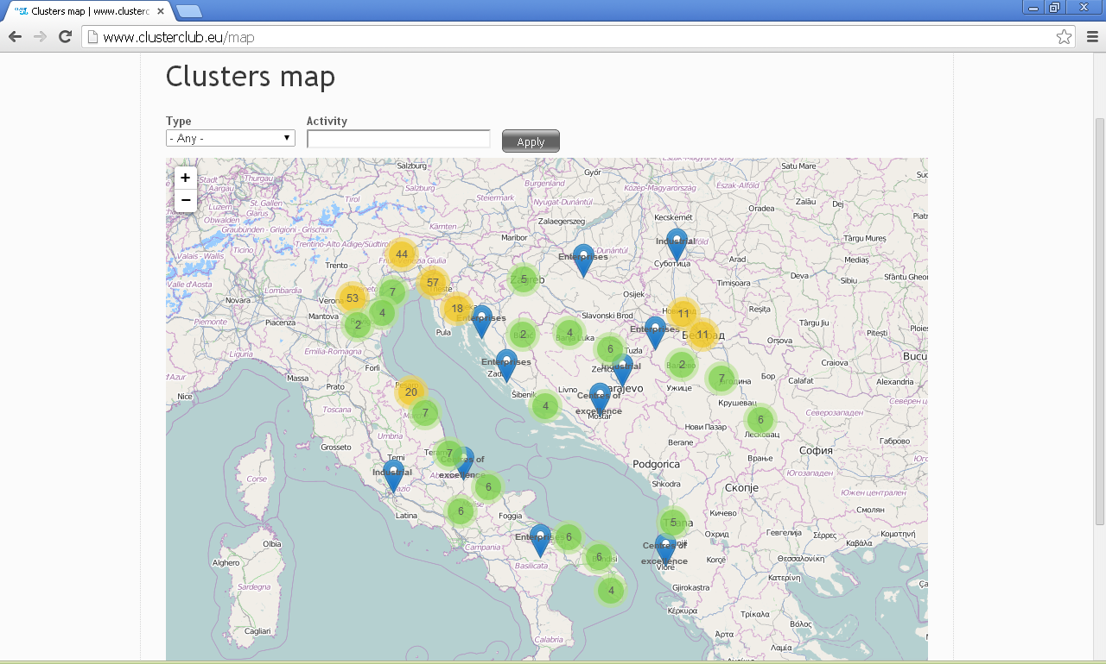
MAP OF THE INDUSTRIAL CLUSTERS & CENTERS OF EXCELLENCE IN NAVAL AND NAUTICAL SECTORS IN ADRIATIC AREA
RESULTS:
n. of cluster mapped = 42
n. of cluster centre of excellence mapped = 53
n. enterprise involved = 327
B2B = 350 enterprises / 1020 meetings
Cluster animation meetings = 142 participants / 42 cluster
www.clusterclub.eu

Slide 18
  GRAZIE!
  THANK YOU!
  FALEMINDERIT!
  Luca Penna
  Azienda Speciale ConCentro – CCIAA Pordenone
  www.pn.camcom.it
  luca.penna@pn.camcom.it

