Slide 1
« How to succeed in doing a cluster strategy? »
DICK Marie-Noëlle
Cluster software.brussels
Notes:
In the last decade, clustering has become a new concept for economic development. A large number of countries and regions are inspired by cluster theories and use elements of it to promote innovation, progress and growth.
Even if clustering, as an economic development strategy is still a new phenomenon, we cansee some success stories that show the important positive effects which can be obtained when cluster concepts are implemented correctly.

Slide 2
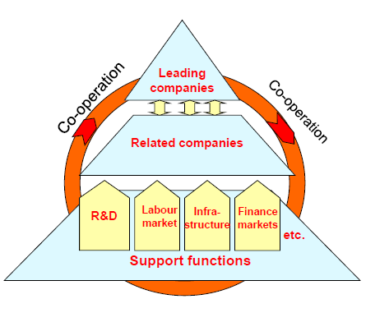
1. What is a cluster?
A geographical concentration of specialized companies and related companies, Research & Development institutions, finance institutions, public actors, and with relations and cooperation between these actors.
Notes:
Clusters are groups of specialised enterprises – often SMEs – and other related supporting actors that cooperate closely together in a particular location. In working together SMEs can be more innovative, create more jobs and register more international trademarks and patents than they would alone.

Slide 3
2. The cluster software.brussels
170+ high-growth potential software companies
Private & government support organizations
Universities and research institutions
Experts
all dedicated to the Brussels software industry.

Slide 4
2. The cluster software.brussels
Specificity of the cluster: public initiative
Subsidized by the government: no membership fees asked to the companies
= Cluster is independent from its partners
= Cluster is independent from any public intervention on the strategy, BUT same objective: economic development!
Notes:
The objective is to facilitate and reinforce drastically the economic development and the competitiveness of the Brussels-Capital region.

Slide 5
2. The cluster: Key Figures
since 2011
Notes:
We provide a unique business-oriented platform where members can share knowledge and best practices. We create opportunities to foster local and international collaborations in which members can simultaneously find specific answers to their business needs and technological challenges.

Slide 6
2. The cluster software.brussels
Which services do we provide to our members?
Workshops, Working Groups & Training Programs
Individual support programs
Networking and visibility
Internationalization
Talent and Expertise
Notes:
We provide a unique business-oriented platform where members can share knowledge and best practices. We create opportunities to foster local and international collaborations in which members can simultaneously find specific answers to their business needs and technological challenges.

Slide 7
3. 4 success factor
Seeking complementarity
Being a key interface
Gathering business
Being prospective
Notes:
Four succes factor which will lead to innovation and competitiveness

Slide 8
1. Seeking complementarity
Gathering companies and creating a platform: Is good but not enough!
➔ Partners
Cluster = interface that launches initiatives with partners or that reinforces a partner’s initiative.

Slide 9
1. Seeking complementarity
Cluster Internationalization:
Enterprise Europe Network (EEN) and National Contact Points (NCP)
➔ Help SMEs finding partners abroad
➔ Provide information and personalized support to apply on funding opportunities
Brussels Invest and Export (BIE)
➔ foreign trade and foreign investment department
Notes:
- Helping Brussels companies to expand into international markets
Prospecting among foreign companies and assisting them in planning their strategic relocation to Brussels
Een + ncp: quels sont leur besoins - visibilité, être en contact avec les entreprises
BIE ne connait pas les entrreprises/ secteurs

Slide 10
2. Being a key interface
Providing added-value and unique services
Feeling of ownership for the members
Cluster = crucial actor for SMEs in a specializied sector located in a region

Slide 11
2. Being a key interface

Slide 12
2. Being a key interface
Organization of Working groups on crucial topics for SMEs companies:
« Academic collaboration, recruitment and training »
« Export »

Slide 13
3. Gathering business
Difficult to attract the interest of the companies and to involve them in a network ➔ too many initiatives
Cluster = Business provider

Slide 14
3. Gathering business
Organization of networking events with the members
➔ Knowledge exchange
➔ Partnership
Organization of forums with investors
➔ Visibility
➔ Networking exchange
➔ Business

Slide 15
5. Being prospective
We need to help the companies being aware of the future opportunities
Cluster = Technological watch

Slide 16
5. Being prospective
Virtual Reality:
« By 2018, the Augmented Reality market is expected to reach $659.98 million and the Virtual Reality market is estimated to total $407.51 million.

Slide 17
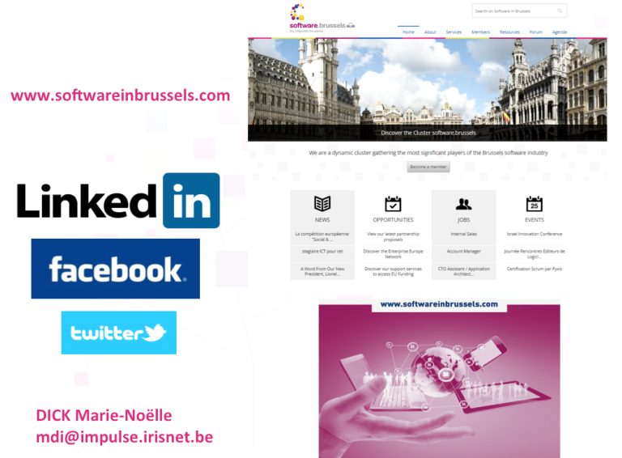
6. Get in touch

