Slide 1
WORKGROUP FOR ECONOMIC ANALISYS
“Diversity as a Potential”
Regional competitiveness and smart specialization
Vinko Muštra, Asistant professor
Chair person of the Summer school Programme
Chair person of the Organizing committee - International Conference Challenges of Europe
Faculty of Economics, Business and Tourism, University of Split
Croatia
SPLIT, 17 October 2018, Hotel Radisson Blu, Split

Slide 2
Regional Competitiveness
Different aproach to defining competitivness:
- productivity and competitivness
- prosperity and competitivness
Regional competitiveness can be defined as the ability to offer an attractive and sustainable environment for firms and residents to live and work.(Dijkstra et al. 2011.)
Notes:
Krugman (1994):
It is misleading and incorrect to make an analogy between a nation and a firm; for example, whereas an unsuccessful firm will ultimately go out of business there is no equivalent “bottom-line” for a nation.
Whereas firms can be seen to compete for market share and one firm’s success will be at the expense of another’s, the success of one country or region creates rather than destroys opportunities for others and trade between nations is well known not to be a ‘zero-sum game.’
If competitiveness has any meaning then it is simply another way of saying productivity; (growth in national living standards is essentially determined by the growth rate of productivity)
Regional competitiveness?
As a starting point, a definition for regional competitiveness comes from the Sixth Periodical Report on the Regions (1999):
“[Competitiveness is defined as] the ability to produce goods and services which meet the test of international markets, while at the same time maintaining high and sustainable levels of income or, more generally, the ability of (regions) to generate, while being exposed to external competition, relatively high income and employment levels’.”
Meyer-Stamer (2008) states that: ‘We can define (systemic) competitiveness of a territory as the ability of a locality or region to generate high and rising incomes and improve the livelihoods of the people living there.’

Slide 3
Regional Competitiveness and Measuring
Measuring Regional Competitivness?
It should balance the goals of business success with those of personal well-being.
It should include short and long period perspective.
It should carefully define spatial coverage (political, functional or statistical regions)
Different development phase => different needs => different approach
Regional Competitiveness Index (RCI)
Notes:
The 2016 index is based on 74 mostly regional indicators covering the 2012-2014 period, but with a number of indicators from 2015 and 2016.
Important notice:
Data is based on the statistical, NUTS 2 regions.
Two pillars are described at the country level only: Macroeconomic stability and Quality of Primary and Basic Education.
The Institutions and Technological Readiness pillars comprise two sub-pillars: one at the national level and the other at the regional level
All the indicators come from official and publicly available sources, mainly regional statistics from Eurostat, but also the World Bank Worldwide Governance Indicators, the Global Competitiveness Indicators by the World Economic Forum, the Quality of Government Index by the Quality of Government Institute, the Programme for International Student Assessment (PISA) indicators by the OECD, Scopus indicators on publications by Science-Metrix, innovation indicators from the Regional Innovation Scoreboard project, and other indicators developed by the Directorate-General for Regional and Urban Policy

Slide 4
Regional Competitiveness Index
Regional Competitivness Index (RCI) has published by the European Commission in 2010, 2013 and 2016 (Annoni and Kozovska, 2010; Dijkstra, Annoni and Kozovska, 2011; Annoni and Dijkstra, 2013)
The RCI is based on the statistical, NUTS 2 (Nomenclature of Units for Territorial Statistics.
The RCI is composed of 11 pillars combined in three groups of factors.
  Basic
  Efficiency
  Innovation
Notes:
RCI does not apply a one-size-fits-all approach to competitiveness. On the contrary, it assumes that the focus in less developed economies should be different than in intermediate or highly developed economies.
RCI does not include factors which fall outside the scope of public policies, or which can hardly be affected by public intervention (climate, presence of natural resources..)
The RCI is composed of 11 pillars that describe the different aspects of competitiveness and combine in three groups of factors.

Slide 5
Regional Competitiveness Index
Basic:
(1) Institutions,
(2) Macroeconomic Stability,
(3) Infrastructures,
(4) Health,
(5) Quality of Primary and Secondary Education

Slide 6
Regional Competitiveness Index
  Efficiency
(6) Higher Education, Training and Lifelong Learning,
(7) Labour Market Efficiency,
(8) Market Size

Slide 7
Regional Competitiveness Index
  Innovation:
(9) Technological Readiness,
(10) Business Sophistication,
(11) Innovation

Slide 8
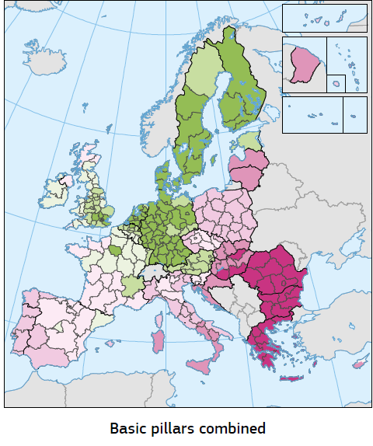
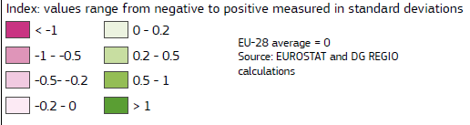
Regional Competitiveness Index 2016
  Basic - TOTAL
Source: EC, 2017
Notes:
Standardna devijacija je statistički pojam koji označava mjeru raspršenosti podataka u skupu. Interpretira se kao prosječno odstupanje od prosjeka i to u apsolutnom iznosu

Slide 9
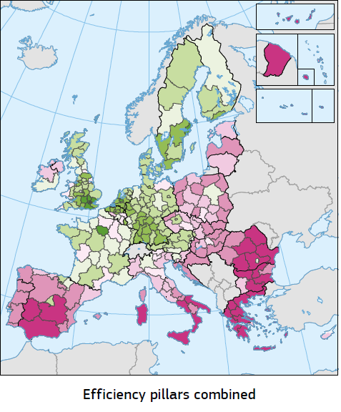
Regional Competitiveness Index 2016
  Efficiency group
  Results for Efficiency group
Source: EC, 2017

Slide 10
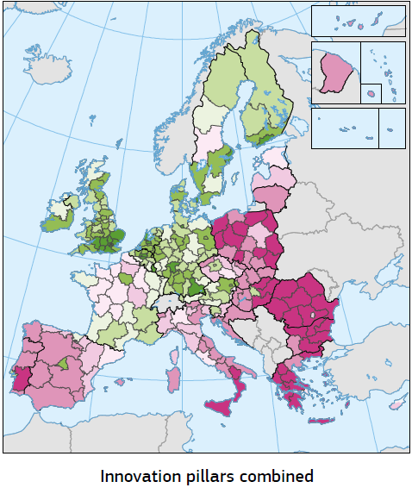
Regional Competitiveness Index 2016
  Innovation group
  Results for Innovation group
Source: EC, 2017

Slide 11
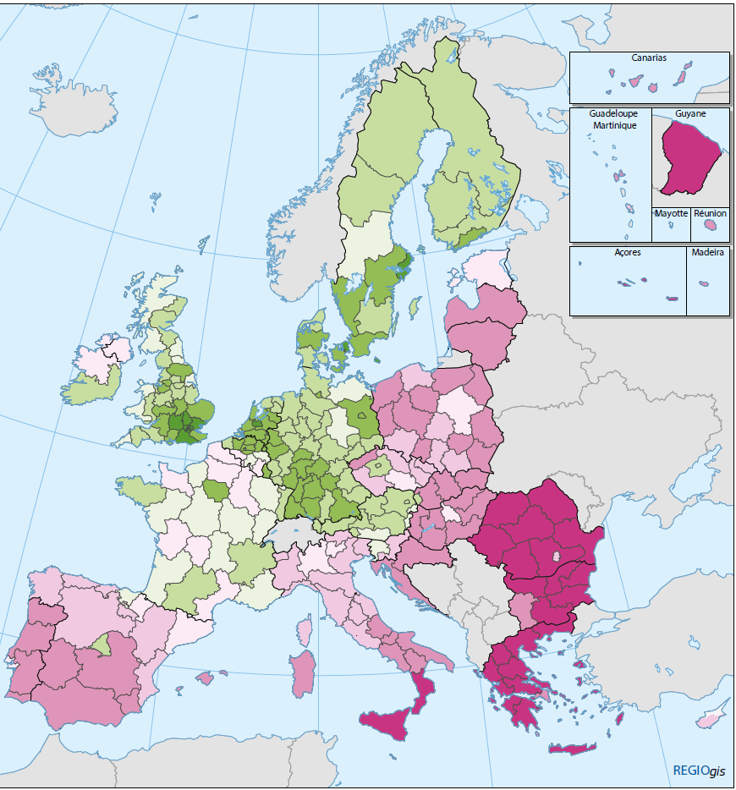
Regional Competitiveness Index 2016
  Total results
Conclusions?
RCI shows a more polycentric pattern with
strong capital and metropolitan regions in many parts of Europe
RCI shows that the Basic group has the least within-country variability, while the Efficiency group and especially the Innovation group vary more!
Source: EC, 2017

Slide 12
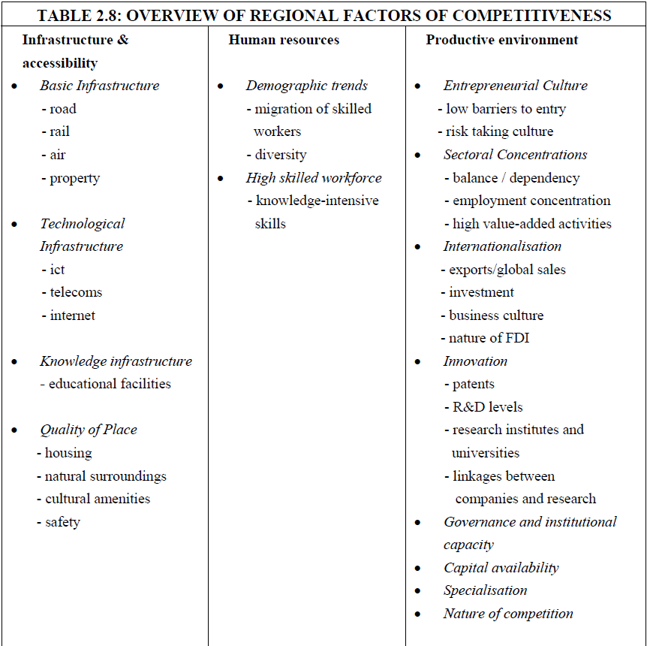
Regional Competitiveness Index 2016 and Smart specialization
Economic literature underlines the importance of Innovation for growth and development and RCI offers evidence for huge differences among regions!
Source: EC, 2012
Source: EC, 2017

Slide 13
Regional Competitiveness Index 2016 and Smart specialization
Economic literature underlines the importance of Innovation for growth and development and RCI offers evidence for huge differences among regions!
European Commission (COM(2010) 553 final) is focused to unlock the growth potential of the EU through identifying activities that offer the best chance of strengthening a region’s competitiveness, while encouraging interaction between businesses, research centres and universities on the one hand and local, regional and national administrations on the other!
In 2014, the European Commission adopted a Communication on ‘Research and innovation as sources of renewed growth’ (COM(2014) 339 final) which proposed that EU Member States should seek to actively support growth enhancing policies, notably through research and innovation!
Innovation as a solution…
But…

Slide 14
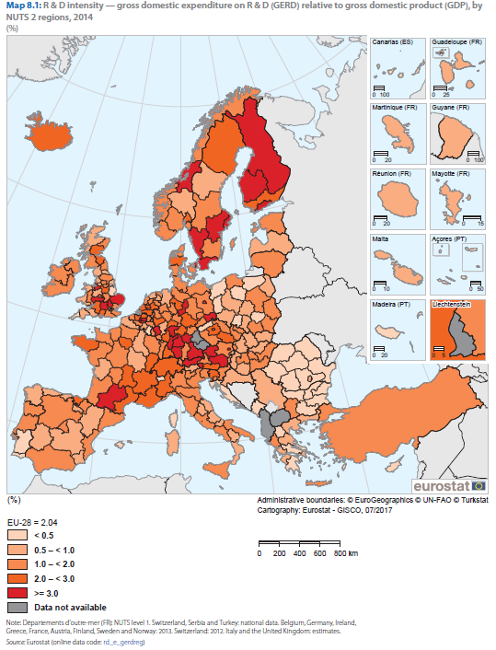
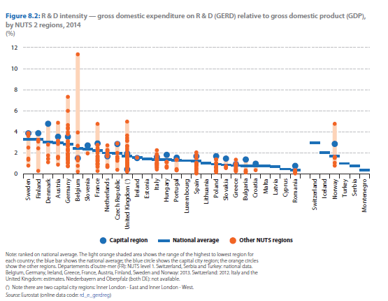
Regional Competitiveness Index 2016 and Smart specialization
Innovation reality check in EU
High regional disparities between and within many EU Member States
Most southern and eastern regions had relatively low levels of R & D intensity
Northern capital cities have the largest levels of R & D intensity
Source: EC, 2017

Slide 15
Regional Competitiveness Index 2016 and Smart specialization
Innovation reality check in EU
Innovation as a solution…
…but key factors for developing Innovation activites are concatranted in capital regions of old (north) member countries…
Is there any hope for less developed, remoted regions ?

Slide 16
Smart Specialisation
"Smart Specialisation is a strategic approach to economic development through targeted support to Research and Innovation"
What is Smart Specialisation ?
= evidence-based: all assets
= no top-down decision, but dynamic/entrepreneurial discovery process inv. key stakeholders
= global perspective on potential competitive advantage & potential for cooperation
= source-in knowledge and technologies etc. rather than re-inventing the wheel
= priority setting in times of scarce resources
= getting better / excel with something specific
= focus investments on regional comparative advantage
= accumulation of critical mass
= not necessarily focus on a single sector, but cross-fertilisations
Notes:
16
Smart =
- evidence-based: SWOT analysis & foresight, taking all assets of a region into account, in particular industrial structures, science, technology and training capacities, skills, environment, market access, but also "difficult assets" (aging population, remote position, rough climate …),
- no top-down decision, but: self-discovery process (Hausmann and Rodrik 2004) with stakeholders to identify potential, actors, cross-fertilisation potential, etc. - possibly using creative problem solving / brainstorming tools (= "help them discover what they know themselves") and developing the smart specialisation concept
- look beyond borders: global perspective to be able to assess potential of competitive advantage compared to other specialised regions & potential for cooperation
- source in knowledge, technologies etc. rather than re-inventing the wheel.
Specialisation =
- priority setting (not "coffee for all")
- getting better (than others) with something concrete, rather than doing a little bit of everything, but without becoming a master in it
- accumulation of critical mass (be it internal to the region or via external insourcing & cooperation)
not necessarily focus on a single industrial / service sector (or individual company), but cross-sectoral
When looking at potential new activities analyse if they are technologically related to existing strengths, as evidence from evolutionary economic geography, especially the concept of 'related variety' shows that this creates the best for success (combination of embededness + relatedness)
Canary island example on how to go about this by specializing through the adaptation of a generic technology – ICT in the tourism sector: a recently internationally awarded ERDF island project in the Balearics which is a new on-line booking system called Avanthotel.
Avanthotel is an enterprising public-private partnership supported by the ERDF, within the framework of the Balearic Islands first innovation strategy promoted by the EU Commission, enabled local businesses, mainly small hotels, to align on customer demand, embrace ICTs and reconnect with a new generation of holidaymakers. In 2007 it involved over 450 companies with a total turnover of over 6m € and annual growth rates above 100%.

Slide 17
In a nutshell:
Smart Specialisation is based on 4 Cs
Smart Specialisation
Competitive advantage: match R&I with business and develop links (related variety); adoption of (generic/new) technologies for diversification/modernisation of sectors + explore emerging areas
Policy Choices (tough ones): select few priorities on basis of specialisation & integration in international value chains
Critical mass of resources & talent: cooperation between regions by avoiding duplication and fragmentation
Collaborative Leadership: involve stakeholders from academia, businesses, public administrations and civil society ("quadruple helix") & synergies between funding instruments (EU, national, regional)
Notes:
It should prioritise domains, areas and economic activities where regions or countries have a competitive advantage or have the potential to generate knowledge-driven growth and to bring about the economic transformation needed to tackle the major and most urgent challenges for the society and the natural and built environment. The number and nature of these priorities will vary from region to region. Note however, that although a first set of priorities should be identified when the S3 is designed, they can be changed or modified when new information/developments make it advisable.
Priorities could be framed in terms of knowledge fields or activities (not only science-based, but also social, cultural and creative ones), sub-systems within a sector or cutting across sectors and corresponding to specific market niches, clusters, technologies, or ranges of application of technologies to specific societal and environmental challenges or health and security of citizens (e.g. ICT for active ageing, mobility solutions to reduce traffic congestion, innovative material solutions for eco-construction, etc.). While some regions or countries may prioritize one or more Key Enabling Technologies (KETs), others will focus on applications of such technologies to specific purposes or defined fields.

Slide 18
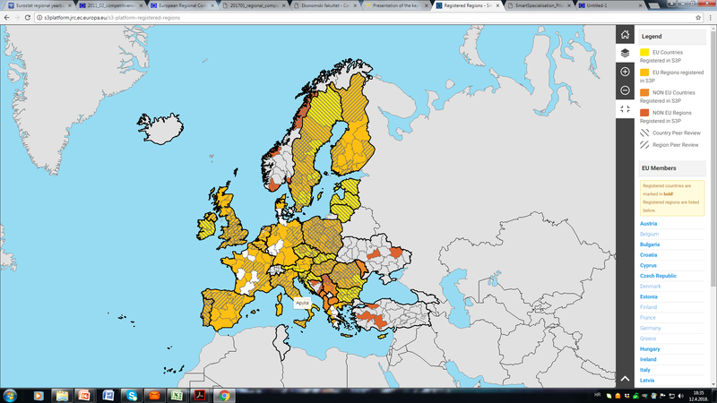

Smart Specialisation
Smart specialization in practise…?
Smart specialization in practise…????

Slide 19
Smart Specialisation in practise..
RIS3 has been described as “the largest innovation policy experiment in the world” (Radosevic et al, 2018)
No coorelation between development stage and implementation rate.
Strong coorelation between development stage and co-financing rate => less oportunity to experiment with policies inativties for less developed regions (Morgan and Marques, 2018)
Source: Morgan and Marques, 2018

Slide 20
Smart Specialisation in practise..
Key messages and Major challenges (especially for less developed regions):
It places huge demands on the public sector, in both the design and implementation stages => low capacity in public sector
Crucial role of An Entrepreneurial Discovery Process (EDP) utilizing entrepreneurial knowledge existing in a region or country => limited demand in private sector for strategic investment and EDP dominated by insiders
It is intended as an experimental policy tool => but operates within a rigid (Low quality) regulatory environment

Slide 21
Thank you for your attention!
Notes:
Explain performance reserve in this slide:
Linked to the programmes: 6% of all OPs are frozen until end 2018. After submission of the Annual Implementation Report by end June 2019, or in the progress report, the EC decides which priorities achieved milestones, detailed by region/fund end August 2019 – review of the programmes. If the priority axes of the OP have met the milestones and therefore are on track to achieve objectives by the end of the period, the 6% are unfrozen. If the priority axis isn't well on track, the 6% are at disposal of another priority axis, if necessary in another OP that works well. Necessary reprogramming is then undertaken.

Slide 22
Appendix

Slide 23
Regional Competitiveness Index 2016
Basic group
(expactations for A-I regions?)

Slide 24
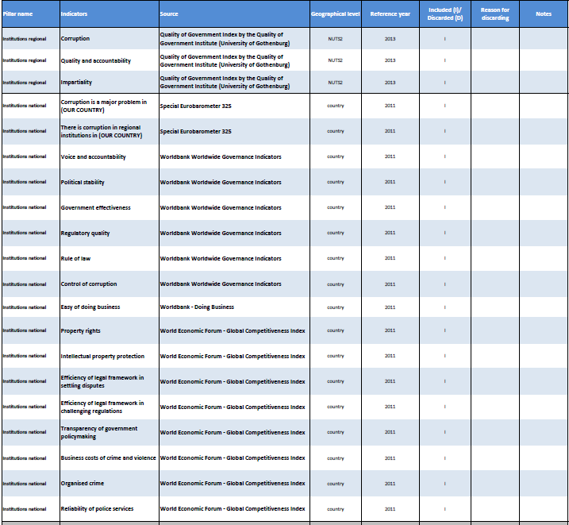
Regional Competitiveness Index 2016
  Basic
  Institutions (National and Sub national level data)

Slide 25
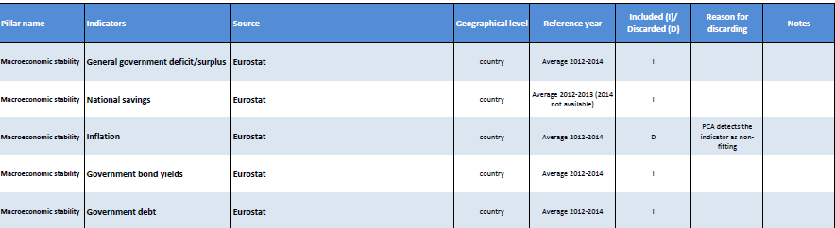
Regional Competitiveness Index 2016
  Basic
  Macroeconomic stability

Slide 26
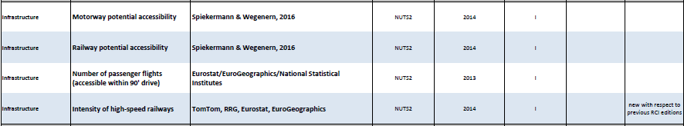
Regional Competitiveness Index 2016
  Basic
  Infrastructure

Slide 27
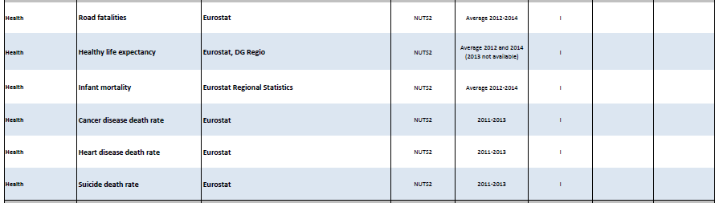
Regional Competitiveness Index 2016
  Basic
  Health

Slide 28
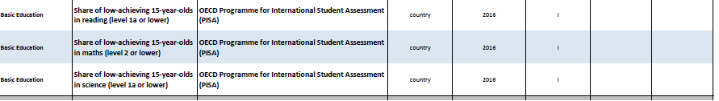
Regional Competitiveness Index 2016
  Basic
  Primary and Secondary Education

Slide 29
Regional Competitiveness Index 2016
  Basic - TOTAL
Notes:
Standardna devijacija je statistički pojam koji označava mjeru raspršenosti podataka u skupu. Interpretira se kao prosječno odstupanje od prosjeka i to u apsolutnom iznosu

Slide 30
Regional Competitiveness Index 2016
  Efficiency group

Slide 31
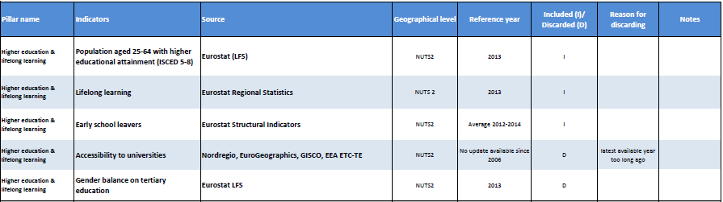
Regional Competitiveness Index 2016
  Efficiency group
  Indicators for Higher Education, Training and Lifelong Learning

Slide 32
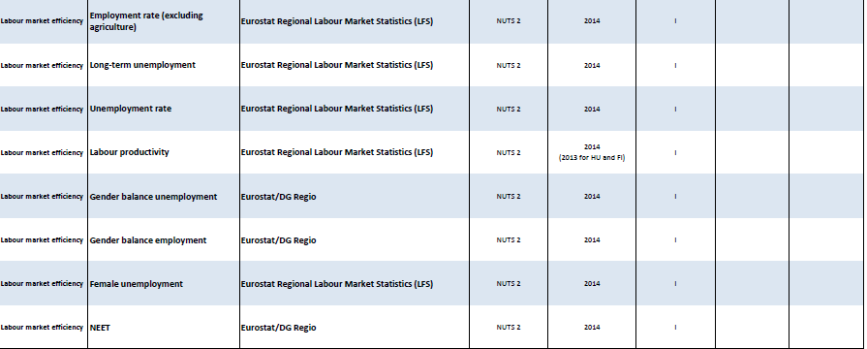
Regional Competitiveness Index 2016
  Efficiency group
  Indicators for Labour Market Efficiency

Slide 33
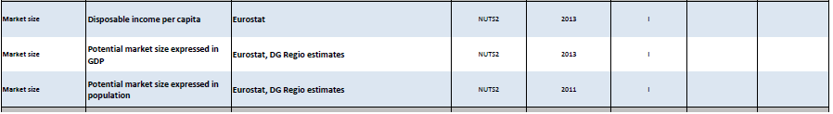
Regional Competitiveness Index 2016
  Efficiency group
  Indicators for Market Size

Slide 34
Regional Competitiveness Index 2016
  Efficiency group

Slide 35
Regional Competitiveness Index 2016
  Efficiency group
  Results for Efficiency group

Slide 36
Regional Competitiveness Index 2016
Innovation group

Slide 37
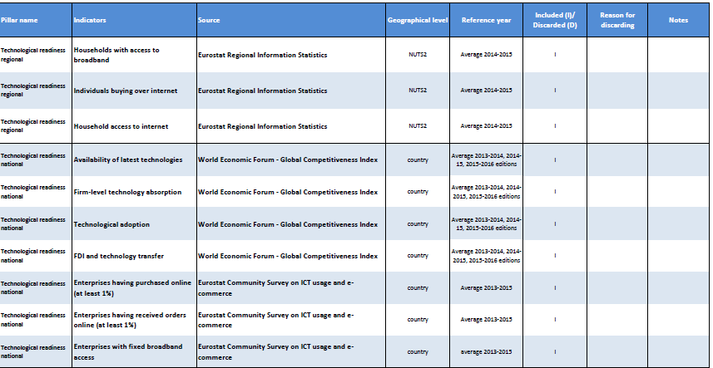
Regional Competitiveness Index 2016
  Innovation group
  Indicators for Technological Readiness

Slide 38
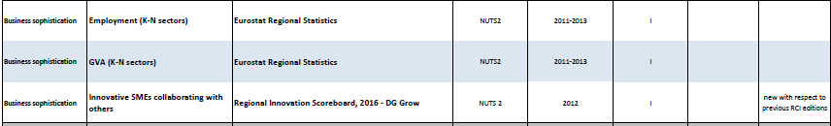
Regional Competitiveness Index 2016
  Innovation group
  Indicators for Business Sophistication

Slide 39
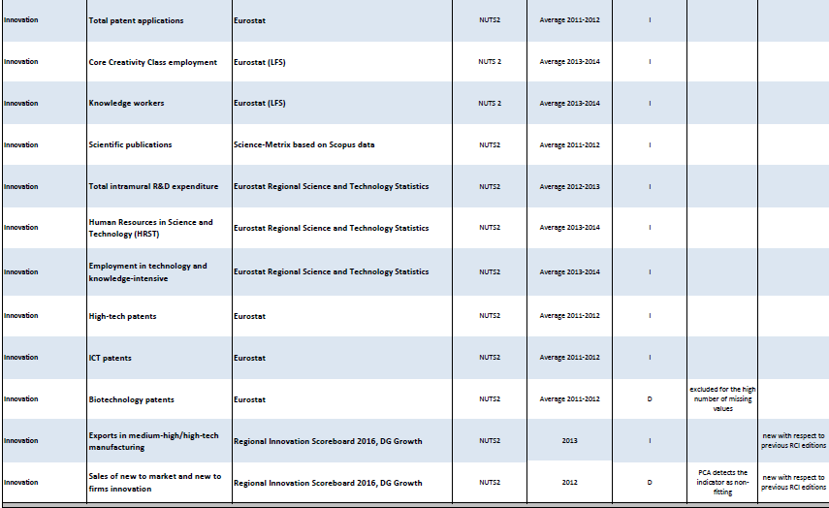
Regional Competitiveness Index 2016
  Innovation group
  Indicators for Innovation

Slide 40
Regional Competitiveness Index 2016
  Innovation group

Slide 41
Regional Competitiveness Index 2016
  Innovation group
  Results for Innovation group

