Slide 1
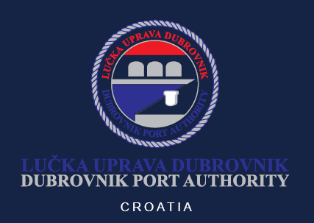
Port of Dubrovnik - Passenger port development 1st Joint Forum Conference of the Adriatic-Ionian Chambers of Commerce, Cities and Universities 17th Oct 2018
Notes:
Poštovana gospođo predsjednice Vlade, gospodine Ministre, dame i gospodo, gospođe i gospari, dragi gosti i uzvanici,
Okupili smo se danas ovdje u Dubrovniku, jednom od gradova simbola hrvatske pomorske tradicije kako bi nazočili otvorenju iznimnog infrastrukturnog projekta u luci Gruž- nastavku gradnje operativne obale Batahovine.

Slide 2
Contents
Basic information
History, location, legal aspects
Traffic data
Cruise industry stakeholders
Economic impact
Port Development Plans

Slide 3
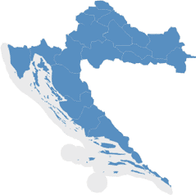
Port Authorities in Croatia
6 State Port Authorities open for international public traffic:
Port Authority of Dubrovnik
Port Authority of Ploce
Port Authority of Split
Port Authority of Sibenik
Port Authority of Zadar
Port Authority of Rijeka
22 County Port Authorities
Members of the Port Authorities Community, ESPO, MedCruise (the Association of Mediterranean Cruise Ports)
RIJEKA
ZADAR
ŠIBENIK
SPLIT
PLOČE
AIVP - The worldwide network of port cities
DUBROVNIK

Slide 4
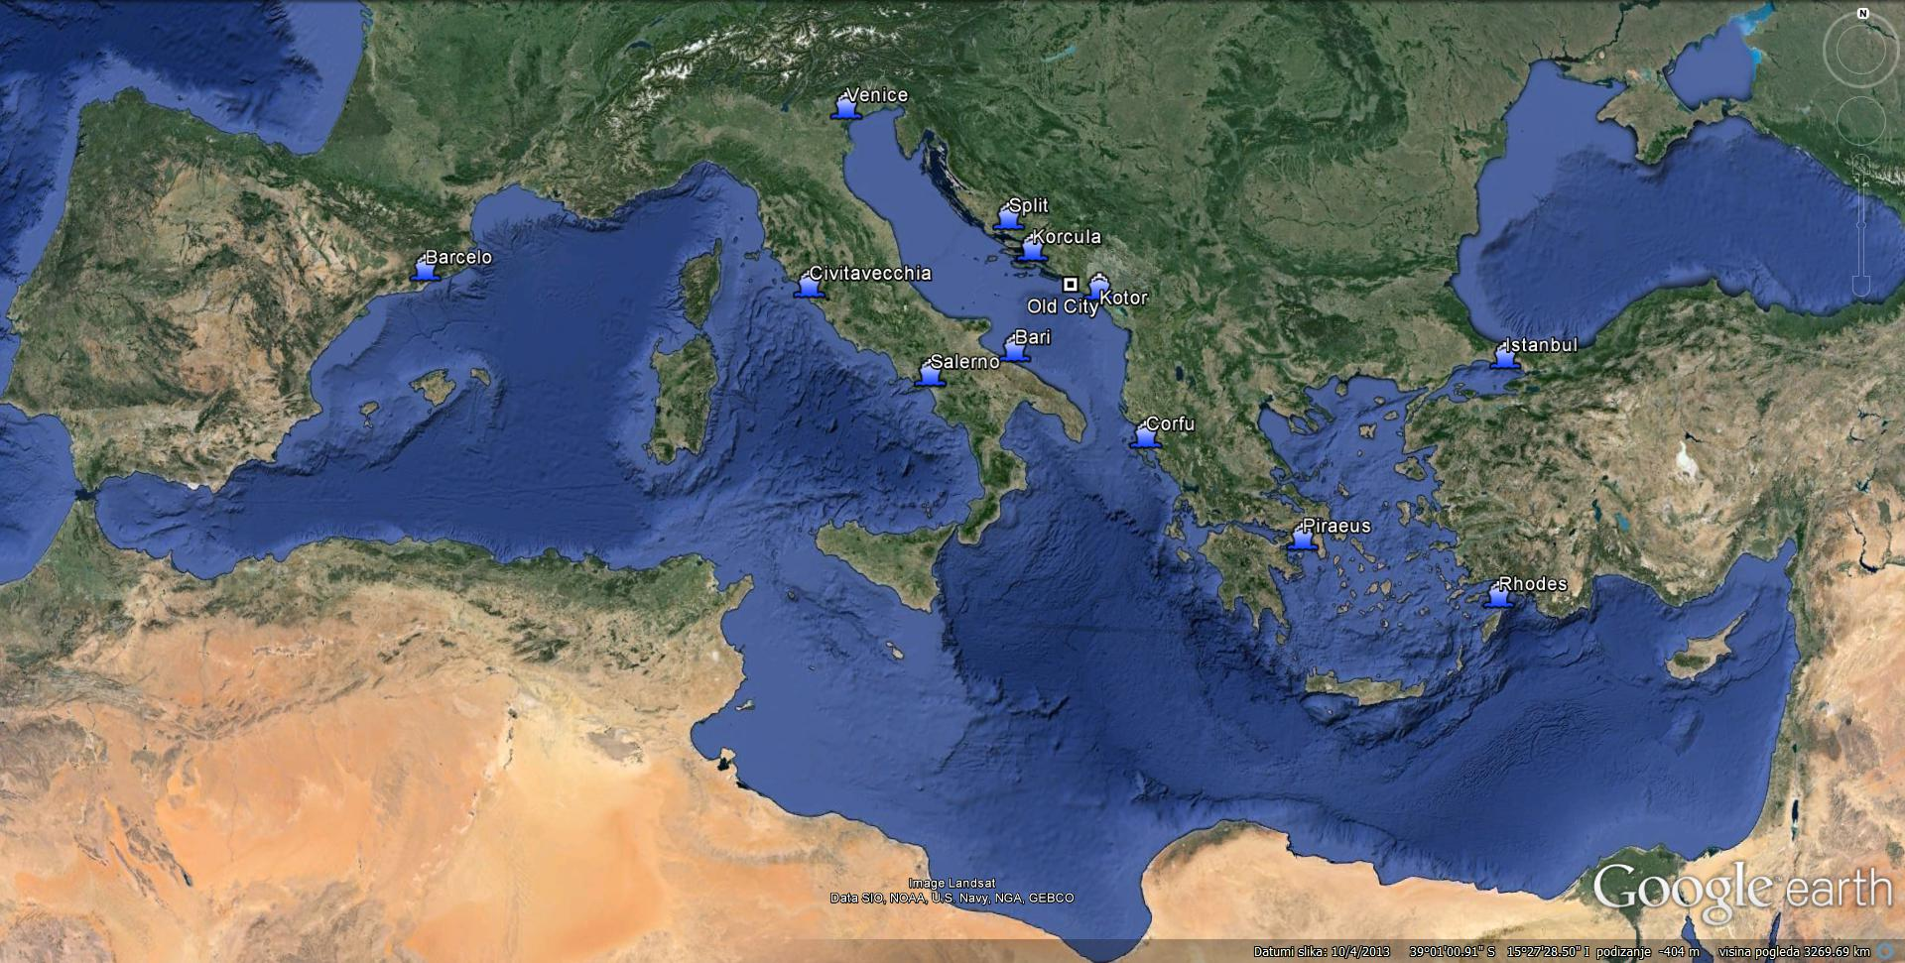
Geographical position

Slide 5
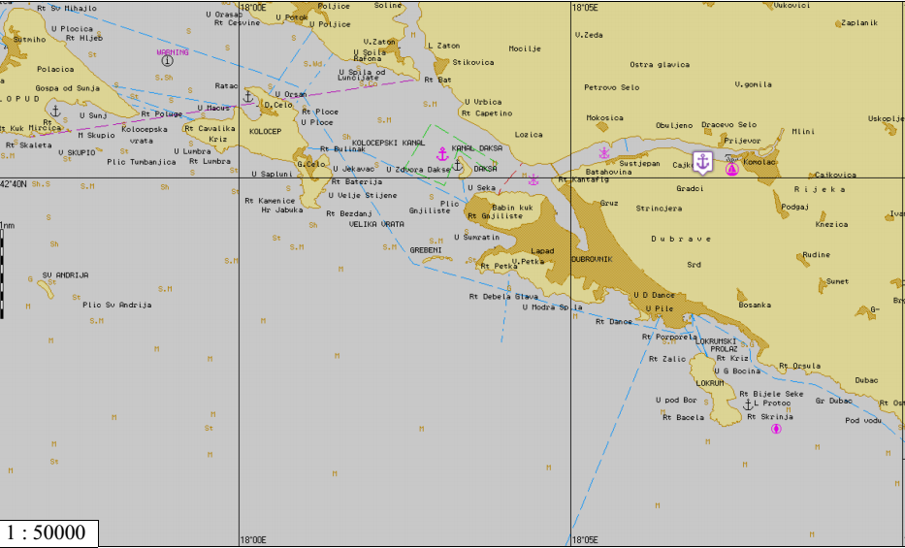
Dubrovnik „one destination - two ports”

Slide 6
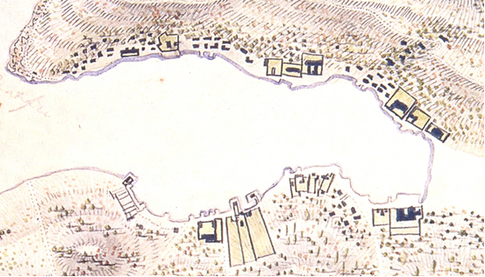
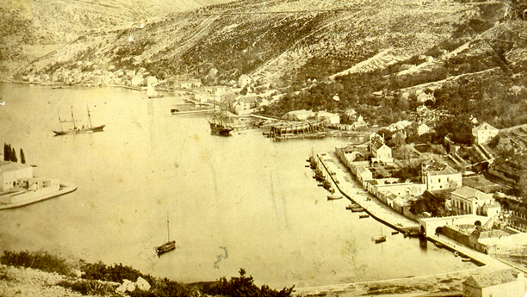
Port of Dubrovnik - history
Before 1667
Beginning of 19th century
1873

Slide 7
Milestone of cruise history
10th August 1844 steam ship BARONE STUERMER arrived from Trieste with 153 pax on „voyage of pleasure”
Before 1st WW s/s: SENEGAL, VECTIS, ARGONAUT, VITTORIA, METEOR, PRINZESSIN VICTORIA LUISE, SALSETTE, ORMUZ, DUNOTTAR CASTLE, FRANCE...
30th March 1931 on s/s THEOPHILE GAUTIER with Bernard Shaw arrived in Dubrovnik
Between 1st & 2nd WW arrived in Dubrovnik: AQUITANIA, ATLANTIS, BRITANNIC, GENERAL VON STEUBEN, MONTE ROSA, SIERRA CORDOBA, ORION, ORCA, ORONTES, ORCADES, ORONSAY, LANCASTRIA, RANCHI, CARINTHIA, STRATHNAVER, STRATHMORE, STRATHAIRD, VULCANIA, SATURNIA, ARANDORA STAR, LEOPOLDVILLE, VOLTAIRE, BATORY, SLAMAT, ROMA, OCEANIA, HELLAS, STELLA POLARIS, CAMPONA, MILWAUKEE, MEXIQUE, ORION, EMPRESS OF AUSTRALIA, EMPRESS OF CANADA, EMPRESS OF FRANCE, EMPRESS OF SCOTLAND, MOLDAVIA, ORFORD, SAMARIA, OTRANTO, VICEROY OF INDIA, CONTE ROSSO, CALGARIC, LAPLAND
1935 more then 50 cruise ships visited Dubrovnik
1953 m/v Oslofjord visited Dubrovnik as first ship after 2nd WW
Ships in fifties: REINA DEL MAR, QUEEN ELIZABETH 2, FRANCE, CANBERRA, ANDES, ATHINAI, AKROPOLIS, HERMES, ELLINIS, AUSONIA, INDEPENDENCE, CONSTITUTION, IBERIA, CARONIA, SAGAFJORD, OSLOFJORD, ORIANA, ORSOVA, ORCADES, ANKARA, EMPRESS OF CANADA, NIEUW AMSTERDAM, STATENDAM, LEONARDO DA VINCI
27th September 1991 m/v La Palma – last ship before Croatian War of Independence
7th November 1994 m/v La Palma returned in Dubrovnik

Slide 8
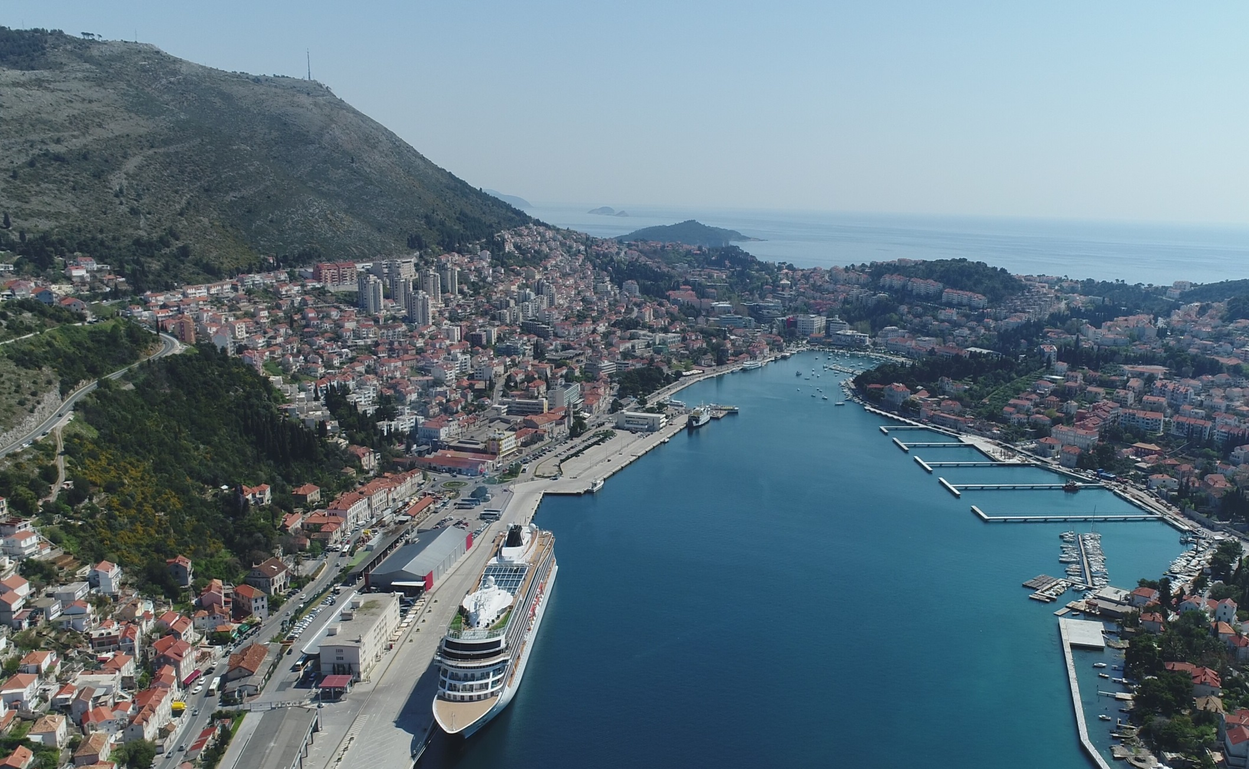
Passenger Port of Dubrovnik

Slide 9
Port Authority of Dubrovnik – legal aspects
Established by Government of Croatia 1997 for development and management of public port
Non profit organization
Main activities:
a. Construction, maintenance, management, supervision, protection and development of maritime domain – port area
b. Management of all kinds of port traffic
c. Providing public services for which economic interests do not exist
d. Granting concessions, supervision and coordination between concessioners

Slide 10
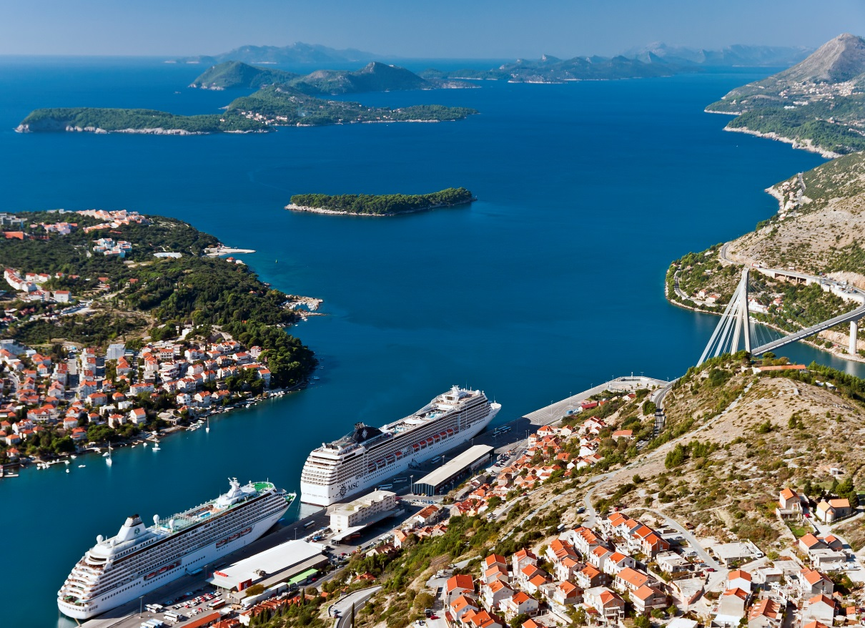
General information
Operative territory surface:
120 000 m²
Founded at the beginning of 20th century
Total length of quays: 1350 m
Number of quays: 7
Draft: 6 – 12 m
Maximum ship dimensions for berthing: unlimited
Distances
Airport: 20 km
Bus terminal: 200 m
City Center: 2 km

Slide 11
Port infrastructure Development plan
NEXT PROJECT
Batahovina II
2020 - 2023
400m (16mil €)
COMPLETED 2011
218m (8mil €)
COMPLETED 2009
825m (26mil €)

Slide 12
Berth particulars
BERTH (no) | LENGTH (m) | DEPTH (m)
7 – 9 | 305 | 5,5 – 6,5
10 – 11 | 605 | 11,0
12 | 220 | 11,0 – 12,0
14 | 218 | 10,0

Slide 13
Anchorage and approaching
navigational channel

Slide 14
Passenger traffic data 2013-2018
Type of traffic | 2013 | 2014 | 2015 | 2016 | 2017 | 2018 expected
Ferry Lines | 418.555 | 427.058 | 441.155 | 496.797 | 569.776 | 586.869
Cruise | 1.086.925 | 844.410 | 812.608 | 833.588 | 748.918 | 768.022
Other | 90.580 | 79.797 | 89.255 | 53.305 | 91.400 | 94.142
Total | 1.596.060 | 1.351.265 | 1.343.018 | 1.383.690 | 1.410.094 | 1.449.033

Slide 15
TRAFFIC FIGURES PORT GRUZ BY CATEGORIES / PERIOD 2013 – 2017
Year / Categories of traffic |  | 2013 | 2014 | 2015 | 2016 | 2017 | Total | %
Domestic passengers | Ferry | 330.118 | 335.072 | 363.649 | 426.329 | 506.159 | 1.961.327 | 29%
 | * Other | 90.580 | 76.470 | 86.135 | 50.300 | 88.400 | 391.885 | 6%
 | Total A | 420.698 | 411.542 | 449.784 | 476.629 | 594.559 | 2.353.212 | 35%
 | % | 29% | 31% | 35% | 35% | 43% | 35%
International passengers | Ferry | 88.437 | 91.986 | 77.506 | 70.468 | 63.617 | 392.014 | 6%
 | Cruise | 942.909 | 806.187 | 768.434 | 800.300 | 704.812 | 4.022.642 | 59%
 | Total B | 1.031.346 | 898.173 | 845.940 | 870.768 | 768.429 | 4.414.656 | 65%
 | % | 71% | 69% | 65% | 65% | 57% | 65%
 | Total A+B | 1.452.044 | 1.309.715 | 1.295.724 | 1.347.397 | 1.362.988 | 6.767.868 | 100,0%
* domestic cruise, daily excursions

Slide 16
Cruise passenger per months 2015/2016

Slide 17
Weekly schedule arrivals of cruise passengers in 2016

Slide 18
Passengers by nationality (2016)
 | Nationality | Pax | Ration in total
1. | UK | 144.387 | 20%
2. | Italy | 129.099 | 18%
3. | Germany | 102.972 | 14%
4. | USA | 64.319 | 9%
5. | France | 43.694 | 6%
6. | Spain | 42.039 | 6%
7. | Switzerland | 21.899 | 3%
8. | Austria | 15.636 | 2%
 | Total top 8. | 564.045 | 76%

Slide 19
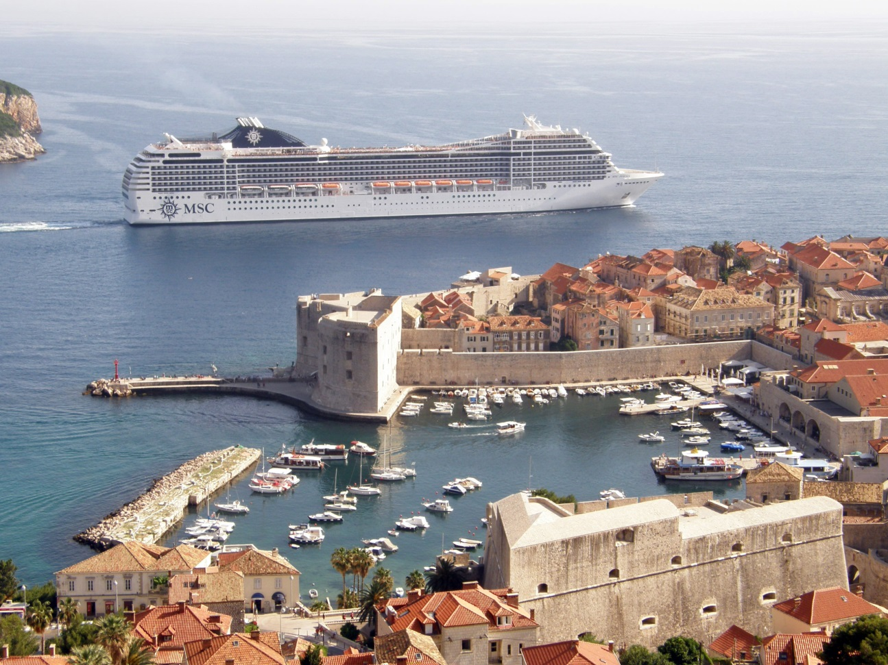
Cruise calls:
2013 - 692
2014 - 577
2015 - 603
2016 - 639
2017 - 539
2018 - 477 expected
Dominant cruise lines:
Costa Crociere
MSC Crociere
Croisimer
Royal Caribbean Cruises
P&O Cruises
Celebrity Cruises
Marella Cruises
TUI Cruises

Slide 20
Cruise Passenger Capacity in the Mediterranean 2016
Company | Ships | Capacity | % Market
Costa Crociere | 11 | 721.404 | 19,0%
MSC | 10 | 706.352 | 18,6%
Royal Caribbean | 9 | 326.794 | 8,6%
Norwegian | 4 | 238.200 | 6,3%
AIDA | 6 | 233.144 | 6,1%
Marella Cruises | 5 | 189.496 | 5,0%
Celestyal | 3 | 162.290 | 4,3%
TUI | 7 | 157.320 | 4,1%
Princess | 5 | 151.698 | 4,0%
Holland America | 5 | 120.768 | 3,2%
Total Top 10 | 65 | 3.007.466 | 79,2%

Slide 21
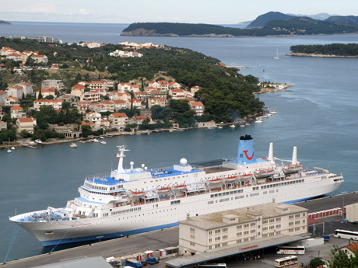
Homeport operations
Home port operations for Marella Cruises since 2015
Passenger ship „Marella Celebration”, every week from May to October (28 calls)
Advantages of being a homeport for cruise ship is the additional revenue from service (flights, hotels accommodation, excursions, transport, taxis etc.)
The importance of positioning Dubrovnik as the turnaround port - homeport lies in the fact that this is the way to extend the stay of tourists in the area and the benefits for the local economy. Homeport for Dubrovnik means a whole new process of cruise tourism.
Number of pax embarked and disembarked in Dubrovnik as part of „Marella Cruises" home port operations:
Year | 2015 | 2016 | 2017
Embarked | 31.168 | 33.470 | 34.075
Disembarked | 30.649 | 34.693 | 34.030
Total | 61.817 | 68.163 | 68.105

Slide 22
Dubrovnik & MedCruise Ports Cruise Traffic data 2017
No | Top 10 Ports | MedCruise Region | Total Pax. | Total Calls | Home in Pax. | Home out Pax. | Transit Pax.
1 | Barcelona | West Med | 2.712.247 | 778 | 719.871 | 720.512 | 1.271.864
2 | Civitavecchia | West Med | 2.204.336 | 729 | 426.839 | 423.154 | 1.354.343
3 | Balearic Islands | West Med | 2.110.663 | 819 | 368.905 | 368.905 | 1.372.853
4 | Marseille | West Med | 1.487.313 | 444 | 207.156 | 207.724 | 1.072.433
5 | Venice | Adriatic | 1.427.812 | 466 | 614.823 | 611.648 | 201.341
6 | Piraeus | East Med | 1.055.559 | 576 | 165.634 | 166.977 | 722.948
7 | Tenerife Ports | West Med | 964.337 | 533 | 66.986 | 71.090 | 826.261
8 | Naples | West Med | 927.458 | 336 | 60.004 | 53.251 | 814.133
9 | Genoa | West Med | 925.188 | 212 | 269.351 | 271.241 | 384.596
10 | Savona | West Med | 854.443 | 187 | 258.307 | 260.543 | 335.593
11 | Dubrovnik | Adriatc | 748.918 | 539 | 34.075 | 34.030 | 680.813

Slide 23
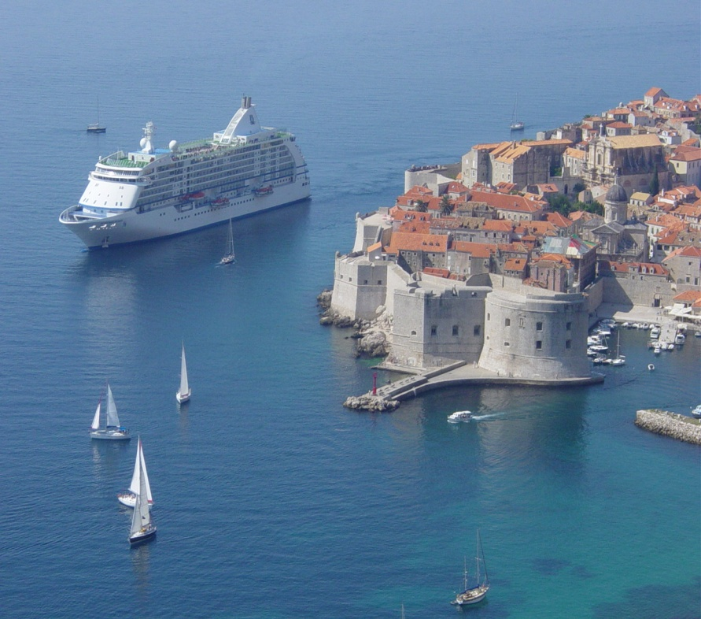
Dubrovnik touristic attraction for cruise industry
Preserved history
Art
Culture
Nature beauty
Way of life
Gastronomy and enology
Adventure
Pilgrimage

Slide 24
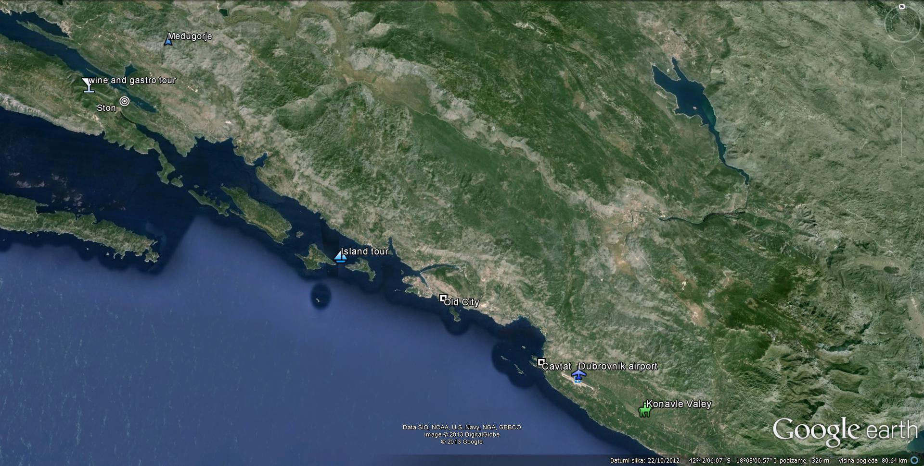
Alternative excursion programme to the surroundings of Dubrovnik

Slide 25
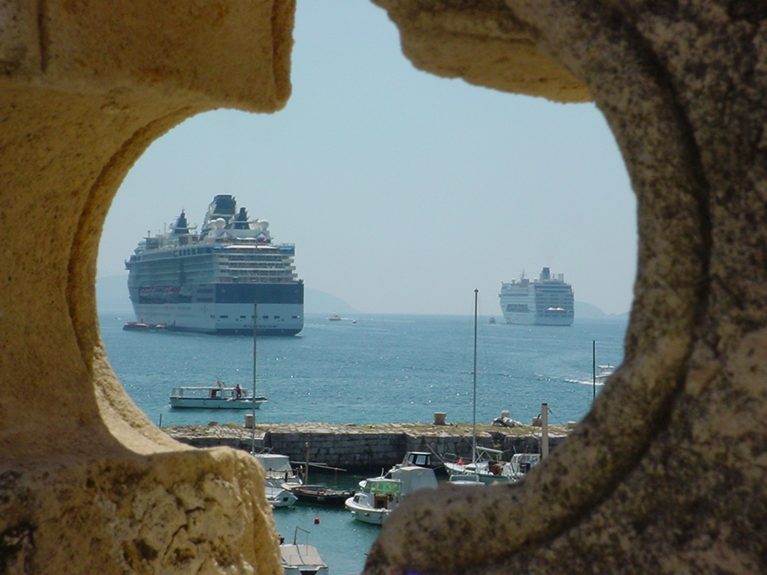
Cruise industry stakeholder
Port authority
Stevedoring company
Ship’s agent
Pilots
Immigration police, Custom, Harbour Master Office
Forwarding company
Suppliers (bunker, provision, water supply, electric supply, etc….)
City (municipal institution, road and pedestrian traffic regulation, public transport …)
Dubrovnik Touristic Board
Touristic agency
Shore excursions
Guide service
Bus service
Boat service
Taxi service
Museum and gallery, parks, beaches
Gastro offer
Shopping
Hospitality industry
Emergency response organization (Fire brigade, hospital, police, red cross..)
Medical services

Slide 26
Economic impact of cruise to Dubrovnik area
2017
SIZE OF THE VESSEL | GT | PAX | No | % | EXPENDITURE *approx. per passenger | INCOME (EUR)
SMALL | 20.000 | 400 | 193 | 36,0 | 6,50€ | 501.800
MEDIUM | 40.000 | 1.000 | 54 | 10,0 | 4,63€ | 250.020
LARGE | 100.000 | 2.600 | 289 | 53,5 | 4,13€ | 3.103.282
MEGA | 130.000 | 4.000 | 3 | 0,5 | 3,45€ | 41.400
Total |  |  | 539 | 100% |  | 3.896.502
*approx. expenditure according the tariffs (not included weekends and holidays, or extra expenditures) operative coast, pilot, mooring/unmooring, lighting
EXPENDITURE OF PASSENGER** | 39€ | 29.207.802 (748.918 x 39)
**approx. expenditure of passenger in destination (souvenirs, excursions, shuttle…)
As per „Study on Sustainable Development of Cruise Tourism in Croatia”, 2007
DESTINATION INCOME*** | 33.104.304 €
***approx. average vessel expenditure per passenger* x passenger expenditure** x number of passengers in Dubrovnik in 2017. (748.918 pax)

Slide 27
Dubrovnik Port Development Project
First Phase – Infrastructure
Reconstruction of the operative quay: enough capacity to accommodate 3 mega cruise ships of approximately 300 m length simultaneously (completed 2006-2011)
Investment value: 36.5 mil EUR (loan from EBRD, period of payment of the loan 2007-2017)
Continuation of construction site: Project Batahovina II (new operative quay in length of 400m with 2 ro-ro ramps)
Investment value: 16.5 mil EUR (based on non-refundable EU funds of 85%)
Second Phase – Suprastructure
Construction of suprastructure (Passenger Cruise Terminal),
Investment value: approx. 30 mil EUR (negotiable model of investment PPP or BOT, expected realisation of the project 2026)

Slide 28
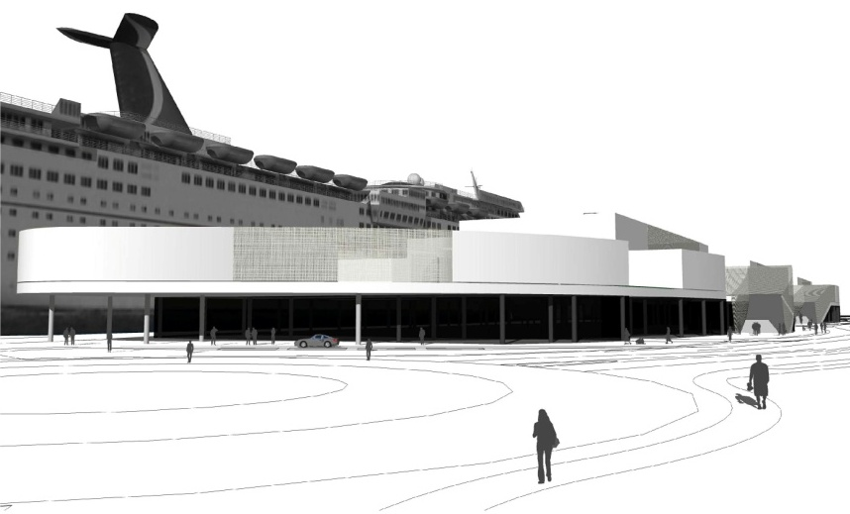
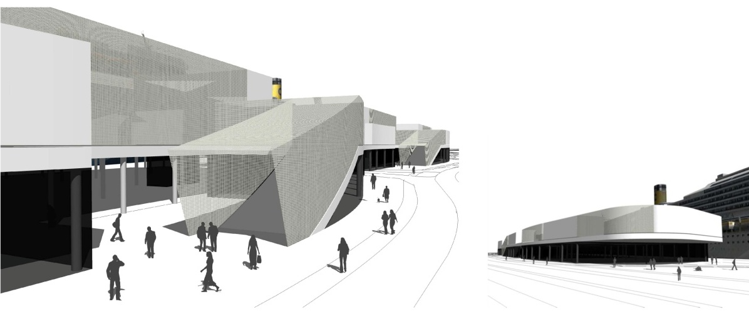
Suprastructure development
Investment plan –
Port facility Terminal building
(expected completition date 2026)
Investment model - considered options:
PAD own assets co-financed with EU funds
BOT – Build Operate and Transfer
PPP – Public Private Partnership
 | FACILITIES | EUR (in mill)
1. | Passenger terminal | 30

Slide 29
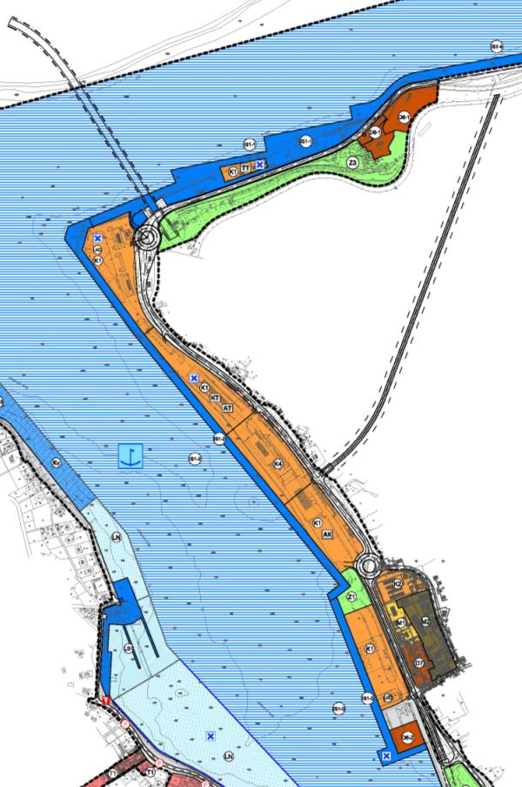
Detailed urban plan
VILLAS
AUDITORIUM
PORT CONTROL CENTER
GARDENS
BUS TERMINAL
Port for ferry transport
Service area
GARAGE BUSINESS
Excursion traffic
CRUISE TERMINAL
Service area
Service area
FERRY TERMINAL
Park area
PORT CONTROL CENTER
Cruise ship port
Service area
Service area

Slide 30
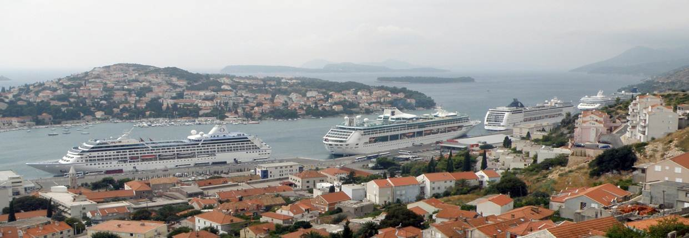
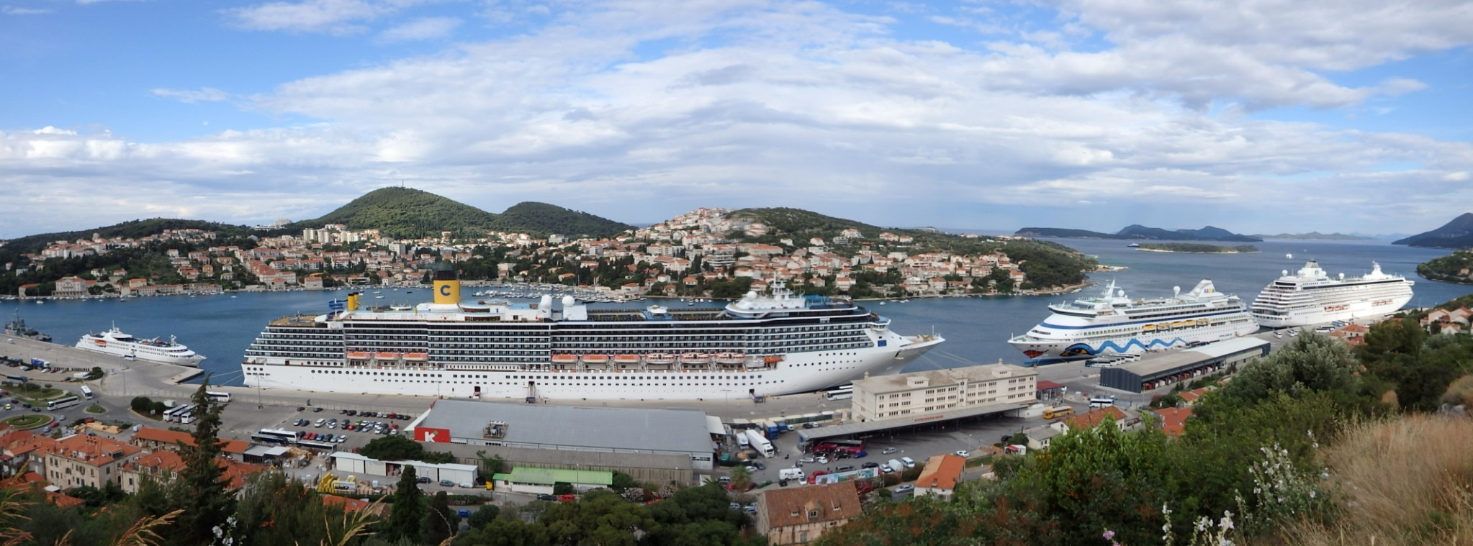

Slide 31
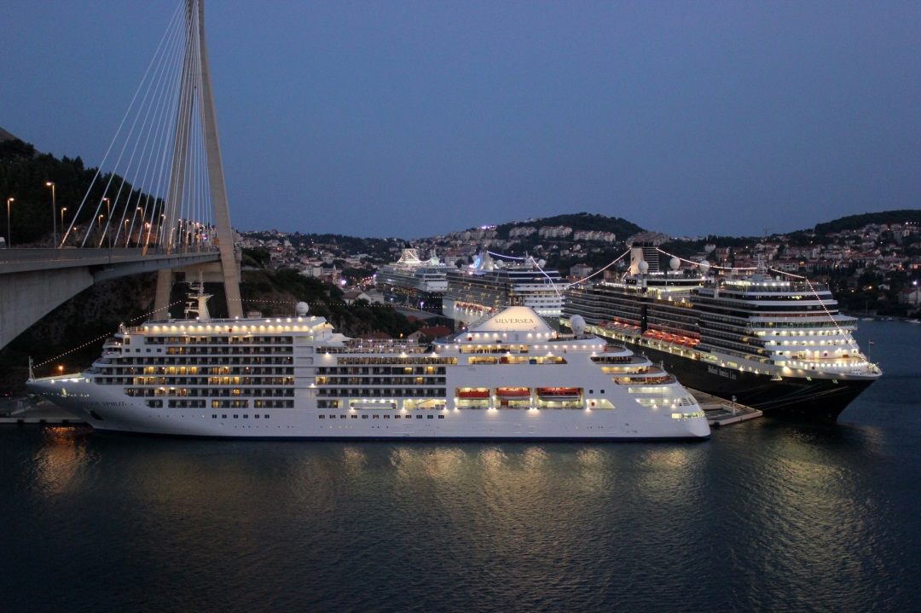
Thank you for your attention!

